Slide 1
South Florida Climate Predictions, Projections, and Uncertainty Characterization
Johnna M. Infanti (UCAR) Nicholas Aumen (USGS) Ben Kirtman (University of Miami) Colin Polsky (Florida Atlantic University) Dorothy Sifuentes (USGS) John Stamm (USGS)

Slide 2
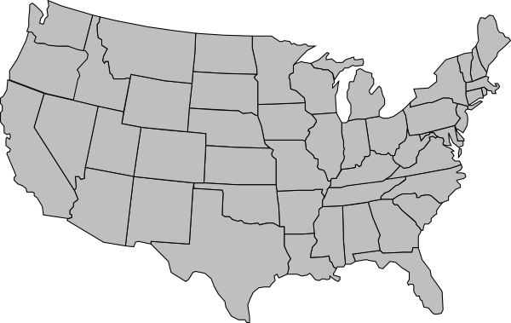
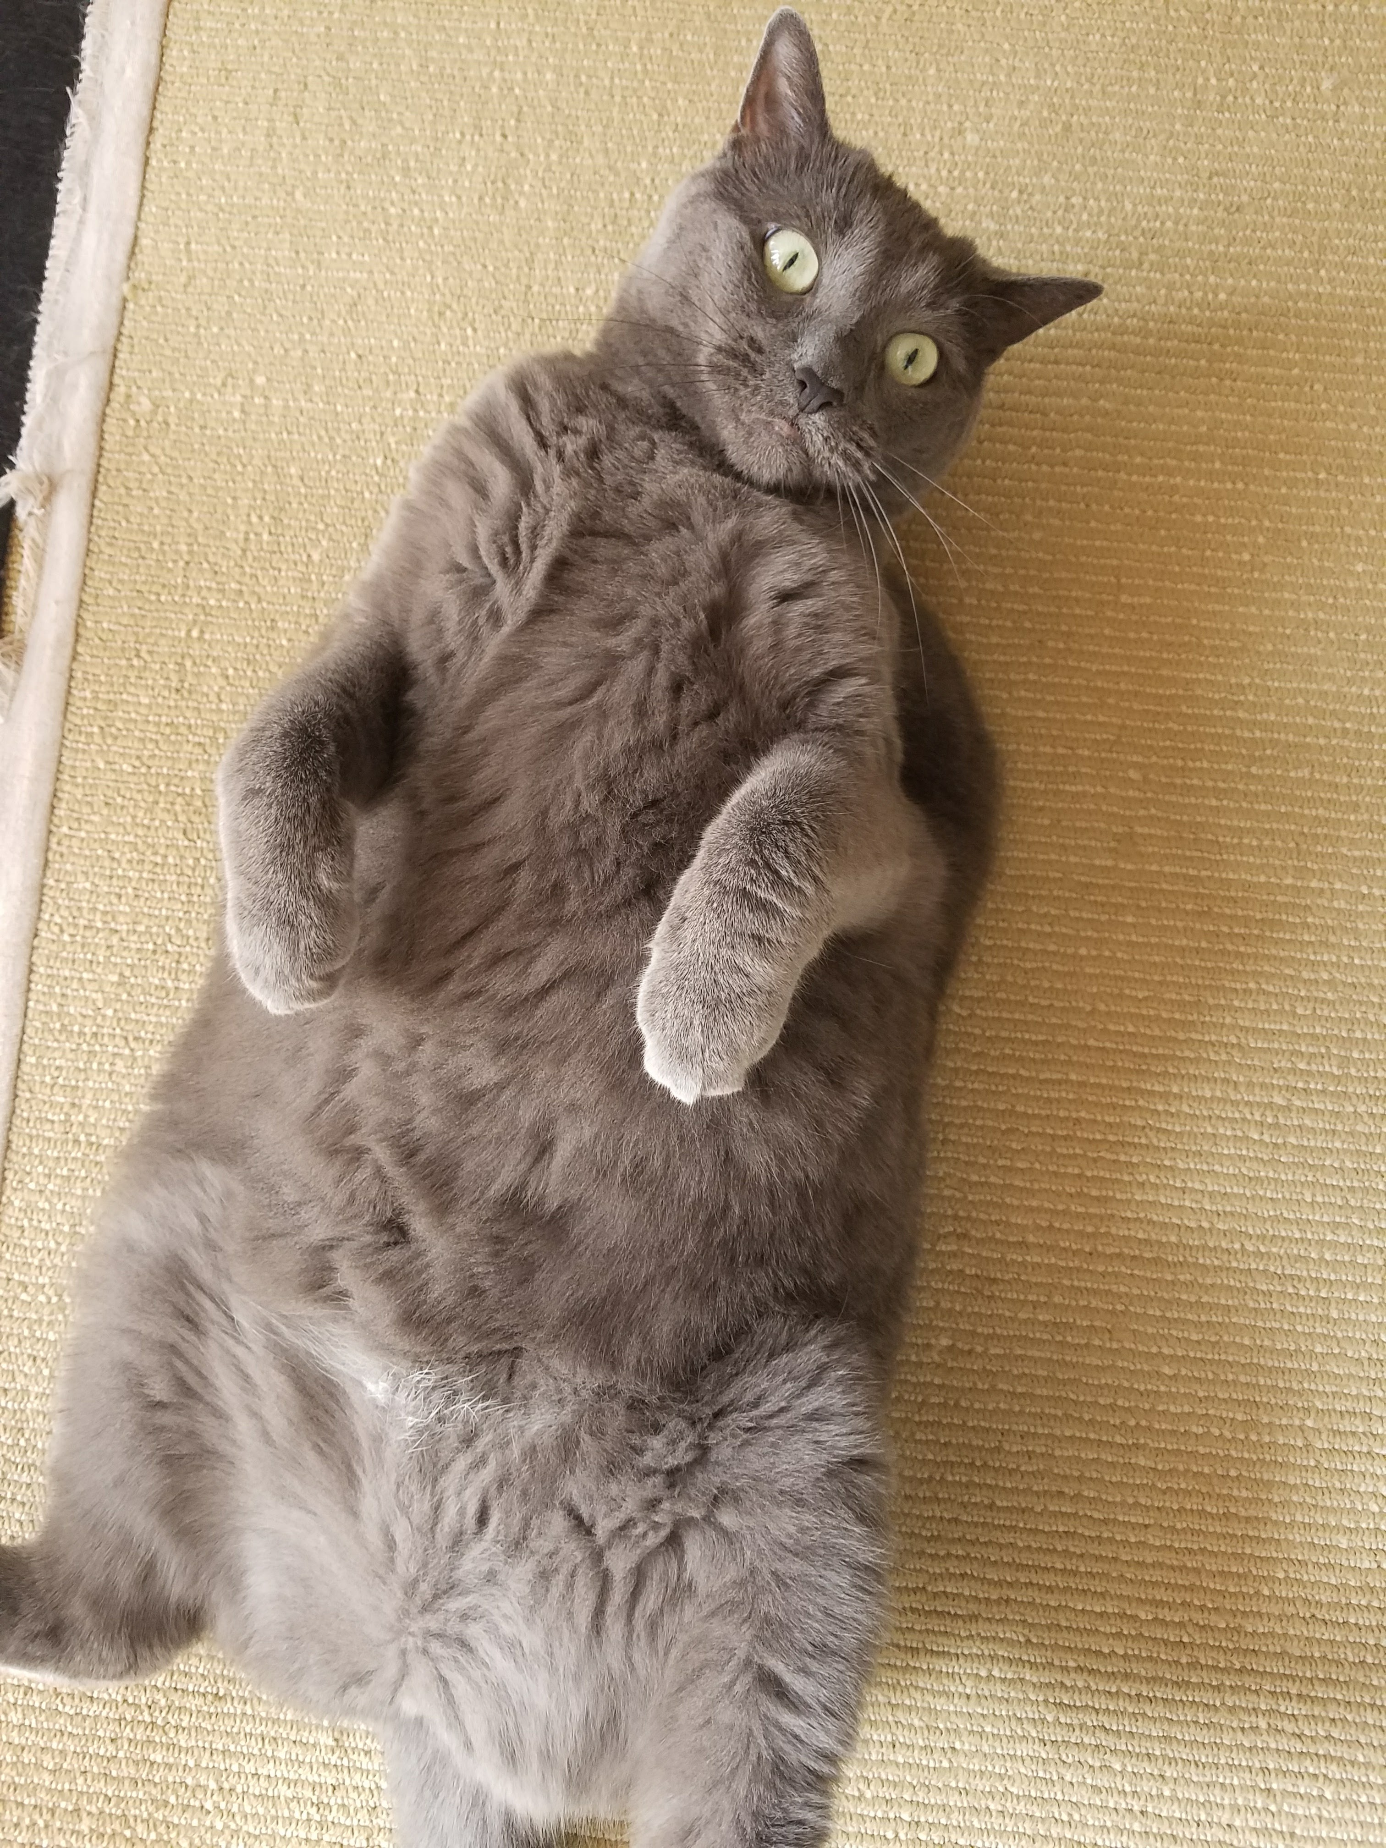
Johnna Infanti - Background
University of Massachusetts (Lowell)
B.S. in Atmospheric Science
PACE Post-Doctoral Fellowship (Current)
University of Miami, Florida Atlantic University, and USGS
University of Miami
PhD in Meteorology and Physical Oceanography
Research Focus: Seasonal Climate Prediction

Slide 3
PACE Postdoctoral Fellowship (Postdocs Applying Climate Expertise)
University Corporation for Atmospheric Research
Cooperative Programs for the Advancement of Earth System Science
Goal: Grow the pool of scientists qualified to transfer advances In climate science and climate prediction into climate-related decision framework(s) and decision tools
Ben Kirtman
Nick Aumen
Dorothy Sifuentes
John Stamm
Colin Polsky

Slide 4
What are we trying to do? Focus on precipitation predictions and projections across time-scales for Everglades restoration
Define uncertainty across time-scales and spatially
Better communicate uncertainty to user groups
Provide tailored representations of future precipitation and uncertainty to users, based on their needs
Reduce the uncertainty associated with future precipitation
Increase credibility and salience of climate model data
“Bridge the Gap” between climate scientists and climate data users

Slide 5
How will we achieve these goals?
Presentations that include information and education on climate data, and results from current scientific projects – Audience comments, ideas, and needs are important!
USGS-CES Workshop on Increasing Confidence in Precipitation Projections for Everglades Restoration: http://www.ces.fau.edu/usgs/downscaling-2.0/
What about scientific research goals?
Characterize, quantify, and reduce the uncertainties surrounding precipitation projections for south Florida from days to decades (internal revision)
Determine a subset of “best models” based on user parameters of interest
Does a high-resolution global model better represent natural variability of Florida precipitation, thus reducing this uncertainty?
Determine if changes in large-scale climate drivers (such as El Niño, the Pacific Decadal Oscillation, etc.) are leading to shifts in Florida rainfall

Slide 6
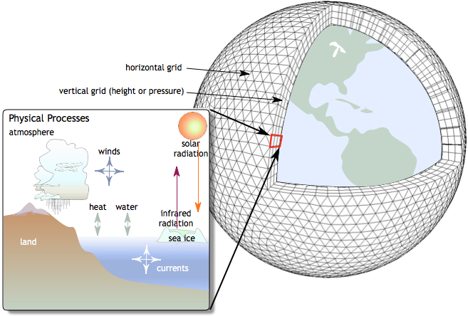
Crash Course: Climate Models and Climate Modeling
Climate Models
Incorporate data about Earth’s natural processes to simulate the climate system
Data
Precipitation, temperature, etc. is produced on hourly to monthly time-steps
Experiments
Experiments can include natural factors, natural and anthropogenic factors, or a variety of different queries
Climate Modelers
Analyze and interpret that data to determine the statistics of weather, or the deviation from the mean (climatology)
Notes:
References:
Left Diagram: www.meted.ucar.edu (login necessary)
Right Diagram: https://climatesciences.jpl.nasa.gov/
Information: https://scied.ucar.edu/longcontent/climate-modeling

Slide 7
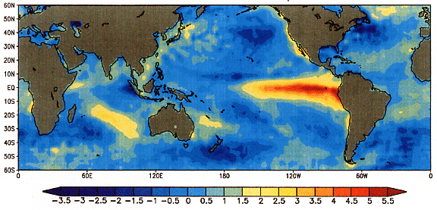
An Incredibly Important Topic: What are climate projections? What are climate predictions? What is the difference?
Climate Prediction
Something will happen in the future based on what is known today
Initial Condition Problem
Climate Projection
Something will happen in the future based on assumptions about how the future could develop
Boundary Condition Problem
EXAMPLE – El Niño
Representative Concentration Pathways (RCPs)
Emissions levels determine temperature rises
RCP8.5
Assumption that the current emission path will remain similar
RCP2.6
Assumption of immediate and rapid reduction in emissions
Notes:
References:
Left Diagrams: https://upload.wikimedia.org/wikipedia/commons/2/27/El-nino.png, http://apollo.lsc.vsc.edu/classes/met130/notes/chapter10/graphics/telec_jets.jpg
Right Diagram: http://nca2014.globalchange.gov/highlights/overview/overview#tab2-images
More Information: http://sciencepolicy.colorado.edu/zine/archives/1-29/26/guest.html, http://www.ipcc-data.org/guidelines/pages/definitions.html

Slide 8
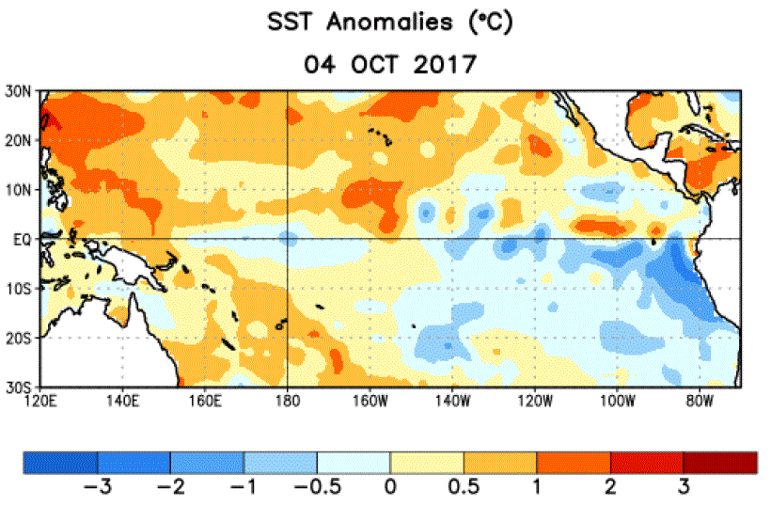
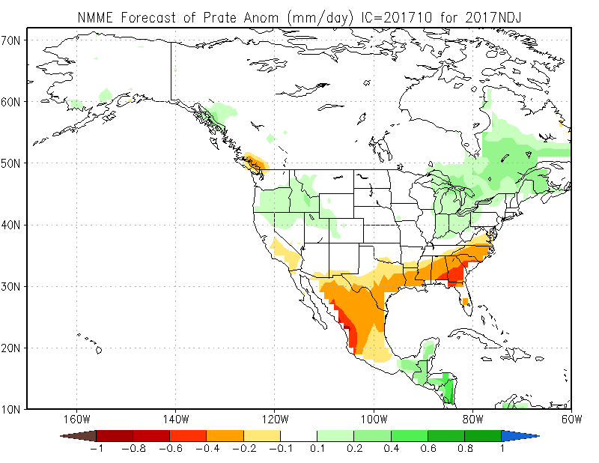
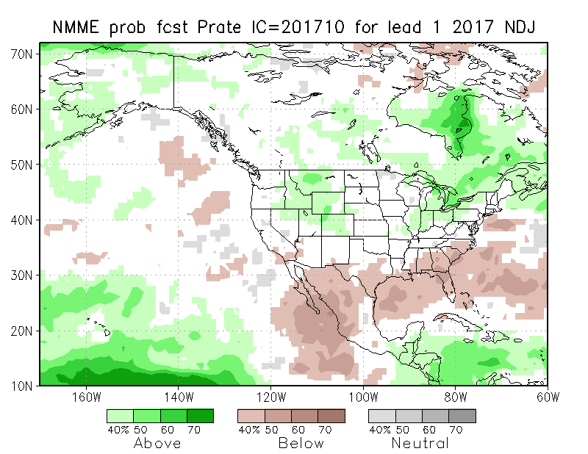
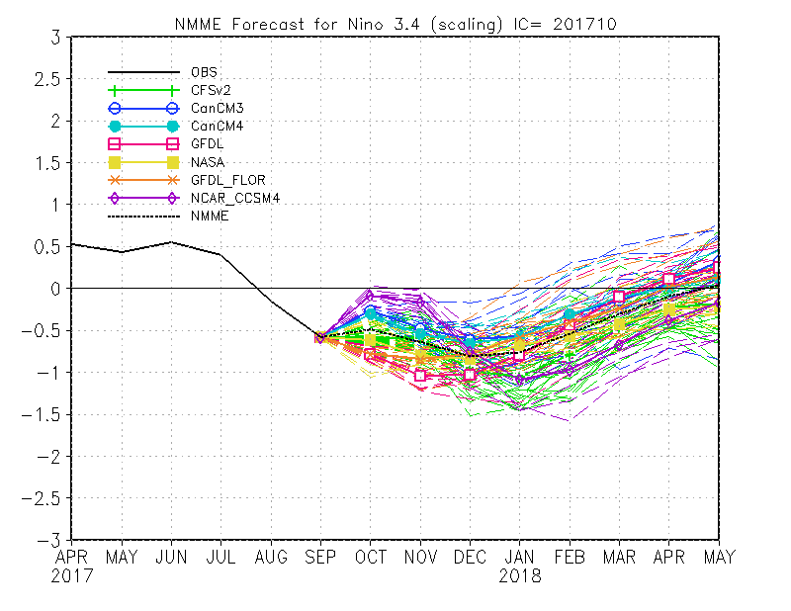
An Example of a Climate Prediction
Available on time-resolutions of days to decades!
Directly verifiable with observations!
Observations
Prediction (from 7 climate models)
DATA ACCESS AND ADDITIONAL INFORMATION
http://www.cpc.ncep.noaa.gov/products/NMME/

Slide 9
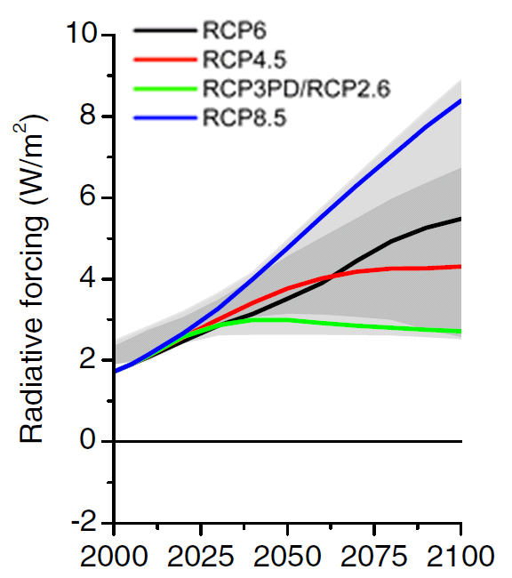
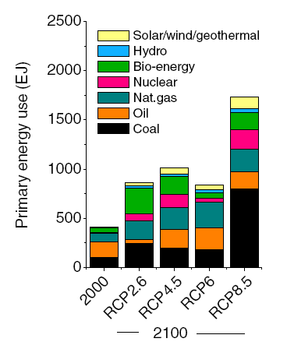
Climate Projections: What are Representative Concentration Pathways (RCPs)?
Describe plausible trajectories of different aspects of the future to investigate potential consequences of anthropogenic climate change. RCPs represent some of the major driving forces (processes, impacts including physical, ecological, and socio-economic, and responses) (IPCC Scenario Process for AR5)
How should RCPs be used?
To better understand uncertainties and alternative futures, and consider how robust different decisions or options may be under a wide range of possible futures
How should RCPs NOT be used?
As a prediction of the future!!
Climate model groups study the effects of increasing emissions on the climate itself
RCP | Description | Projected Warming (2046-2065)
2.6 | Stringent mitigation of emissions | 1.0 C (0.4 to 1.6)
4.5 | Intermediate scenario | 1.4 C (0.9 to 2.0)
6.0 | Intermediate scenario | 1.3 C (0.8 to 1.8)
8.5 | Very high GHG emissions | 2.0 (1.4to 2.6)
Notes:
Reference: The Beginners Guide to Representative Concentration Pathways (G. P. Wayne) https://www.skepticalscience.com/rcp.php and http://sedac.ipcc-data.org/ddc/ar5_scenario_process/RCPs.html

Slide 10
What kinds of data are available?
If you need
Predictions of precipitation, temperature, or sea surface temperature for the next year based on an observed initial state with daily to weekly (SubX), monthly (NMME) or seasonal (NMME) temporal resolution
Climate Prediction(s)
http://www.cpc.ncep.noaa.gov/products/NMME/
SubX The Subseasonal Experiment
http://cola.gmu.edu/kpegion/subx/index.html
If you need
Projections of precipitation for the next 100 years based on plausible future trajectories
Climate Projections
http://cmip-pcmdi.llnl.gov/cmip5/
http://gdo-dcp.ucllnl.org/downscaled_cmip_projections/dcpInterface.html#Welcome

Slide 11
Further details on available data…
Subseasonal to Seasonal Predictions (S2S) |  | Climate Projections
NMME (Seasonal Climate Predictions) http://www.cpc.ncep.noaa.gov/products/NMME/ For the southeast in CCSM4: http://rsmas-ccsm4.weebly.com/ |  | CMIP5 Decadal Predictions (Combination of prediction and projection) http://cmip-pcmdi.llnl.gov/cmip5/data_portal.html
Daily (limited), monthly. Lead times of at least 9 months ahead. | 1 degree latitude x 1 degree longitude | 3 hourly (limited), 6 hourly (limited), daily (limited), monthly. Lead times of at least 10 years ahead, some models include 30 years. | Varies, but around 1 degree latitude x 1 degree longitude
SubX (Sub-Seasonal Climate Predictions) http://cola.gmu.edu/kpegion/subx/ |  | CMIP5 (Raw) http://cmip-pcmdi.llnl.gov/cmip5/data_portal.html
Daily. Lead times up to 45 days ahead. | 1 degree latitude x 1 degree longitude | 3 hourly (limited), 6 hourly (limited), daily (limited), monthly | Varies, but around 1 degree latitude x 1 degree longitude
NMME and SubX S2S Climate Outlooks for Watersheds http://hydro.rap.ucar.edu/s2s/ |  | CMIP5 Statistically Downscaled (DCHP) https://gdo-dcp.ucllnl.org/downscaled_cmip_projections/
Daily and monthly (in progress) | Watershed | Daily (limited), monthly | Daily: 1/16, 1/8, 1 degree Monthly: 1/8, 1/2, 1 degree
 |  | CMIP5 Dynamically Downscaled (CORDEX) https://na-cordex.org/
 |  | 30 minute (very limited), 1 hour (very limited), 3 hour (very limited), 6 hour (very limited), daily (limited), monthly | 0.11 degree latitude x 0.11 degree longitude, 0.22 degree latitude by 0.22 degree longitude
CCSM4 High-Resolution Climate Predictions and Projections Contact bkirtman@rsmas.miami.edu, jinfanti@rsmas.miami.edu
Daily and monthly for lead times up to 12 months (in progress, not all initial months available) | 0.5 degree latitude x 0.5 degree longitude | Daily and monthly for 1%/year CO2 increase (in progress) and climate of the 20th century | 0.5 degree latitude x 0.5 degree longitude

Slide 12
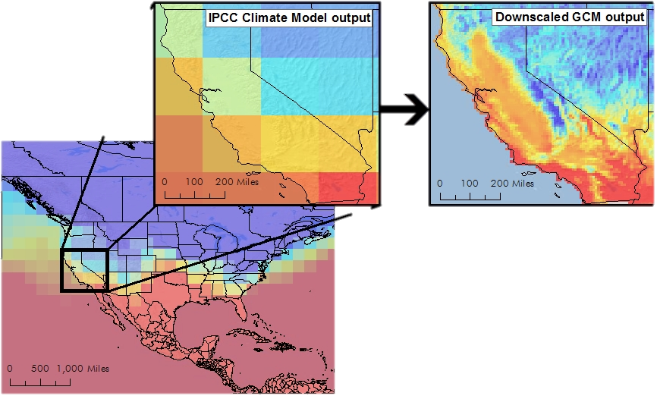
What is Downscaling?
Take information at large spatial scales and use a certain set of assumptions to estimate the local scale
2 Popular Methods
Statistical Downscaling: Use statistical relationships between local climate variables and large-scale fields to transform climate model output to a smaller scale
Dynamical Downscaling: Use a high-resolution climate model for a given domain, with low-resolution climate model output as a boundary condition
2 Popular Methods
Statistical Downscaling: Use statistical relationships between local climate variables and large-scale fields to transform climate model output to a smaller scale
Dynamical Downscaling: Use a high-resolution climate model for a given domain, with low-resolution climate model output as a boundary condition
But… Because assumptions are made, this adds to uncertainty!
Notes:
References:
Graphic: http://v1.cal-adapt.org/blog/2011/apr/13/global-climate-models/
Information: http://climate.calcommons.org/article/downscaling, https://gdo-dcp.ucllnl.org/downscaled_cmip_projections/dcpInterface.html

Slide 13
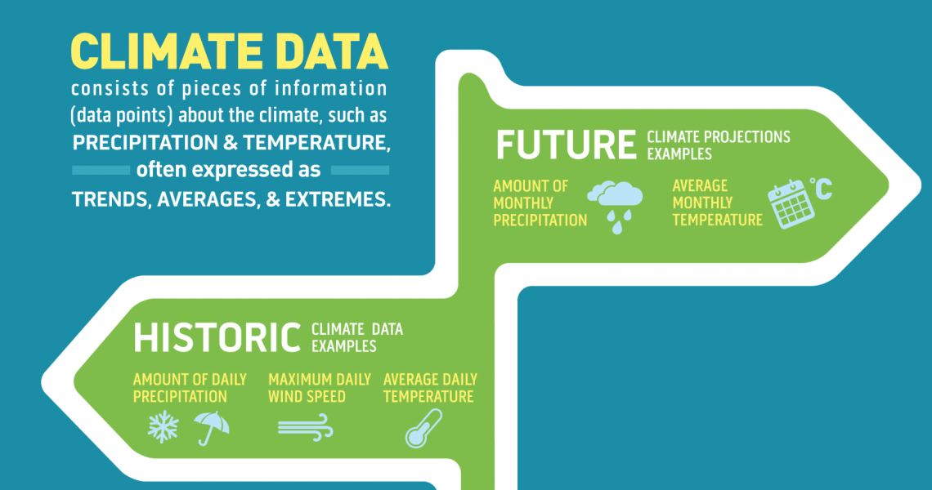
What is included in downscaled CMIP5 projections?
39 Climate Models
(With a varying number of realizations)
1/8 degree grid
Monthly (BCSD) and Daily (BCCA) Time-Steps
“Modeled History”
RCP2.6
RCP4.5
RCP6.0
RCP8.5
“Modeled History” (Historical or Climate of the 20th Century): A climate model run that represents 20th century climate, but does not represent the exact variations of the time-period
Scenarios or RCPs: A plausible description of a possible future state of the world. Each scenario or RCP is an alternative image of how the future could unfold
Notes:
Reference: https://gdo-dcp.ucllnl.org/downscaled_cmip_projections/dcpInterface.html

Slide 14
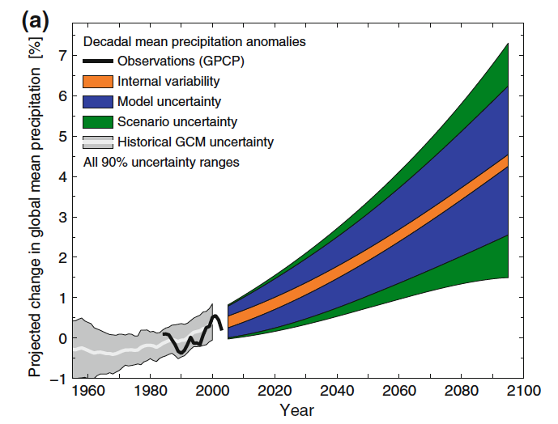
Sources of Uncertainty for Precipitation
Internal Variability
Natural processes that cause short term changes in climate
Contributes 50-90% of the total uncertainty for the next decade
Model Uncertainty
Arises from incomplete understanding of Earth system processes and the representation of these in climate models
Dominant after about a decade to 30 years
Scenario Uncertainty
We do not know what the future will hold
Dominant after about 50 years, but negligible over most land areas
CMIP3 Global Mean, Decadal Mean Projections
Hawkins and Sutton (2009)
Notes:
Reference: Hawkins E, Sutton R (2009) The Potential to Narrow Uncertainty in Regional Climate Predictions. Bull Amer Meteor Soc 90:1095–1107 . doi: 10.1175/2009BAMS2607.1

Slide 15
A (very) Brief Review of 2015 Downscaling Meeting
USGS-FAU Precipitation Downscaling Technical Meeting (June 2015)
http://www.ces.fau.edu/usgs/downscaling/
End Users would Benefit From:
A centralized online portal for where Florida global climate model (GCM) output could be easily obtained
Consistency in file types
Consistency in procedures for calculating uncertainty
Consistency in detailed, accurate, and informative metadata that accompany GCM downscaled output data

Slide 16
How can we define uncertainty, and why do we want to?
First we need to understand uncertainty in order to reduce it or ensure it is reflected in effective decision-making
There are approximately 7 billion ways to define uncertainty, that range from simple (the range of all changes across the models) to complex (Bayesian approaches, etc.)
Multi-Model Mean Change (MMM)
Coefficient of Variation
Standard deviation about the mean divided by the MMM change
Degree of model agreement
Model Agreement
Percent of models that agree on the sign of the change
Measure of Robustness
Bootstrapping
Randomly re-sample original data 1000 times to create 1000 new sets of projections
Quantitative Uncertainty Bounds
Similar to Vavrus et al. 2015
Notes:
References: http://climate-adapt.eea.europa.eu/knowledge/tools/uncertainty-guidance/topic1, Vavrus SJ, Notaro M, Lorenz DJ (2015) Interpreting climate model projections of extreme weather events. Weather and Climate Extremes 10, Part B:10–28 . doi: 10.1016/j.wace.2015.10.005

Slide 17
Now what? Plus needs identified by the Workshop on Increasing Confidence
Future Directions
Using a high-resolution global climate model and focus on uncertainty surrounding natural variability
Determine which models best represent the global drivers important for Florida precipitation to use in our “culled” set of models, focusing on the important parameters identified by climate data users, and determine a useful subset of models
We have now quantified uncertainty, but users need to know what the changes in physical processes are that lead to these changes in precipitation
Some common needs and topics identified by workshop attendees
2 case study groups: Ecological Modeling and the Western Everglades Restoration Project (WERP)
More communication: Further education, a glossary of common terms, and methodology that spans disciplines, credible assessment of climate models used, climatologist expert guidance
Time-series data, a “decision matrix”, a subset of models
Many parameters highlighted, but dry events or drought was highlighted as a priority
Climate data on a 2km x 2km grid on hourly to daily temporal resolutions

Slide 18
Thank You!
What time-scales, spatial resolution(s), and parameters would you be interested in predictions or projections of, and how does uncertainty come into play in your work?

