Slide 2
High Time Resolution Modeling of Groundwater Levels in the Arch Creek Basin Repetitive Loss Areas
Professor Michael Sukop, PhD, PG, CHg, FIU Earth and Environment
Dr Greg Guannel, University of the Virgin Islands, St Thomas
Katherine Hagemann, Miami-Dade County Office of Resilience
Dr Jayantha Obeysekera, South Florida Water Management District
Dr Jeffrey Czajkowski, Wharton Risk Management and Decision Processes Center
South Florida Hydrologic Society, February 1, 2017, Coral Springs FL

Slide 3
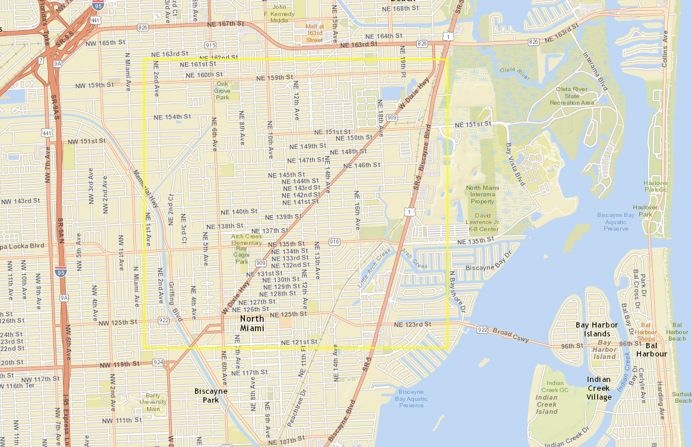

Slide 4
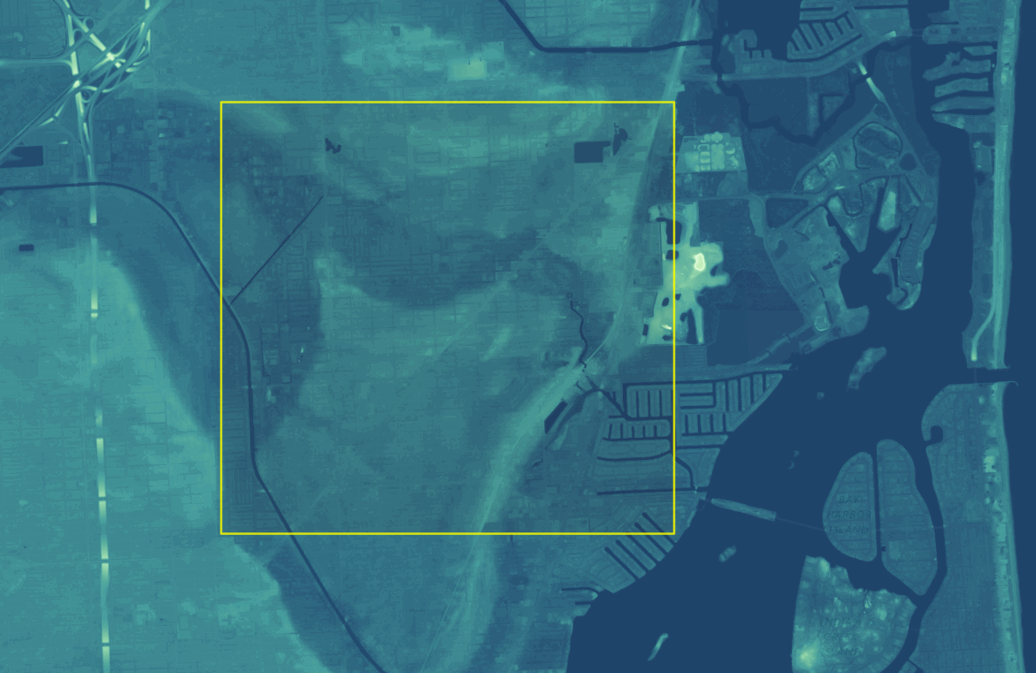
https://coast.noaa.gov/dataviewer/#/lidar/search/-8927577.374109587,2984999.719335632,-8922685.404299336,2989662.3780610277/details/6230

Slide 5
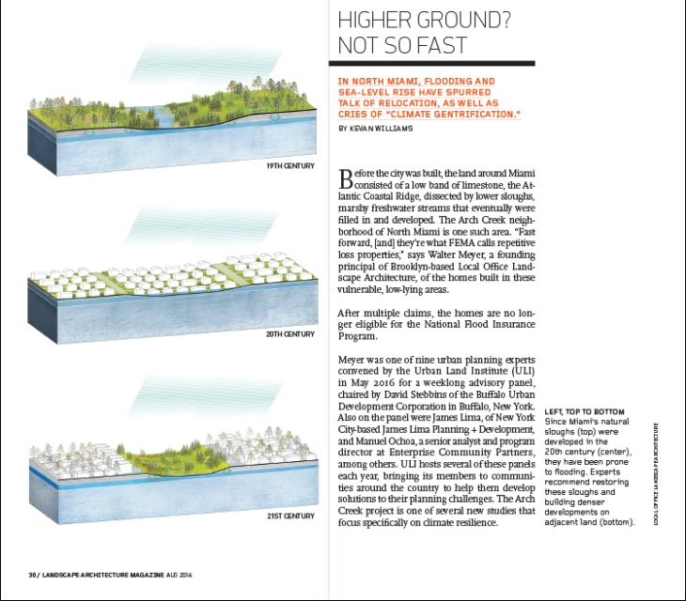
https://landscapearchitecturemagazine.org/2016/08/23/higher-ground-not-so-fast/

Slide 6
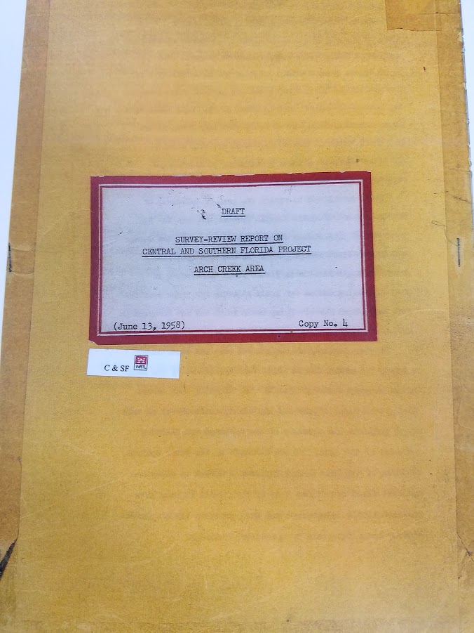

Slide 7
Repetitive Loss Areas
Miami-Dade County prioritizes the mitigation activities in repetitive loss areas, based on the number of claims placed in each neighborhood.
Miami-Dade County is often considered as ‘ground zero’ for sea level rise, increased inland flooding, and other effects of climate change. In 2013, Florida passed legislation to create Adaptation Action Area (AAA) designation for areas uniquely vulnerable to climate impacts to serve as a planning tool and to encourage technical assistance and funding opportunities.
In 2015, after the approval of Resolution R-44-15, Miami-Dade County added the tool to its Comprehensive Development Master Plan, Land Use Element, and is currently working to identify Adaptation Action Areas (Policies LU-3K, LU-3L and LU-3M).
Currently the County is prioritizing the Arch Creek Basin, as a pilot Adaptation Action Area, as part of a comprehensive strategy that has the goal improve the resilience of the entire community to Climate Change and natural disasters, in addition of mitigation of repetitive losses.
The 2,838 acre Arch Creek Basin is located east of I-95, main roadways include sections of US 1 and State Highway 922 (NE 125th Street). The study area encompasses land within four municipalities: North Miami (1,784 acres), Miami Shores (51 acres), Biscayne Park (332 acres) and North Miami Beach (92 acres). The remaining 579 acres are located within unincorporated Miami-Dade County.
http://www.miamidade.gov/environment/repetitive-losses.asp

Slide 8
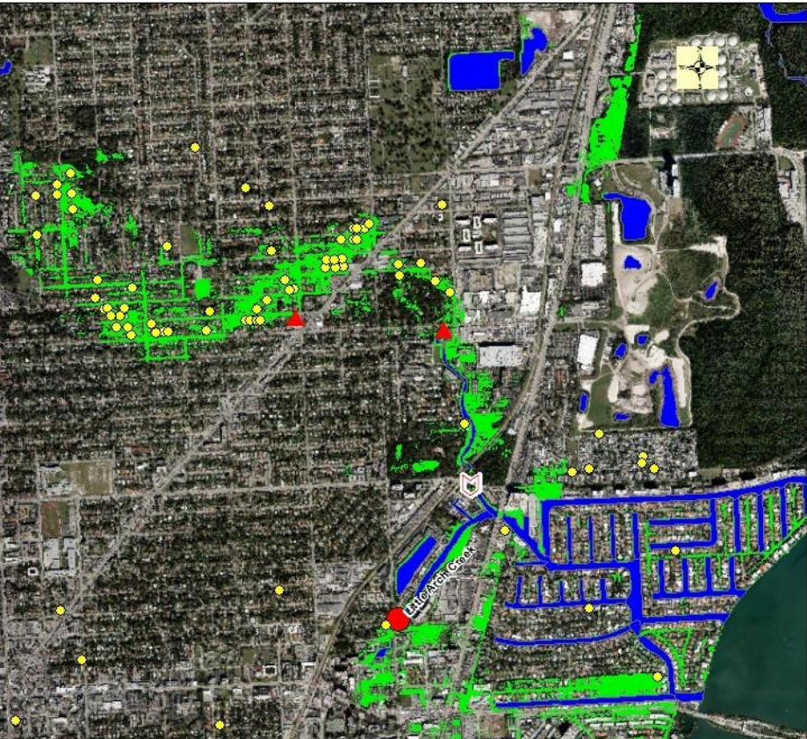
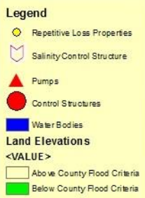
Repetitive Loss Properties
http://uli.org/wp-content/uploads/ULI-Documents/Miami-Presentation.pdf

Slide 9
75th Percentile October (USGS)
1 foot
Study Area
1+ foot
2+ feet

Slide 10
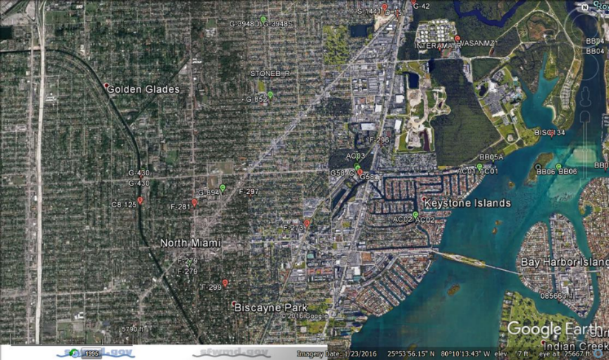
Available DBHydro Data (current green and discontinued red)

Slide 11
Well G-852
Structure
G-58

Slide 12
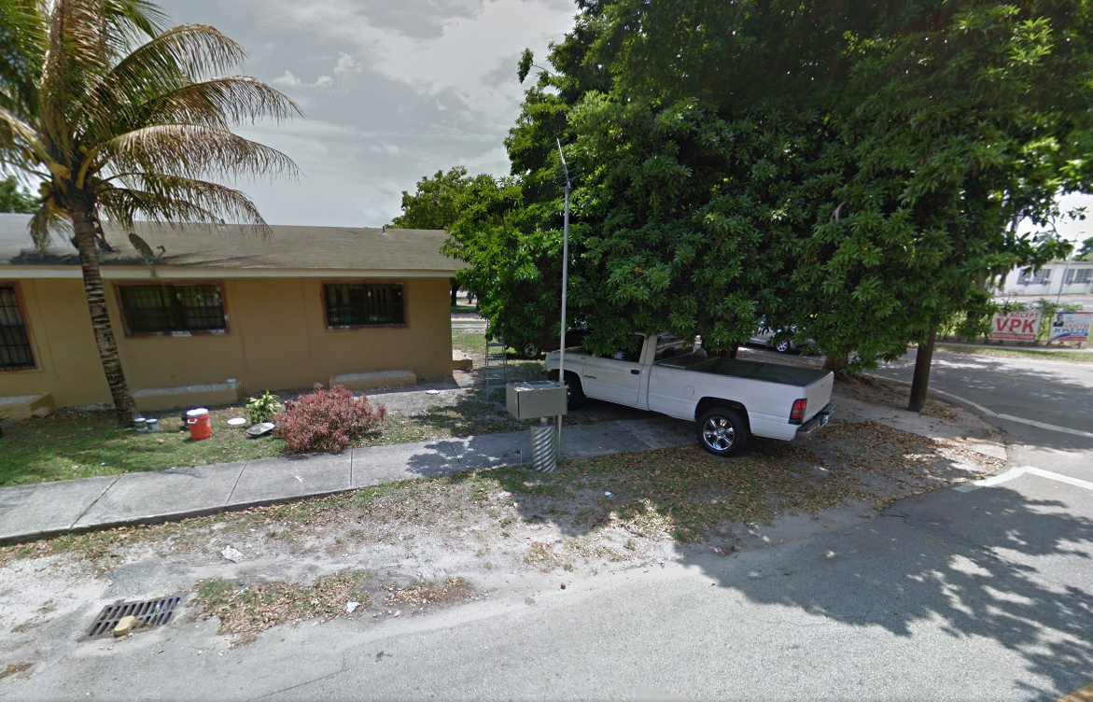

Slide 13
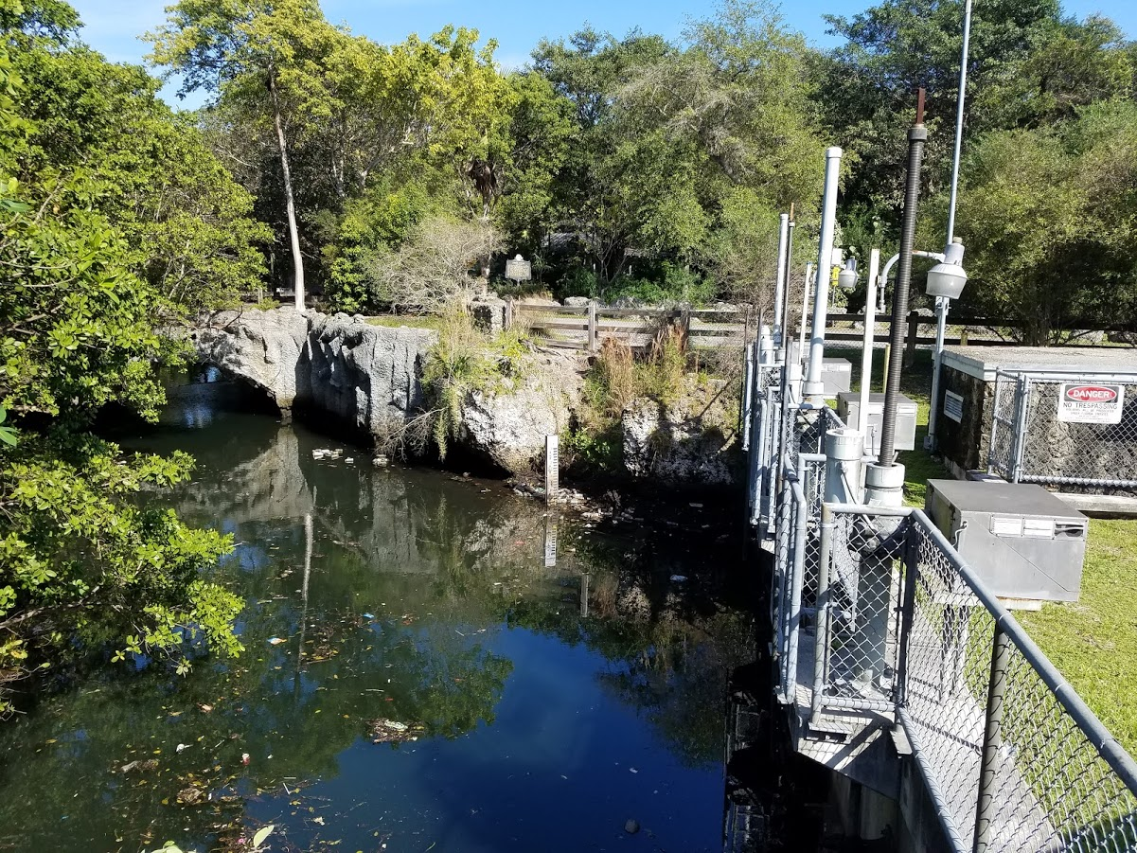

Slide 14
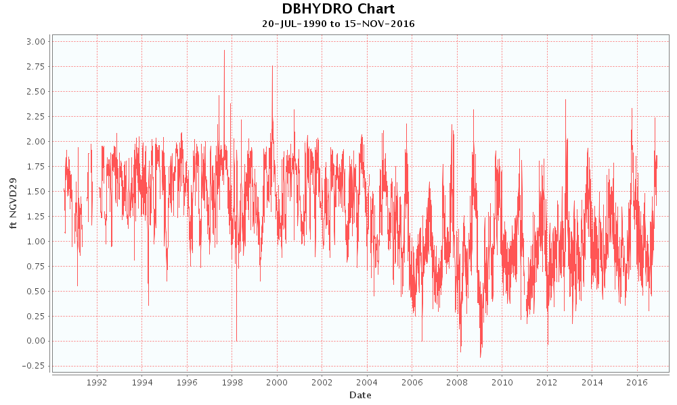
Structure G58_H
(Subtract 1.54 feet to get NAVD)
Arch Creek historically had an unimpeded flow path to Biscayne Bay. The USACE installed the G-58 structure in 1959 and it was later modified by the South Florida Water Management District.…According to the Study report by Burns and McDonnell the G-58 structure has been inoperable with its gates in the open position for the past five (5) years. http://www.saj.usace.army.mil/Portals/44/docs/regulatory/JDs/Florida/CWR/20151005-CWR-SAJ-2013-00380-AJD-AWP.pdf (2015)
DBKey Station Agency Data Type Unit Statistic Frequency
15729 G58_H WMD STG ft NGVD29 MEAN DA

Slide 15
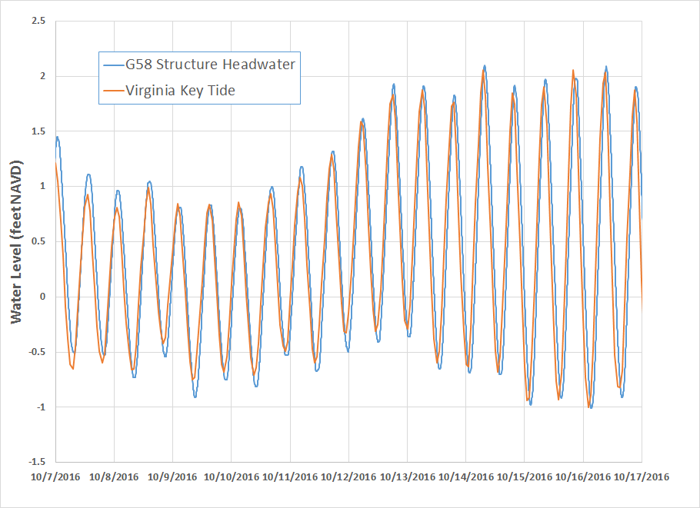
Arch Creek level at G58 structure now controlled by tide (1 hour lag from VA Key)

Slide 16
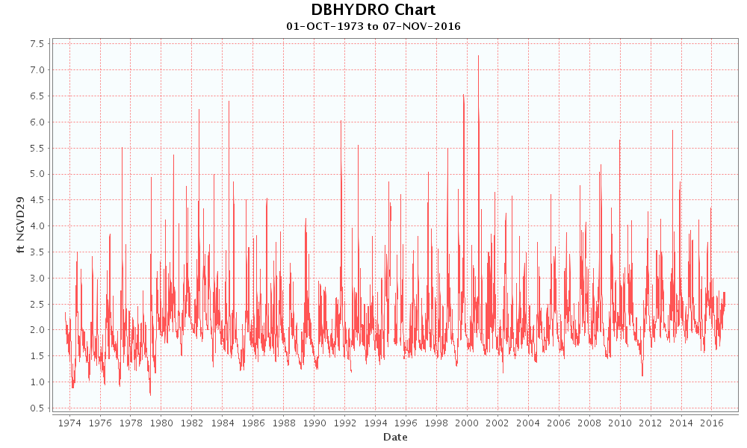
Well G-852, 43 years (daily maxima)
(Subtract 1.54 feet to get NAVD)
DBKey Station Agency Data Type Unit Statistic Frequency Strata Gate/Pump#
01662 G-852 USGS WELL ft NGVD29 MAX DA 20 N/A

Slide 17
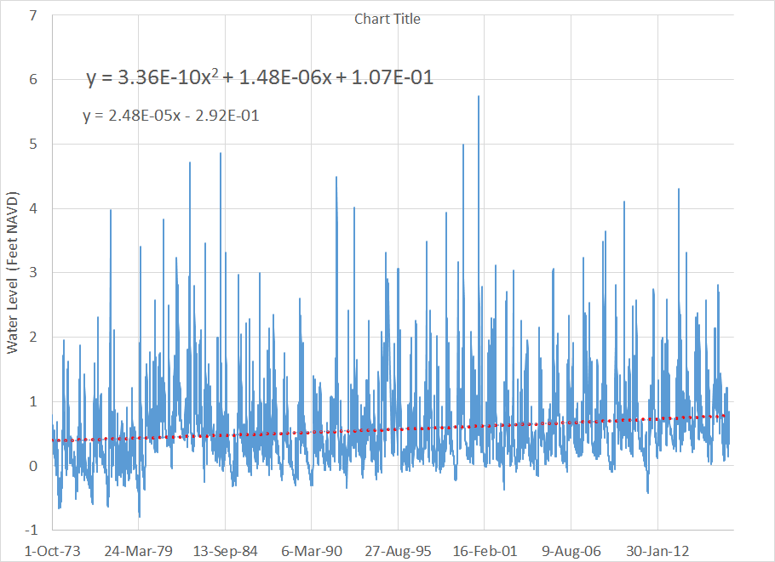
Well G-852
G-852 Linear fit: 2.8 mm/yr; Key West Long term 2.33 mm/yr
October 3, 2000, “No Name” storm: >19 inches rain in 24 hours

Slide 18
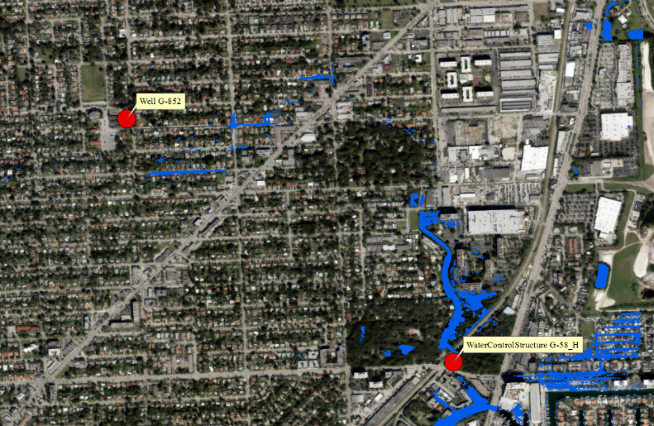
Land Surface < 3 feet NAVD

Slide 19
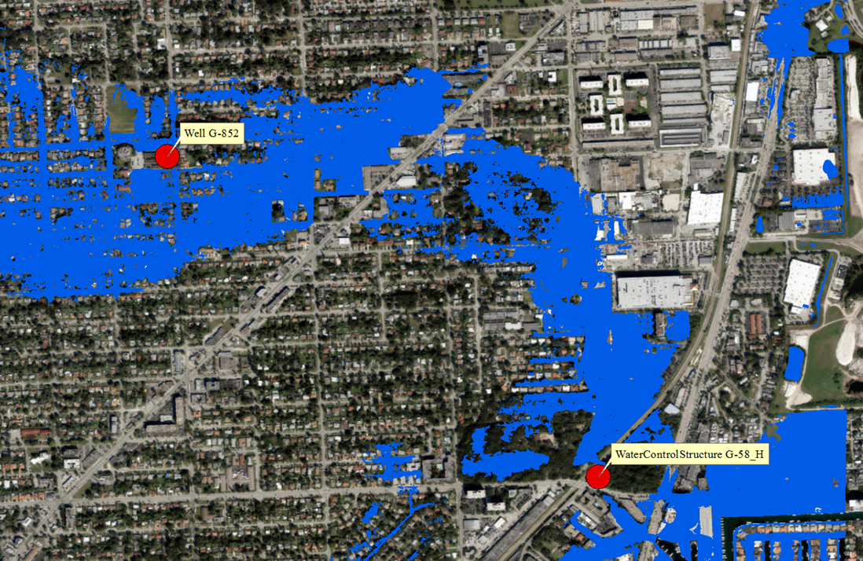
Land Surface < 5 feet NAVD

Slide 20
G-852 Extrapolation
October 3, 2000, “No Name” storm: >19 inches rain in 24 hours

Slide 21
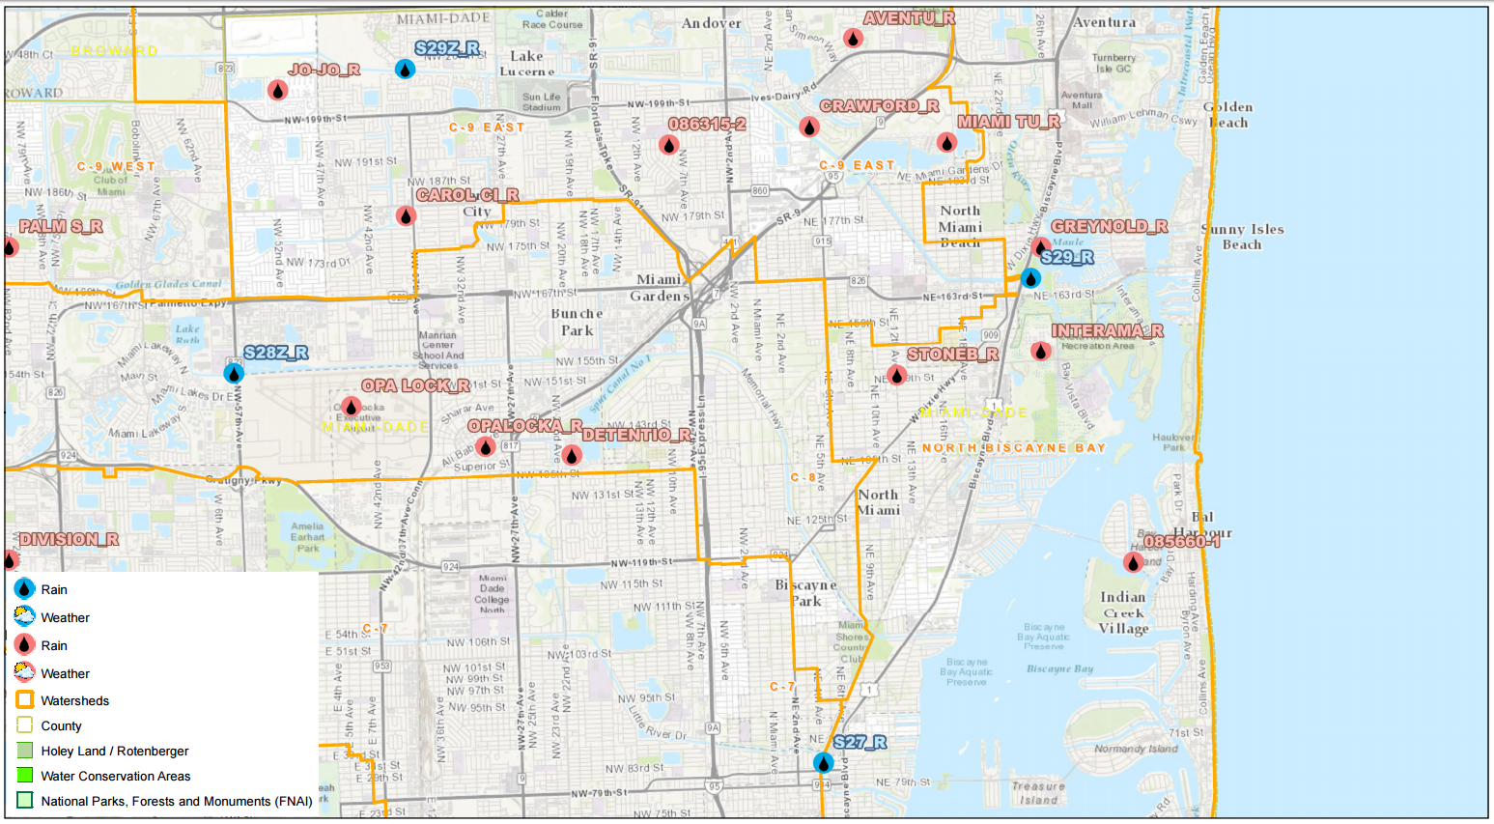
Current rainfall data sparse: NexRad?
Study Area

Slide 22
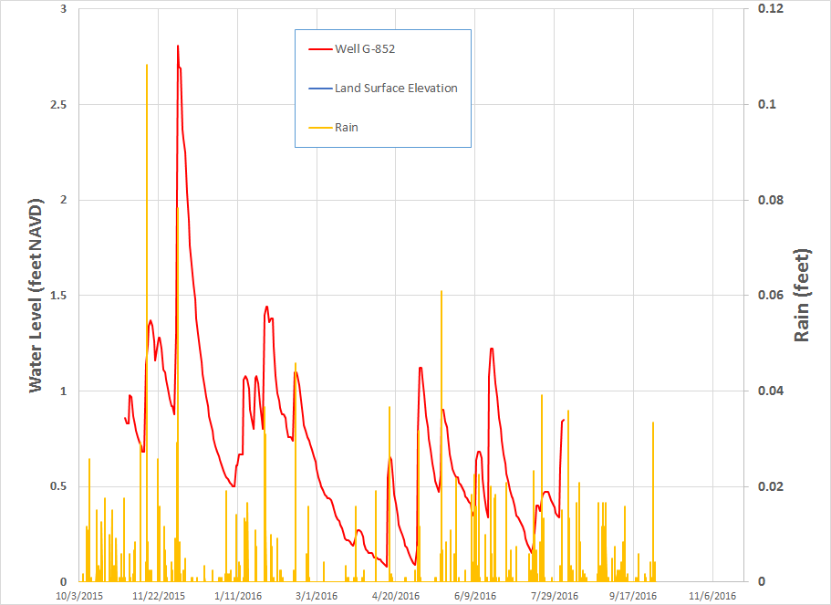
11/14/15 and 12/4/15; each ~ 0.5 ft rain preceding week, but big difference in groundwater response

Slide 23
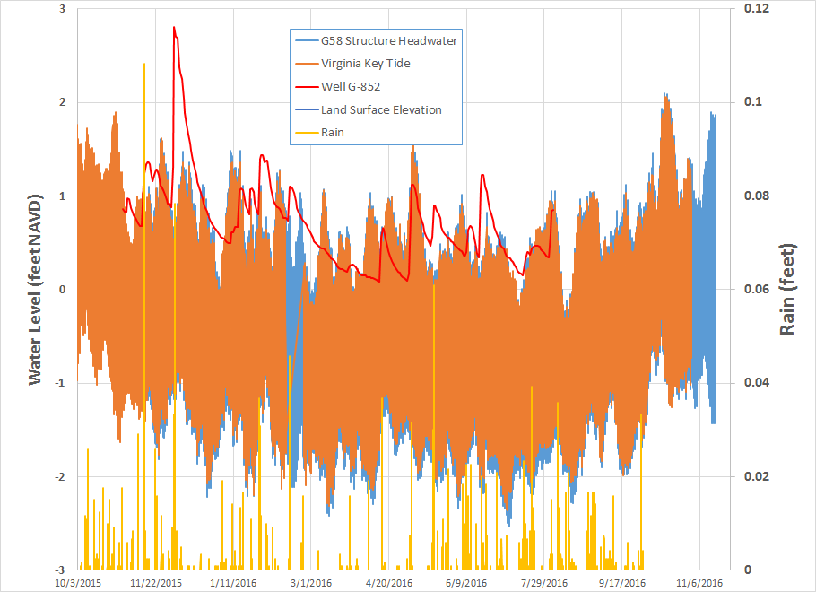
11/14/15 and 12/4/15; antecedent tide levels?

Slide 24
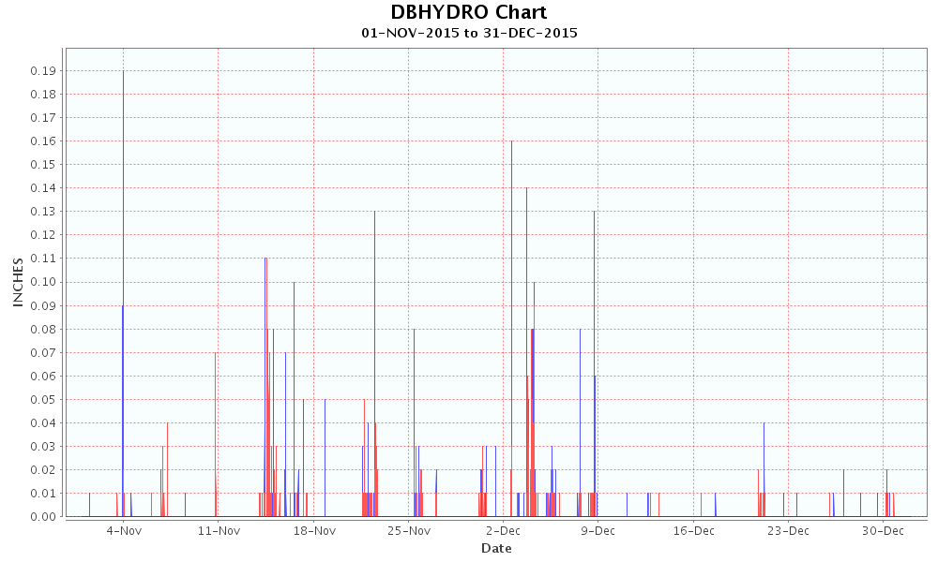
S-27 (southwest)
S-29 (northeast)

Slide 25
1st Numerical Model

Slide 26
Jacob 1950 Analytical Model
Jacob, C. E., 1950, Flow of ground water, Chapter 5, in Engineering Hydraulics: edited by H. Rouse, John Wiley, p. 321-386.

Slide 27
Jacob 1950 Analytical Model and 1st MODFLOW Model

Slide 28
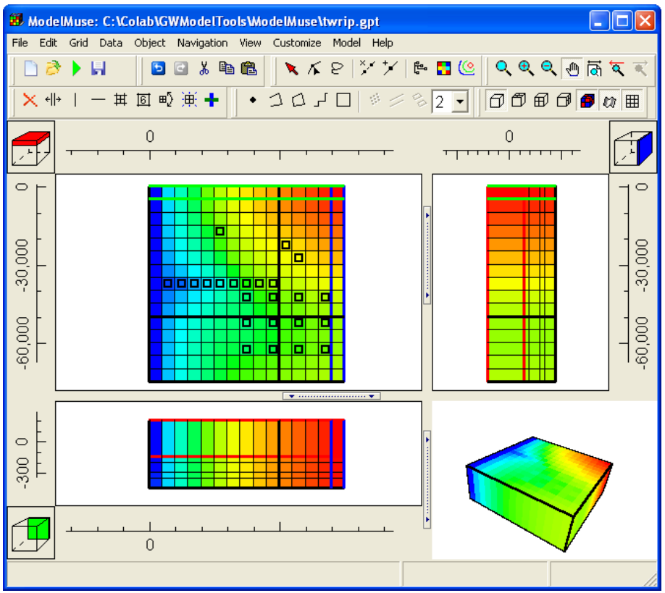
ModelMuse USGS
Winston, R.B., 2009, ModelMuse—A graphical user interface for MODFLOW–2005 and PHAST: U.S. Geological Survey Techniques and Methods 6–A29, 52 p., available only online at http://pubs.usgs.gov/tm/tm6A29.

Slide 29
Mass-conserving rain consolidation
Convert 15 minute to 30 minute rain data:
e.g., p_{0.5adj} = p_{0.25}/2 + p_{0.5} + p_{0.75}/2
 | Index | t (hours) | Original | Adjusted
11/3/2015 22:00 | 4 | 70 | 0
11/3/2015 22:15 | 1 | 70.25 | 0
11/3/2015 22:30 | 2 | 70.5 | 0 | 0.005417
11/3/2015 22:45 | 3 | 70.75 | 0.010833
11/3/2015 23:00 | 4 | 71 | 0.07 | 0.07875
11/3/2015 23:15 | 1 | 71.25 | 0.006667
11/3/2015 23:30 | 2 | 71.5 | 0 | 0.003333
11/3/2015 23:45 | 3 | 71.75 | 0
 |  | sums | 0.0875 | 0.0875

Slide 30
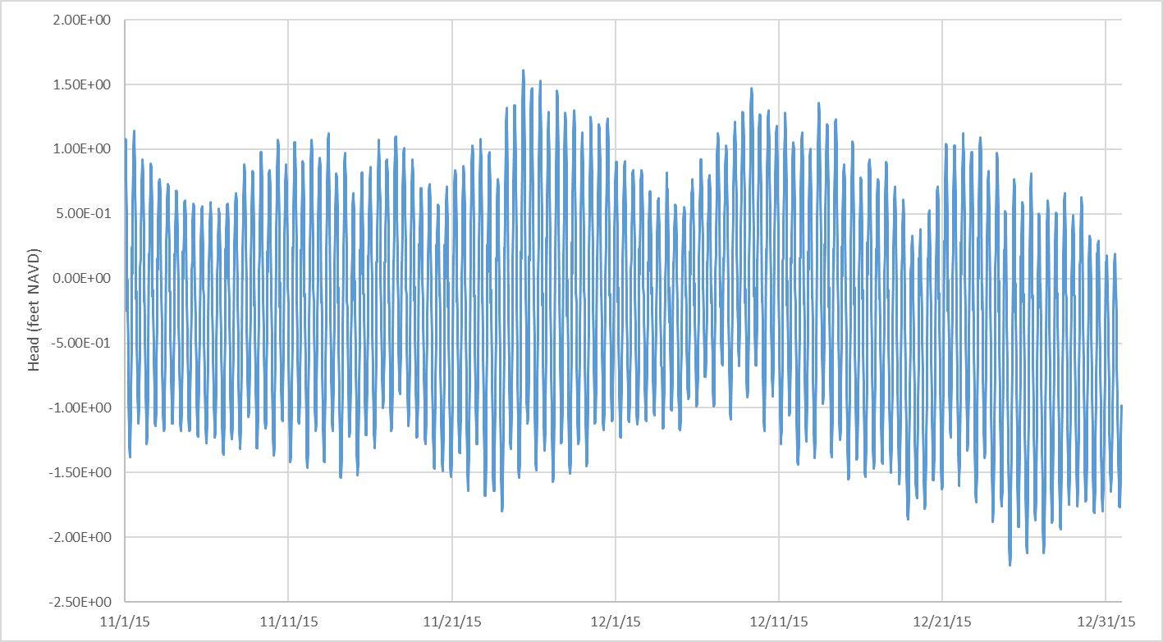
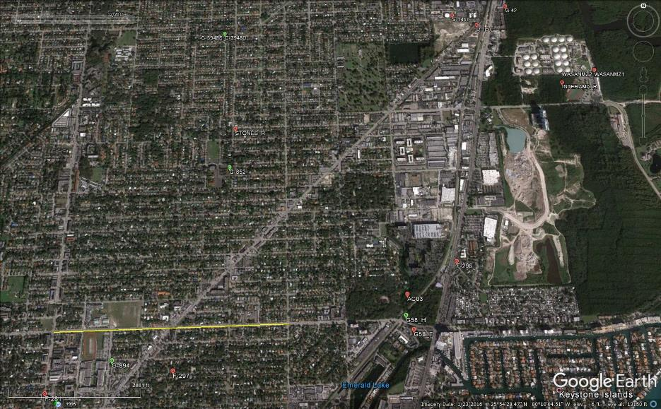
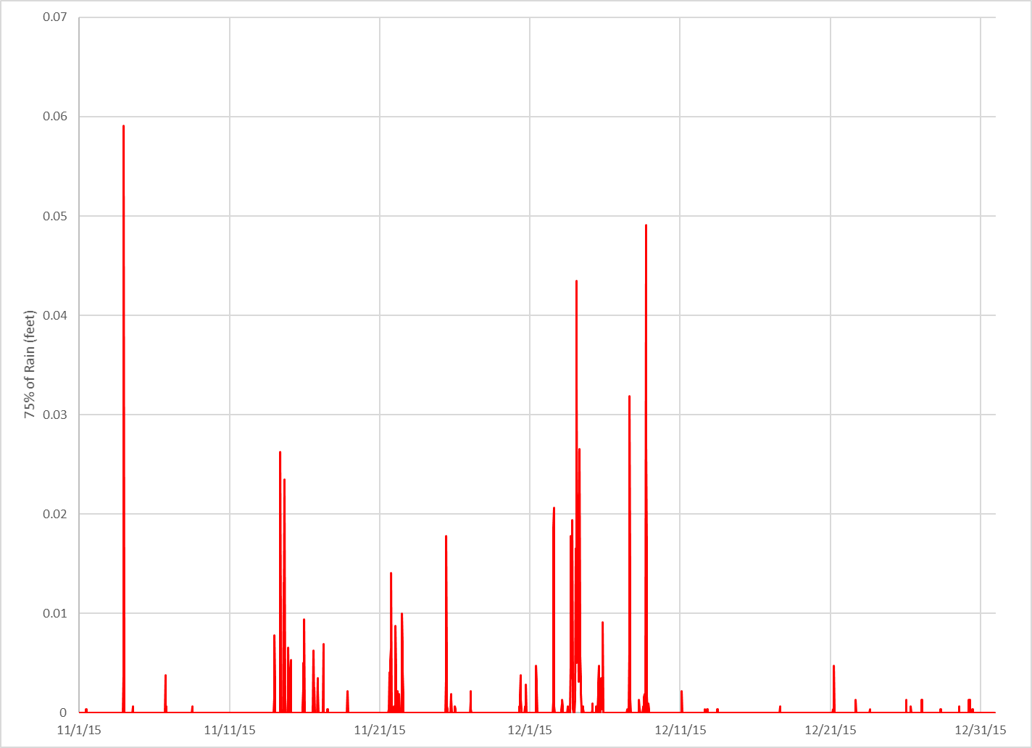
Model Domain
+2 ft NAVD
-2 ft NAVD
Fixed Head: 2 feet
11/1/15
12/31/15
G-852
Time Varying Fixed Head
10,000 feet
Recharge
0.05 ft
1 mile
11/1/15
12/31/15

Slide 31
Transient Groundwater Flow Equations
Hydraulic Diffusivity

Slide 32
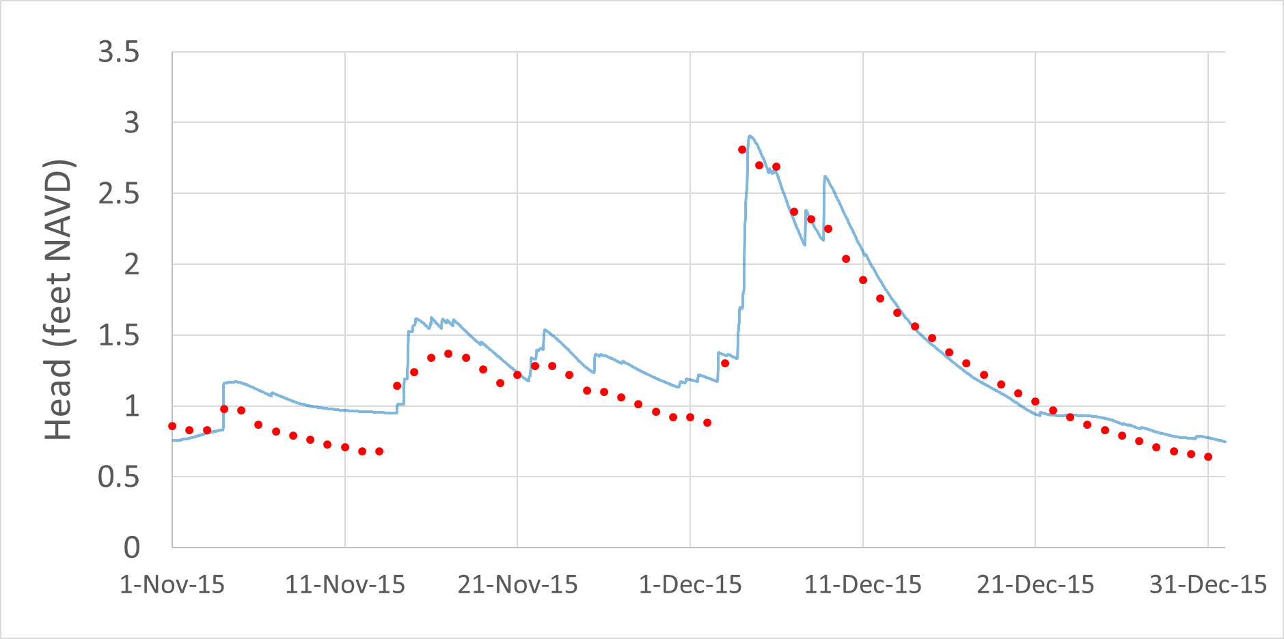
Preliminary Calibration to Well G-852
K = 100 ft hr⁻¹ (b ~ 100 ft => T = 2 x 10⁵ ft² d⁻¹), S = 0.1, R = 0.75P
Daily maxima data?

Slide 34
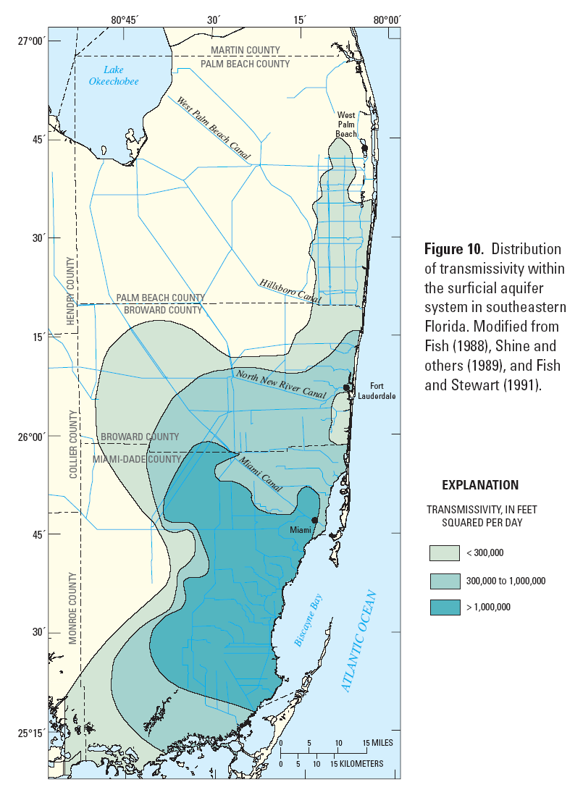
Consistent with observations of others
T = 2 x 10⁵ ft² d⁻¹
T>10⁵ m²d⁻¹
(K >~ 0.04 ms⁻¹)
Renken, R.A., Dixon, J., Koehmstedt, J., Lietz, A.C., Ishman, S., Marella, R.L., Telis, P., Rogers, J., and Memberg, S., 2005, Impact of Anthropogenic Development on Coastal Ground-Water Hydrology in Southeastern Florida, 1900-2000: Reston, Va., U.S. Geological Survey Circular 1275, 77 p.

Slide 35
What else?
Salinities?
Upstream boundary condition
Longer calibration period
Validation
Model build-out
Incorporate land surface elevation
Incorporate drainage features

