Slide 1
The value and challenges of quantitatively assessing water conservation programs: an example from lawn water restrictions in southeast Florida
Dr. Tara Root, Associate Professor
Department of Geosciences
Florida Atlantic University

Slide 2






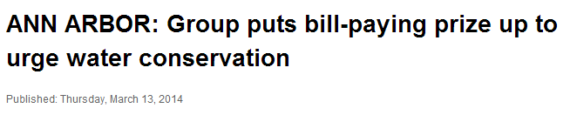
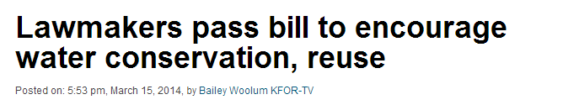
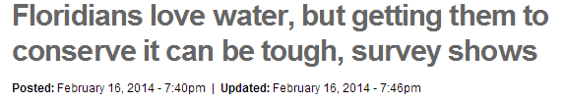
Conservation programs aimed at reducing domestic water consumption are common
With stressed U.S. water supplies posing
long-term peril to its production, MillerCoors is focusing on sustainability
By John Schmid of the Journal Sentinel
March 16, 2014
There has been little or no rainfall since mid-January, and the importance of
water conservation was stressed by our leaders as Singapore observes World
Water Day on Saturday. Activities aimed at spreading the water conservation
message were held island-wide.
By Vimita Mohandas Posted: 15 March 2014
Water conservation is essential to maintain the state’s water supply, but actually getting Floridians to conserve is tough.
OKLAHOMA – The state Senate this week advanced legislation that would encourage water districts and municipalities to expand the state’s supply of water through reuse and conservation.
The Saving Water Saves Energy project of the Huron River Watershed Council has launched a “Pledge, Save, Win” contest
to encourage homewowners in the watershed to tap into saving water, energy and money…

Slide 3
2005 Freshwater Withdrawals
Data source: Kenny et. Al, 2005, USGS Circular 1344
National
Florida
Total freshwater withdrawals:
349,000 Mgd
Total freshwater withdrawals:
6,820 Mgd
Domestic water use represents about 60% of public water supply withdrawals

Slide 4
Common water conservation strategies
  Pricing incentives to curb demand
  Other economic incentives
    rebates to install low flow toilets
    “cash for grass” rebates to convert turf to xeriscaping
  Landscape ordinances
    restrict the type of plants that can be planted
    regulate the type of irrigation allowed

Slide 5
Common water conservation strategies
  Informational campaigns aimed at changing water use behavior
  Prescribed management of water use
    e.g. water restrictions

Slide 6
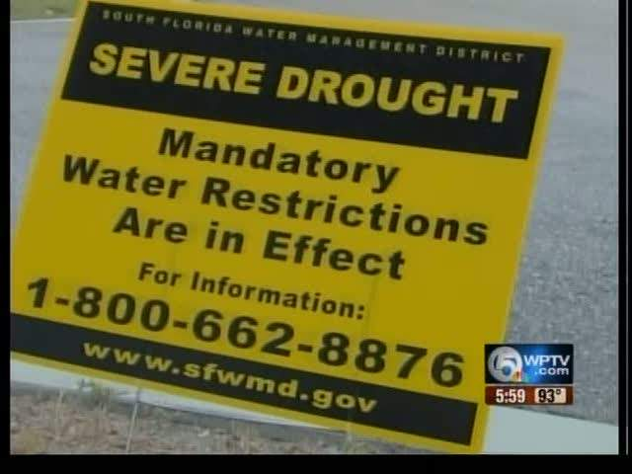

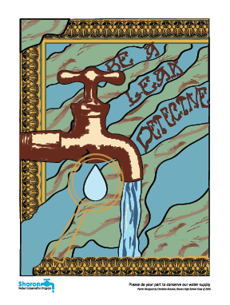
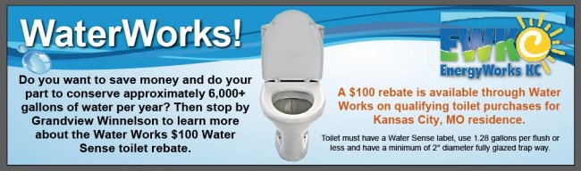
http://www.grandviewwinnelson.com/blog/index.php/new-waterworks-toilet-rebate-for-kcmo-residents/
http://sharonwater.com/
http://conservationcenter.org/water-home/slow-the-flow-colorado/
http://sinais2012.blogspot.com/2011/06/west-palm-beach-water-could-run-out-in.html

Slide 7

How do we know if a water conservation program is successful?
  Sometimes we don’t know
    A lot of research about price elasticity of water demand
    Historically not much research about the effectiveness of other water conservation policies
    Many water conservation programs are based on anecdotal evidence or modelled off of existing programs without quantitative evidence of effectiveness

Slide 8
How do we know if a water conservation program is successful?
  Commonly used metrics
    Reduction in water use
      The difference in use before and after the conservation program was implemented
    Compliance to prescribed watering scheme
      “day of the week” lawn watering

Slide 9
Some Complicating Factors
  Data availability
    Water use data
      best data often come from utility billing records
        typically do not separate indoor from outdoor use
        do not account for self-supply water use
        large uncertainties in water use estimation
“easily retrievable, standardized, and comprehensive baseline urban water use data are not available…” (California Department of Water Resources, 2009 cited in Cahill and Lund, 2013)

Slide 10
Some Complicating Factors
  Data availability
    Compliance data
      difficult to obtain a robust long term database of compliance
      compliance does not necessarily equate to conservation
        adherence to day of the week watering schedule can result in significant overwatering

Slide 11
Some Complicating Factors
  Most comprehensive water management plans include quantifiable conservation targets
    targeted per capita use
    percent reduction in use
    BUT… goals for individual components of comprehensive plans are often poorly defined
    Hinders quantitative assessment of program effectiveness

Slide 12
The “ideal” conservation metric
  Tied to quantifiable target
  Normalized to facilitate comparative analysis
  Flexibility to work with a variety of programs and data types
  Easy to conceptualize and communicate
  Necessary data readily available

Slide 13

One possible, very simple metric
  Conservation effectiveness ratio (CER)
    Tied to quantifiable target
    Normalized to facilitate comparative analysis
    Flexibility to work with a variety of programs and data types
    Easy to conceptualize and communicate
    ? Necessary data readily available
$$CER= \frac{target use}{actual use}$$

Slide 14
Case study
Applying the CER to evaluate water restrictions in Wellington, FL
(Survis and Root, 2012. Evaluating the effectiveness of water restrictions: A case study from Southeast Florida. Journal of Environmental Management, 112, 377-383.)

Slide 15

Defining the target use and using the CER as a communication tool
  The ideal target for lawn watering is to apply just the amount of water needed to supplement rainfall (P) in order to meet lawn water demand
    Turf grass demand ≅ potential ET (ET_{p})
  target use = weekly ET_{p} – weekly P
$$CER= \frac{target use}{actual use}$$

Slide 16
Defining the target use and using the CER as a communication tool
  target use = weekly ET_{p} – weekly P
Survis and Root, 2012

Slide 17
Estimating actual use
Data collection
    July – October 2009 (16 weeks)
    Weekly lawn water use
      165 households
  # of watering events per week x output per watering event

Slide 18
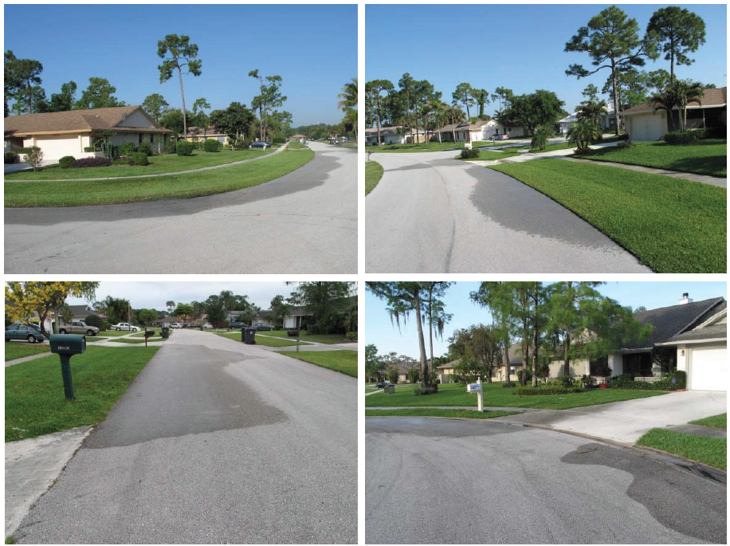
Estimating actual use
  # of watering events per week

Slide 19
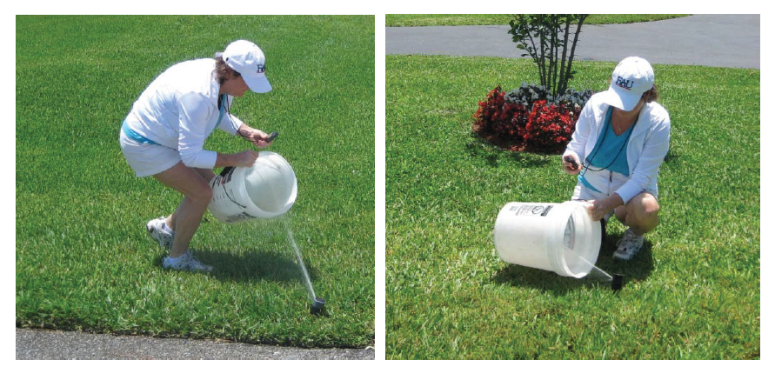
Estimating actual use
  Weighted mean output per watering event
    Irrigation audits
      Stratified random sample: 12 public supply and 16 self supply households

Slide 20
Results
Compliance
  More people watering events on non-sanctioned days than on sanctioned days
    Compliance to rigid days of the week suggests watering restrictions were not effective
BUT…
  Average # of watering events per week (1.3) was significantly less than the allowed 2 days per week
        Compliance to # of waterings per week suggests restrictions might have been effective
Compliance data are ambiguous and provide no information about amount of water used

Slide 21
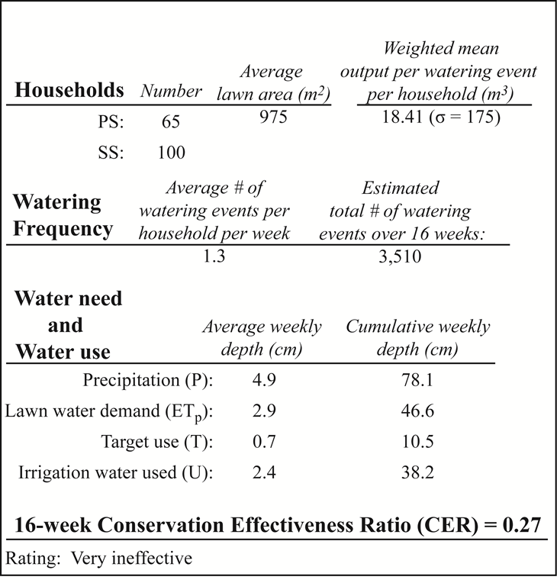
Results
  16-week CER
Survis and Root, 2012

Slide 22
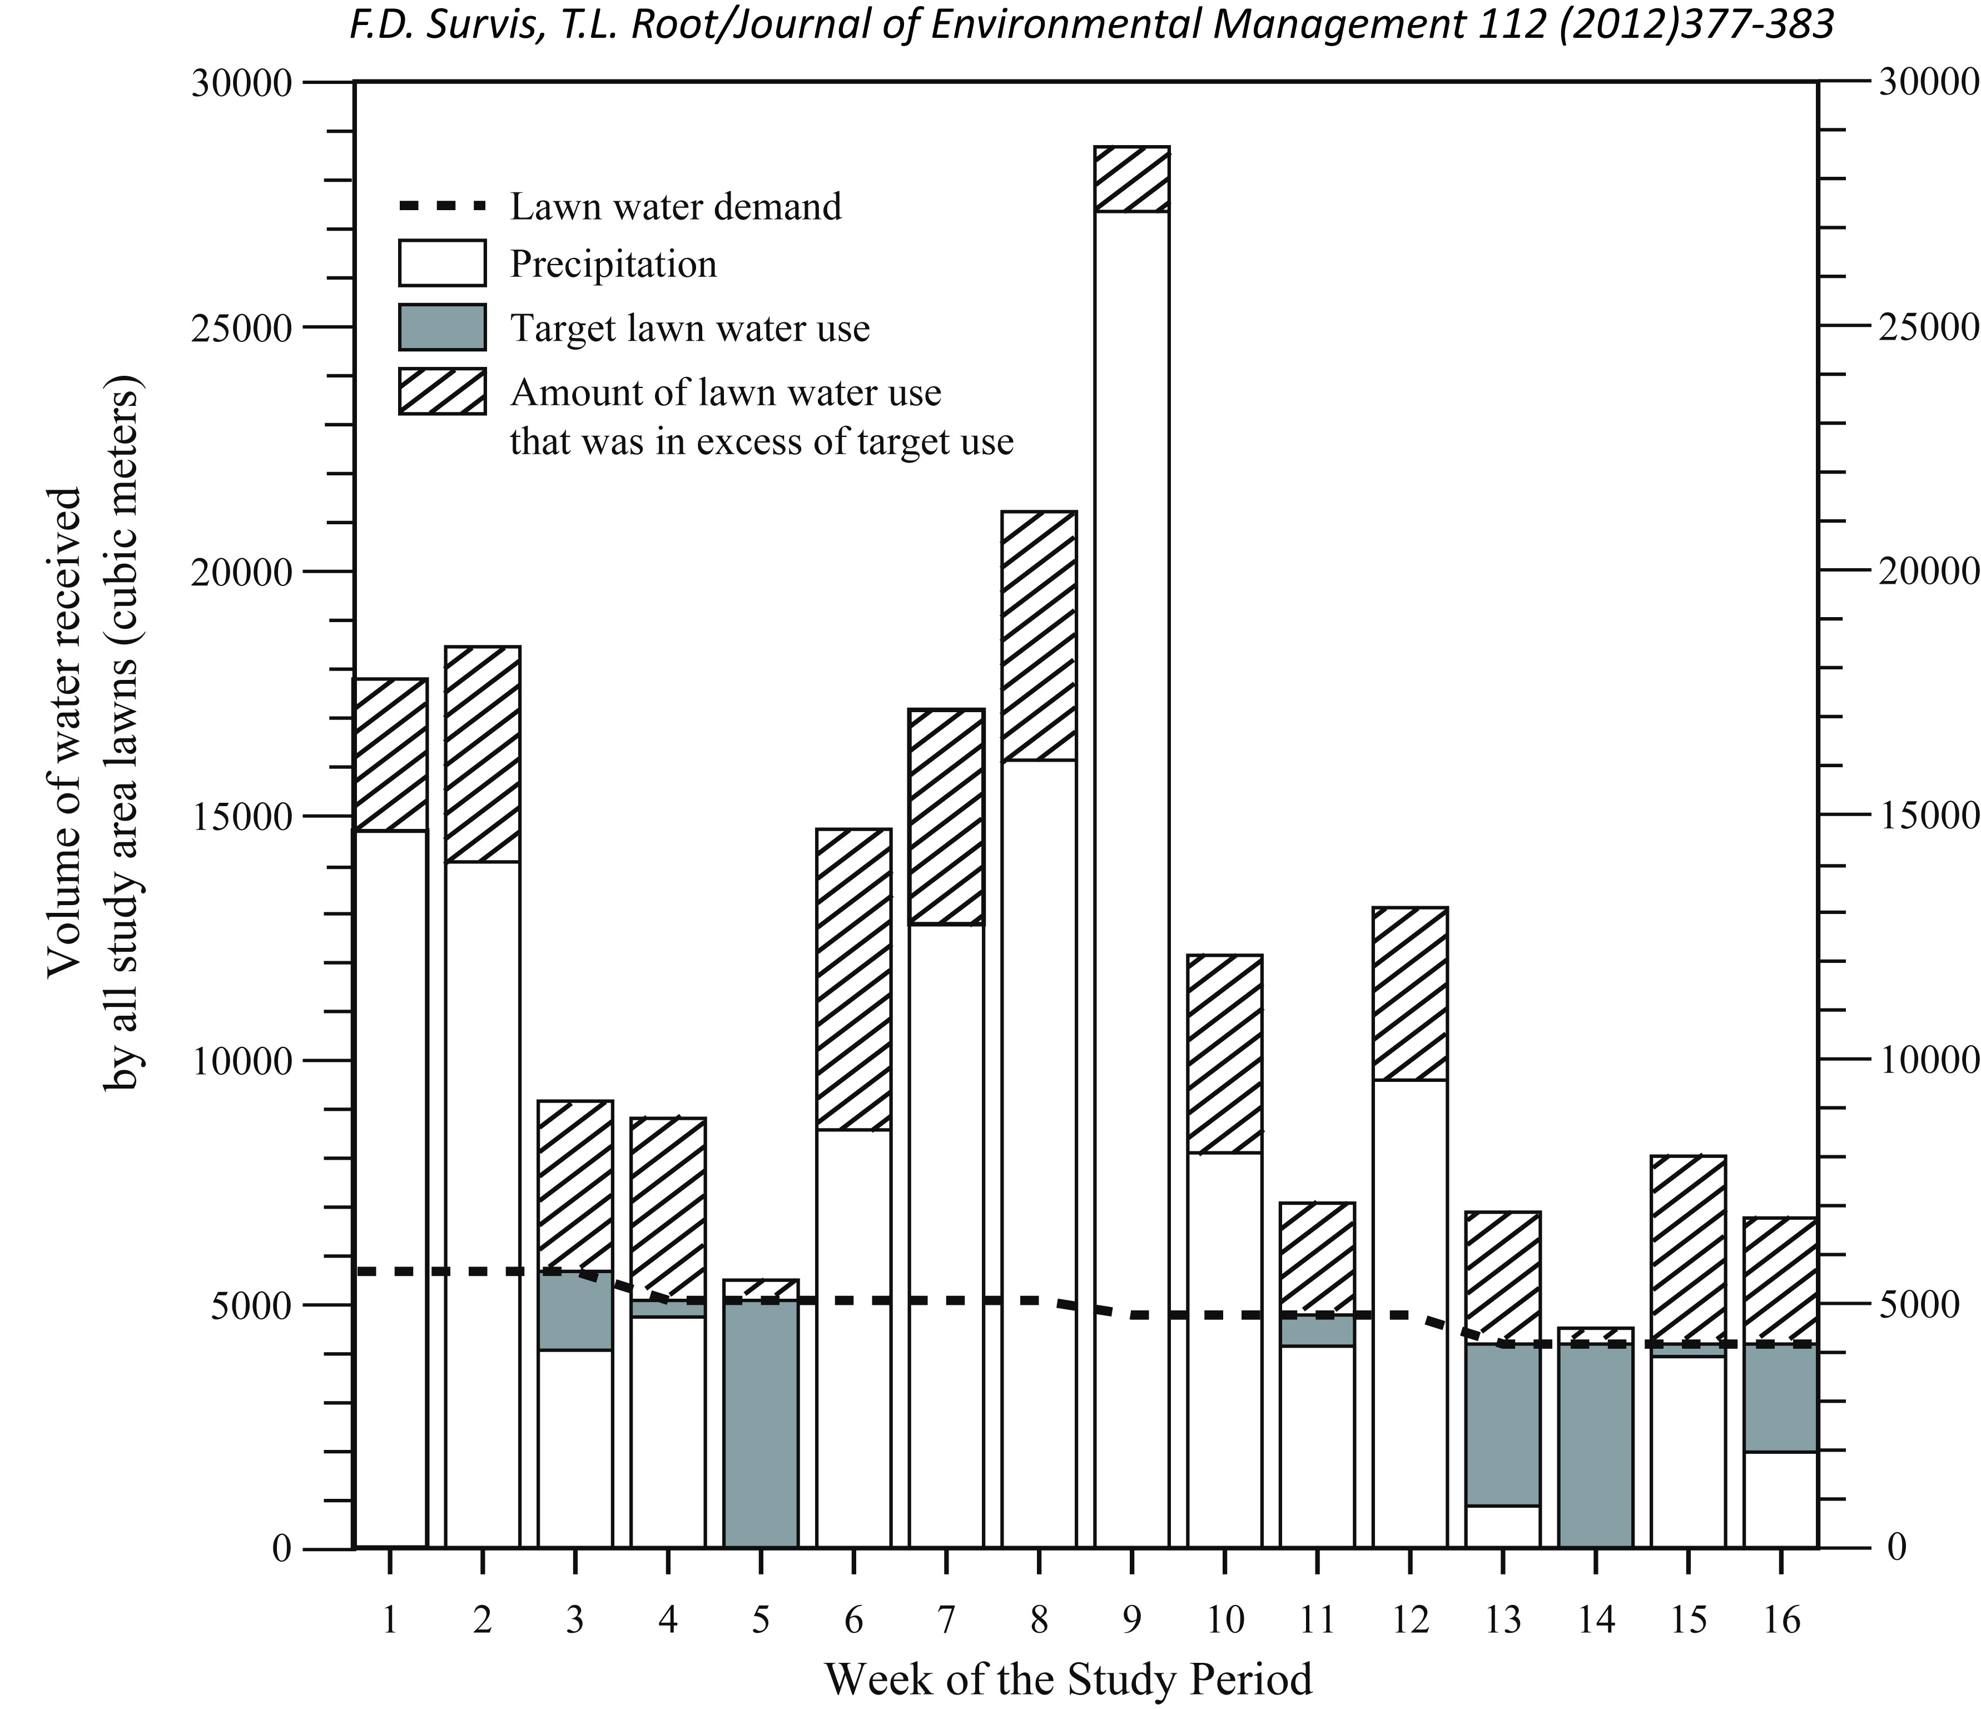
Results
  Week by week

Slide 23
Case study conclusions
  Compliance data were ambiguous and not a reliable indicator of the effectiveness of water restrictions
  CER
    Indicated water restrictions were ineffective
    Facilitated identification of opportunity to conserve large volumes of water by only watering when rainfall has not met lawn water demand.
      12 million gallons for the 165 households in this 16 week study

Slide 24
Recommendations/needs
Need for continued research into effectiveness of various water conservation strategies
Increased use of scientific research in design of water conservation programs
Importance of quantifiable targets for water conservation programs
Importance of easily understandable metrics to assess the effectiveness of water conservation programs
  Role of CER

Slide 25
Recommendations/needs
Benefits of approach like CER
  Flexible target
    Can be tied to comprehensive water management plans or regional water budgets
    Can be used to evaluate single program or entire water conservation plan
  Normalized ratio
    Allows for comparative analysis
  Simple to calculate and understand
    Facilitates communication
  Facilitates understanding of opportunities for water conservation

Slide 26
Recommendations/needs
Limitations of approaches like CER
  Availability of water use data
  Attributing trends in metrics to a specific water conservation program
  Time scale of analysis

Slide 27
Acknowledgements
Felicia Survis, Ph.D. candidate, Dept. of Geosciences, FAU
Village of Wellington
South Florida Water Management District

