Slide 1
Southeast Florida Regional Climate Change Compact:
A local government collaboration to address climate change and sea level rise
South Florida Hydrologic Society
May 9, 2012
Susanne Torriente | City of Fort Lauderdale
Dr. Jennifer Jurado | Broward County

Slide 2
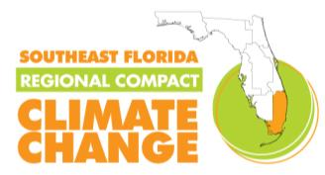
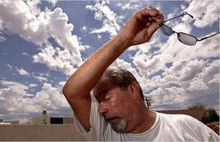
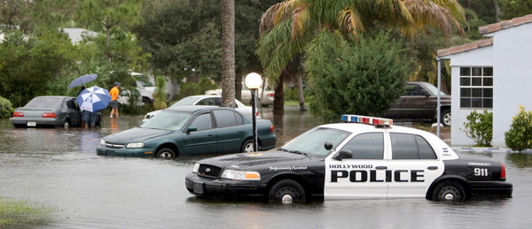
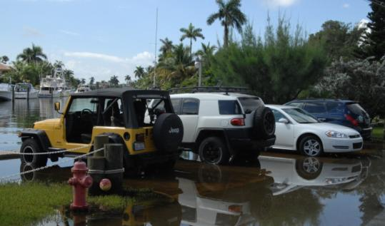
Climate Change Impacts in SE FL
Increasing Temp (2 to 10°F) by 2100
Increasing occurrence of extreme weather
hotter summers
drier droughts
wetter rainy seasons
cold snaps
Sea level rise (2-5 feet) by 2100
Photo Credit: Sun-Sentinel
Photo Credit: Sun-Sentinel
Photo Credit: Paul Krashefski (Broward County)
Notes:
Even with mitigation, South Florida will need to adapt to certain climate change impacts that are inevitable.
Temperatures over the next century are expected rise from 2 to 10 degrees. However, we are already feeling these effects recognizing that eight of the last ten years have been the hottest on record going back to 1880.
We can also expect and increasing occurrence of extreme weather including hotter summers (Dallas, Texas exceeded 100 degrees F (37.8 degrees C) on 30 of the 31 days during July, 2011.)
Wet seasons will be wetter, dry seasons drier and rainfall will be more spotty. Hollywood rain event in the Dec 2009 where 8-16 inches fell in a period of just over 24 hours
Cold snaps - Jan-March 2010 - 4.5⁰F below average

Slide 3
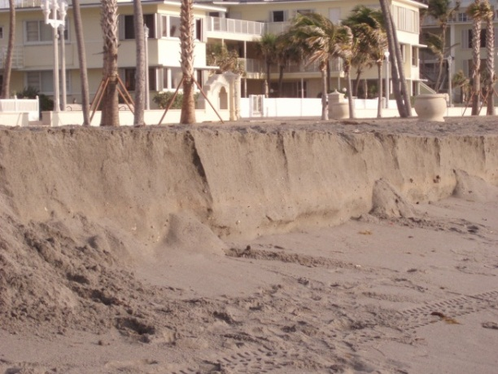
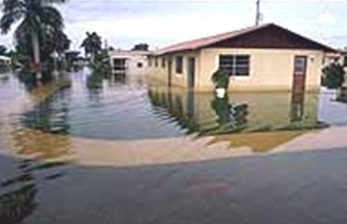
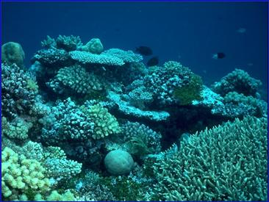
Implications for SE FL
Threats to public and private infrastructure
Coastal/Tidal Flooding
Inland Flooding
Beach Erosion
Wind Damage
Impacts on water supplies
Water shortages
Salt water intrusion
Compromised natural systems
Everglades
Coral Reefs
Notes:
Even with mitigation, South Florida will need to adapt to certain climate change impacts that are inevitable.
Temperatures over the next century are expected rise from 2 to 10 degrees. However, we are already feeling these effects recognizing that eight of the last ten years have been the hottest on record going back to 1880.
We can also expect and increasing occurrence of extreme weather including hotter summers (Dallas, Texas exceeded 100 degrees F (37.8 degrees C) on 30 of the 31 days during July, 2011.)
Wet seasons will be wetter, dry seasons drier and rainfall will be more spotty. Hollywood rain event in the Dec 2009 where 8-16 inches fell in a period of just over 24 hours
Cold snaps - Jan-March 2010 - 4.5⁰F below average

Slide 4
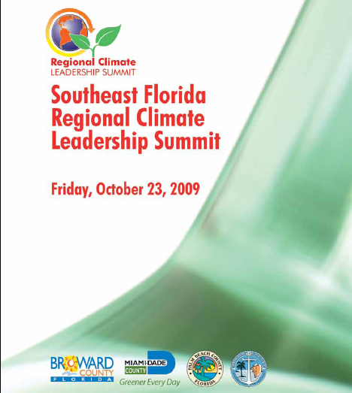
Regional Summit
300 participants
56 elected officials
Federal
State
County
Municipal
34 municipalities
Members of green teams & task forces

Slide 5
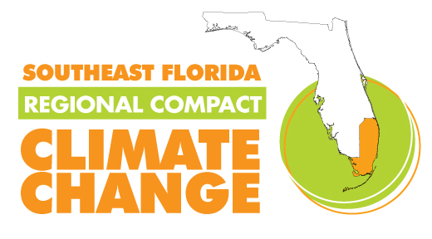
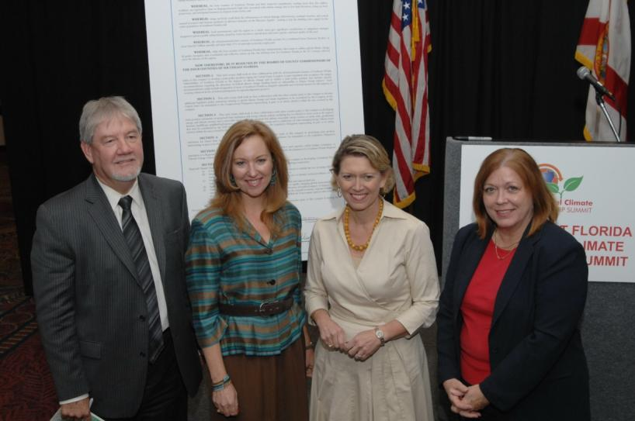
SE FL Climate Change Compact
Fully Ratified January 2010
Commitments include:
Policy Collaboration
Develop Regional Tools
Unified SLR Projection
Inundation Maps
GHG Emissions Baseline
Create a Regional Action Plan
Mitigation and adaptation strategies
Convene Annual Summits
)
Notes:
Even with mitigation, South Florida will need to adapt to certain climate change impacts that are inevitable.
Temperatures over the next century are expected rise from 2 to 10 degrees. However, we are already feeling these effects recognizing that eight of the last ten years have been the hottest on record going back to 1880.
We can also expect and increasing occurrence of extreme weather including hotter summers (Dallas, Texas exceeded 100 degrees F (37.8 degrees C) on 30 of the 31 days during July, 2011.)
Wet seasons will be wetter, dry seasons drier and rainfall will be more spotty. Hollywood rain event in the Dec 2009 where 8-16 inches fell in a period of just over 24 hours
Cold snaps - Jan-March 2010 - 4.5⁰F below average

Slide 6
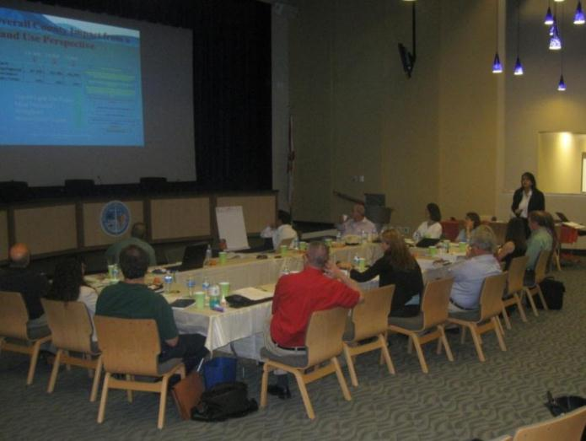
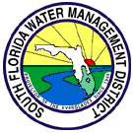
Collaborating Partners Lending Expertise
Notes:
Expertise and partnerships can from regional agencies, federal agencies, non-profits and local academic institutions.

Slide 7
Before the Compact
)
Notes:
Even with mitigation, South Florida will need to adapt to certain climate change impacts that are inevitable.
Temperatures over the next century are expected rise from 2 to 10 degrees. However, we are already feeling these effects recognizing that eight of the last ten years have been the hottest on record going back to 1880.
We can also expect and increasing occurrence of extreme weather including hotter summers (Dallas, Texas exceeded 100 degrees F (37.8 degrees C) on 30 of the 31 days during July, 2011.)
Wet seasons will be wetter, dry seasons drier and rainfall will be more spotty. Hollywood rain event in the Dec 2009 where 8-16 inches fell in a period of just over 24 hours
Cold snaps - Jan-March 2010 - 4.5⁰F below average

Slide 8
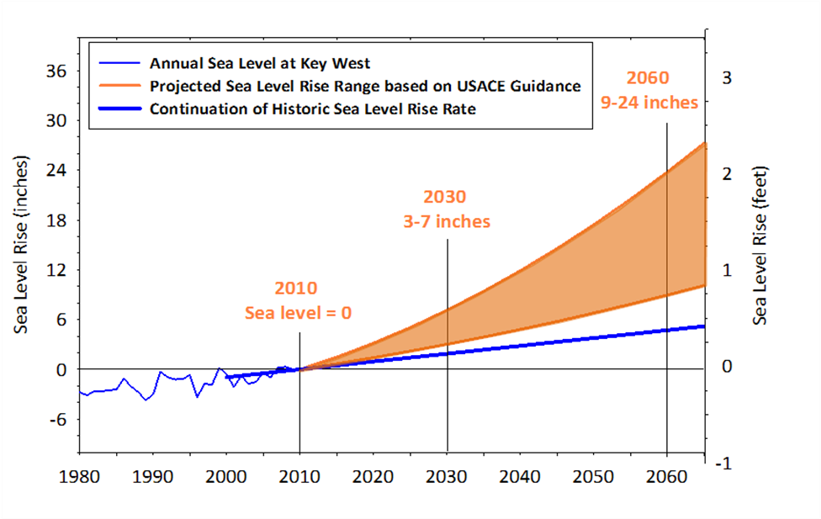
Unified Sea Level Rise Projection
Key West
Timeline of Sea Level Rise in SE FL
1 foot = 2040 – 2070 2 foot = 2060 – 2115 3 foot = 2075-2150
Notes:
The four counties of the SE FL Regional Climate Change Compact brought together a group of local sea level rise experts to develop a sea level rise projection for our region.
The blue line on the left shows part of the long term record from Key West. Over the last 100 years, sea level has risen 8-10 inches.
If that trend continued, we would expect 5 inches of sea level rise by mid century.
However, experts agree that we will be experiencing an acceleration on sea level rise during this century,
expecting 3-7 inches of sea level rise from todays levels by 2030 and up to 2 feet of sea level rise in the next 50 years.

Slide 9
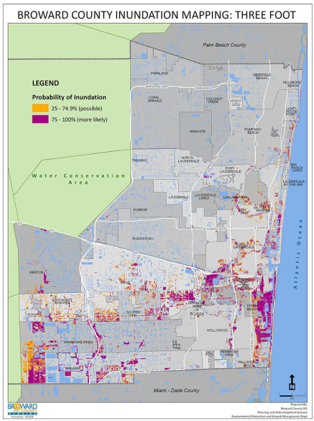
Vulnerability Work Group
Inundation Mapping
Regional digital elevation model
1, 2, and 3 foot scenarios
Common method to express potential risk
Identifies areas with LiDAR elevation at the mean higher high water line
Vulnerability Analysis
Prioritized infrastructure for analysis
Tested geospatial analytical methods
Included uncertainty

Slide 10
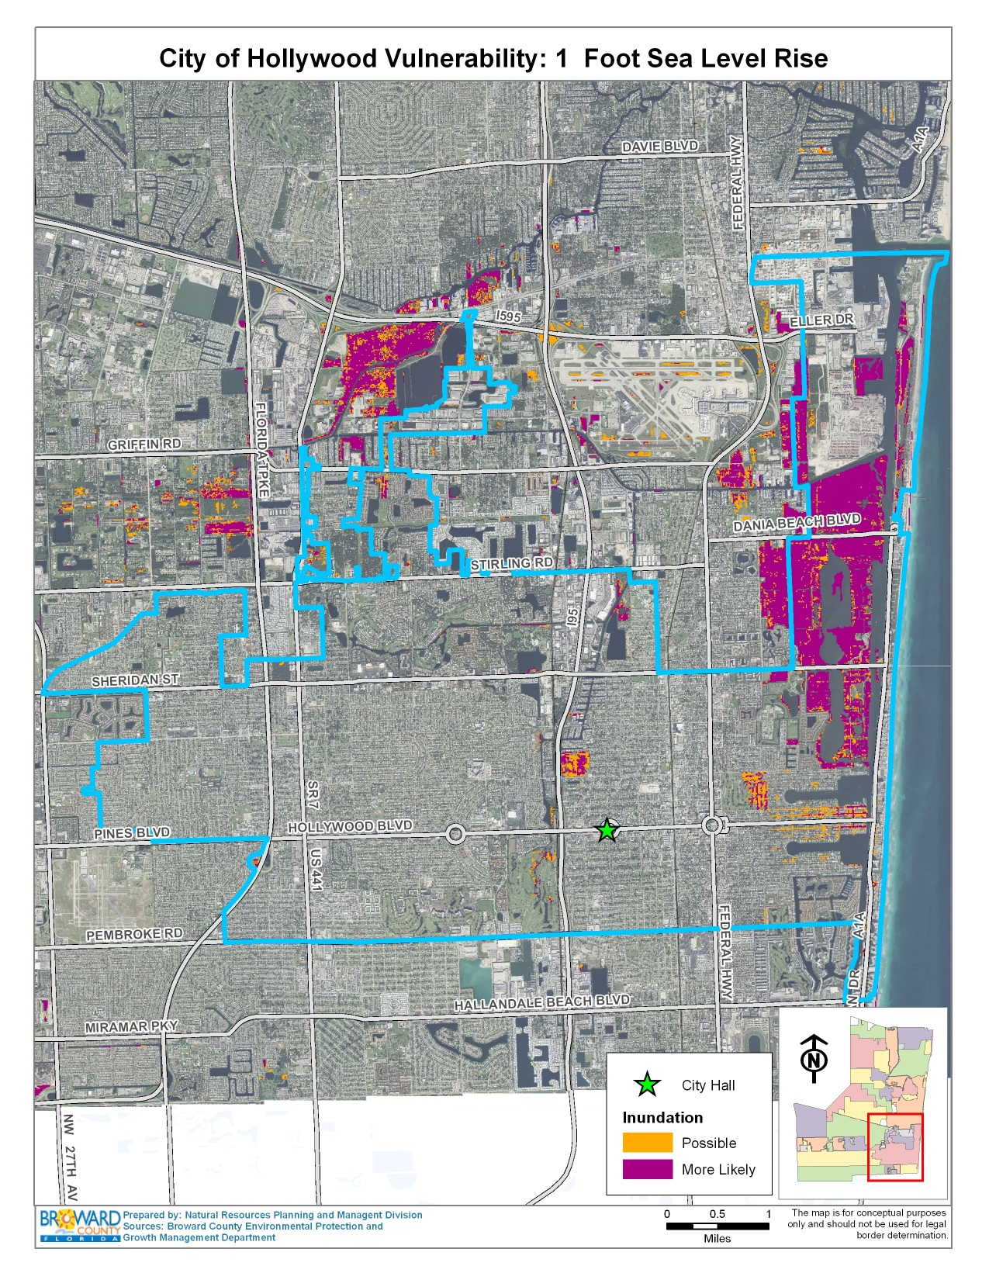
Hollywood – 1 ft
Major Impacts
2040 – 2070
Parks
Natural areas
Low-lying tidal areas
Local roads (Lakes Area)
Notes:
The city borders are shown in light blue and the city hall is identified by a green star. At the 1 foot sea level rise scenario, expected to occur between 2040 and 2070, we mainly see impacts to
Parks and historical sites
Select local roads
Natural areas
Low-lying tidal areas

Slide 11
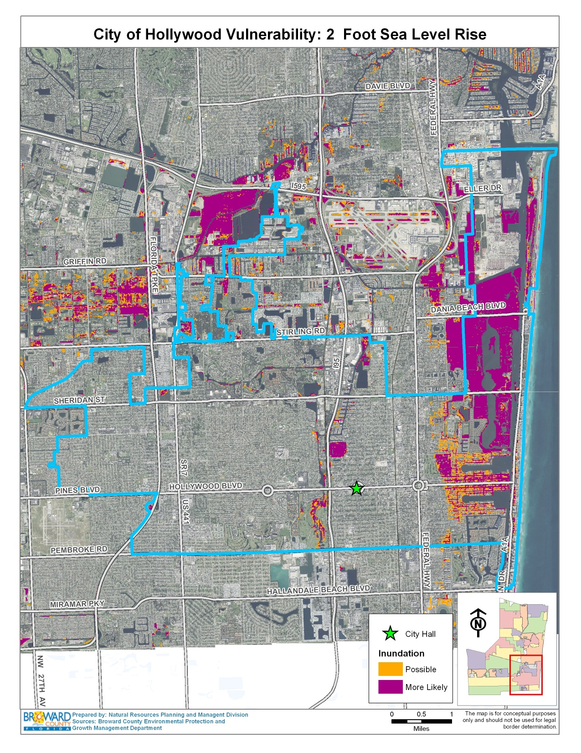
Hollywood – 2 ft
Major Impacts
2060 – 2115
Local streets
Low lying communities especially near waterways
Low lying areas in golf courses
Beach erosion
Notes:
At two feet sea level rise which is possible by mid century, we see an
increasing occurrence of street inundation
Impacts to low lying communities
Marine facilities

Slide 12
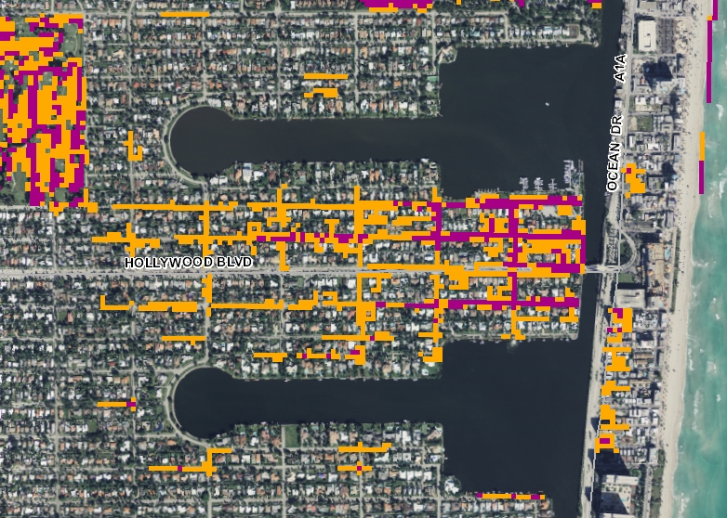
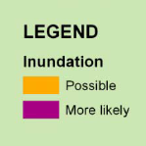
Road Impacts
Lakes Area of Hollywood – 1 Ft Scenario
Roads by FDOT Category
Number of miles impacted
(% total road miles)
 | Miami-Dade County | Broward County | Palm Beach County | Total
1 foot | 72 m (<1%) | 9.5 m (<1%) | 0 m | 81 miles
2 foot | 257 m (3%) | 76 m (1%) | 13 m | 346 miles
3 foot | 556 m (6%) | 296 m (4%) | 41 m (<0.01%) | 893 miles

Slide 13
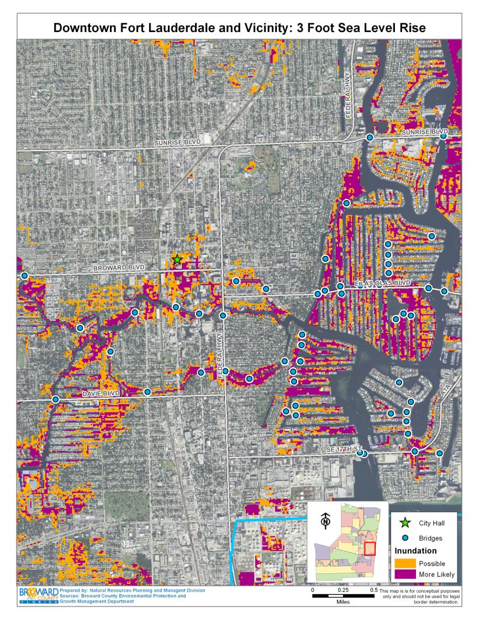
Bridges – 3 ft
Major Impacts
Navigation under fixed bridges
Notes:
The blue dots on this map are bridges.
As the Venice of America, the City of Fort Lauderdale also has the concern of sea level rise to fixed bridges. Higher water means less clearance for navigation under those bridges.

Slide 14
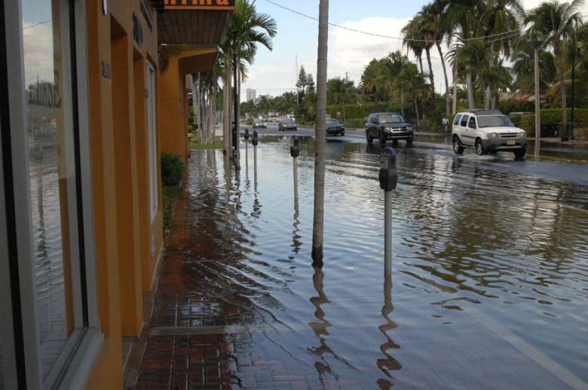
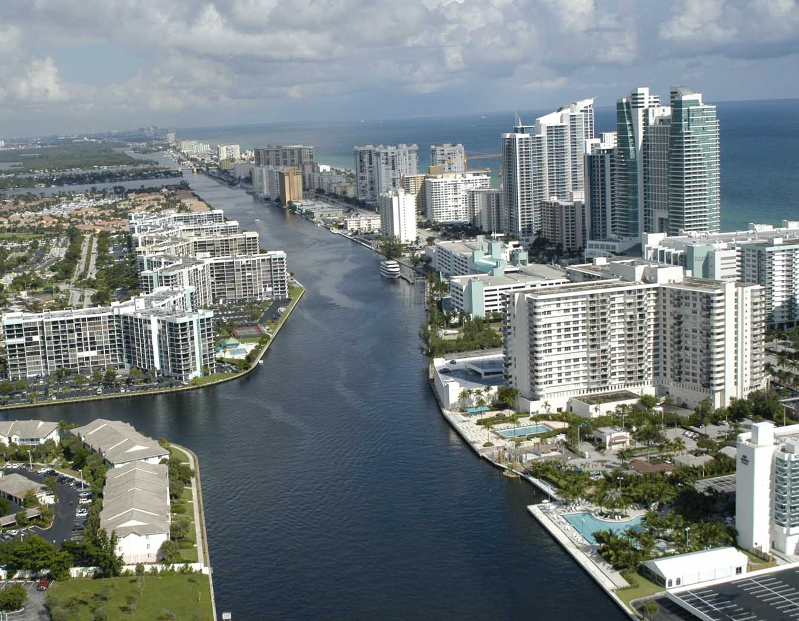
Taxable Value of Property
 | Monroe | Broward | Palm Beach
1 foot | $ 2,763,294,786.00 | $ 403,069,831.00 | $ 396,618,089.00
2 foot | $ 8,388,138,219.00 | $ 1,751,104,870.00 | $ 1,251,877,561.00
3 foot | $ 15,087,755,147.00 | $ 6,900,509,868.00 | $ 3,559,471,158.00
Total | $ 26,239,188,152.00 | $ 9,054,684,569.00 | $ 5,207,966,808.00

Slide 15
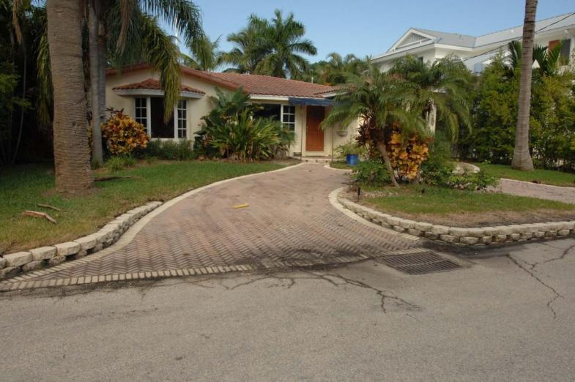
Pre-High Tide Event
Notes:
High and Dry today. Storm sewers keep properties dry the majority of the year.

Slide 16
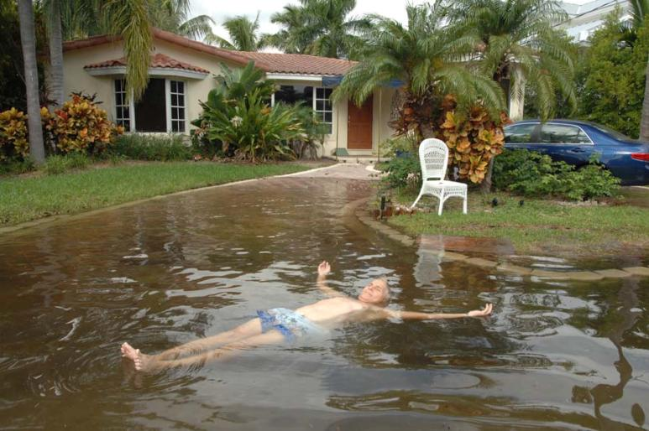
High Tide Event
Notes:
Slide title: Tidal Inundation (Broward Home - Wet)
However, the following day residents are helpless to stop the rising tide from being conveyed through that same system. Here, saltwater rose through the drainage culvert, inundating the road and entrance to the home.
This resident resigned himself to simply try and enjoy it.

Slide 17
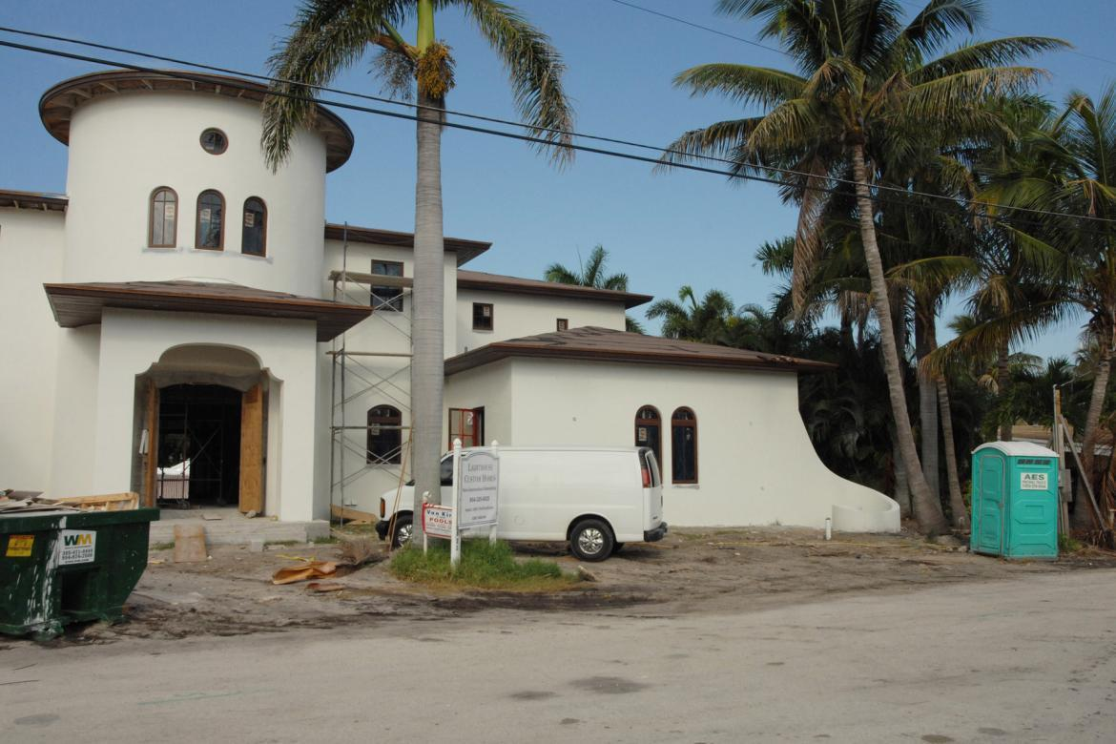
New Construction
Notes:
We are currently building homes with ocean views and ocean access, with little to no consideration for future conditions.

Slide 18
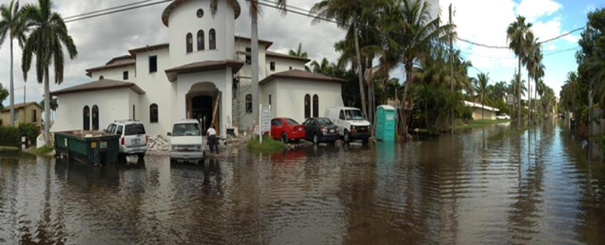
High Tide Event
Notes:
But these high tide events illustrate the need for building designs and land use plans to begin to incorporate new design criteria as part of the approval process for new construction.
Such measures will be needed to ensure that new properties and public investments in infrastructure will remain viable for their expected life span.

Slide 19
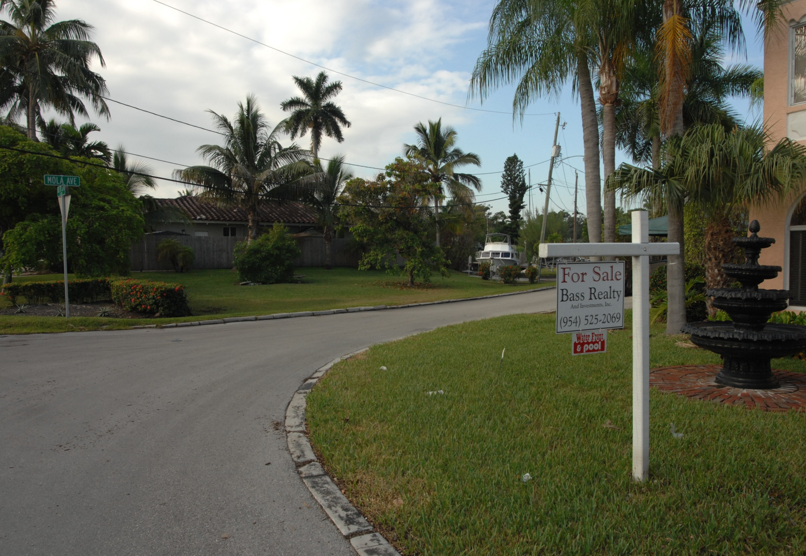
Pre-High Tide Event

Slide 20
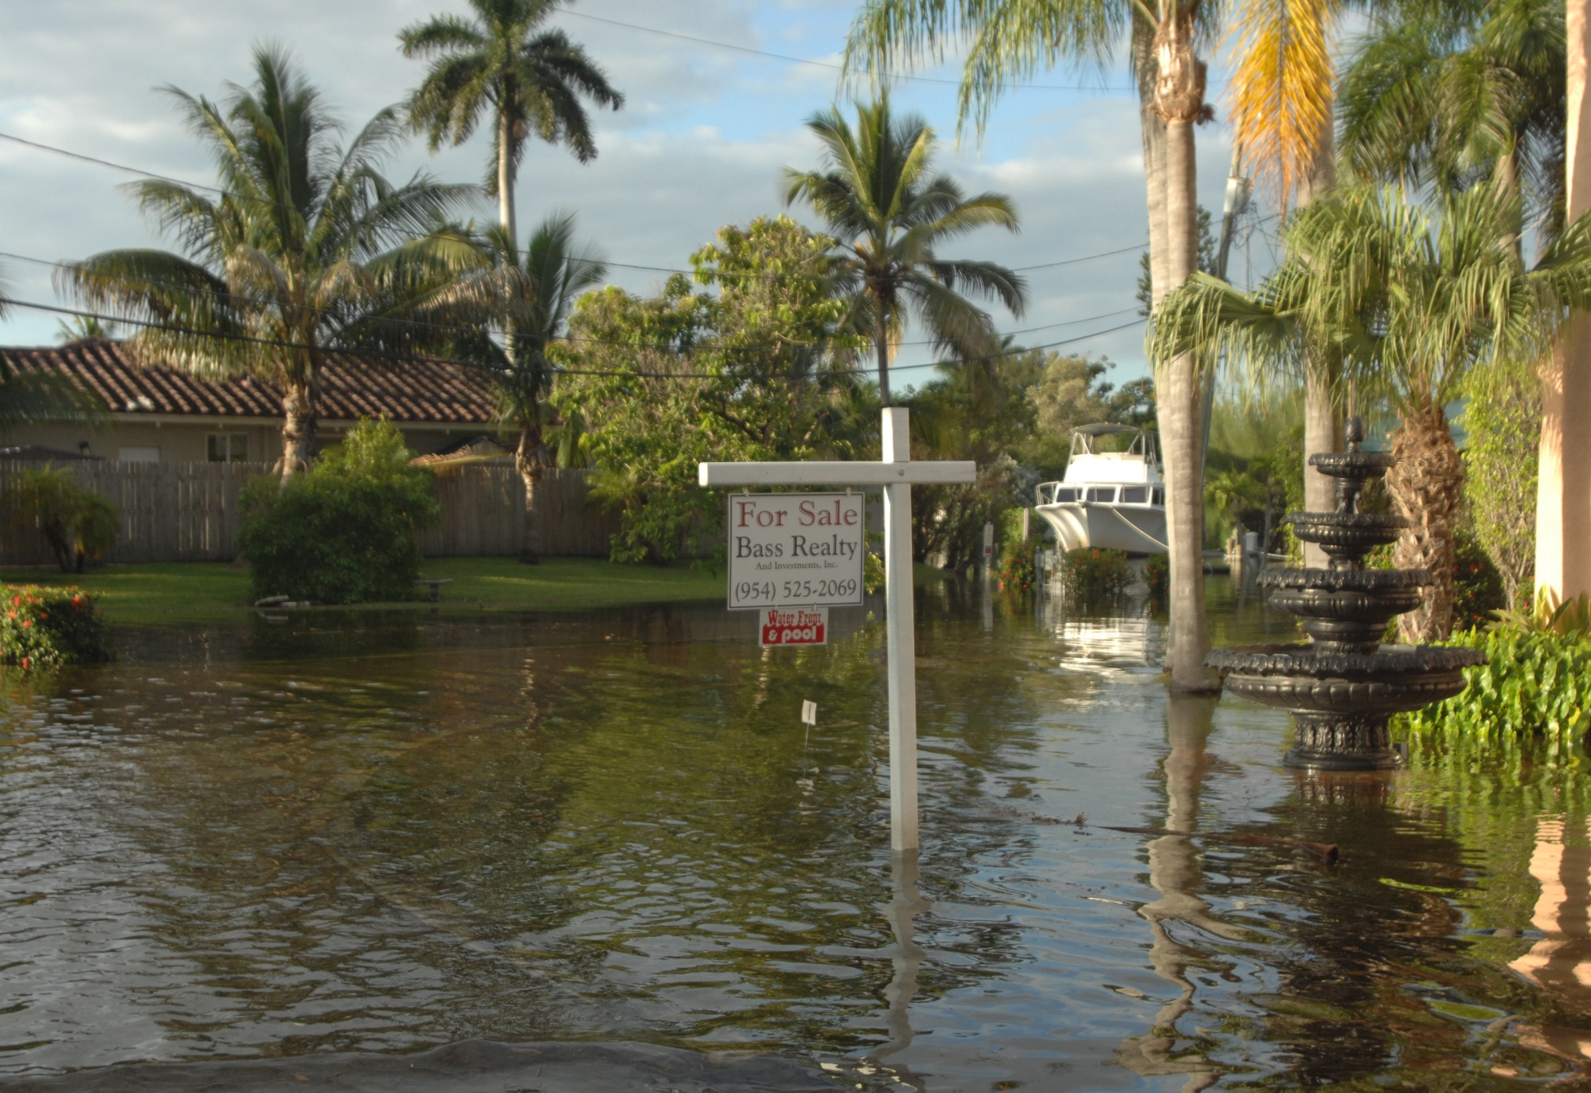
High Tide Event

Slide 21
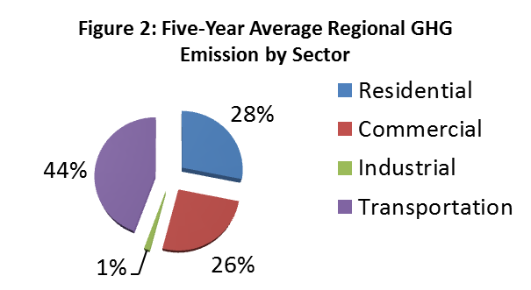
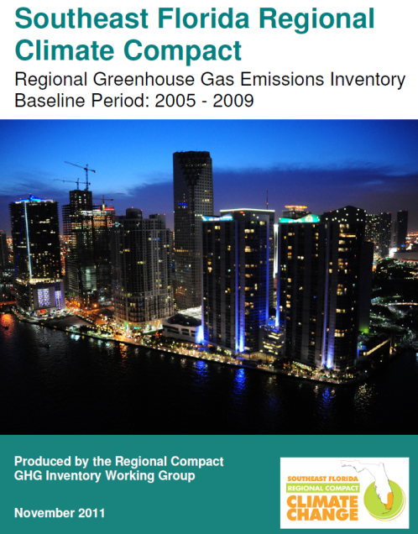
Regional GHG Baseline

Slide 22
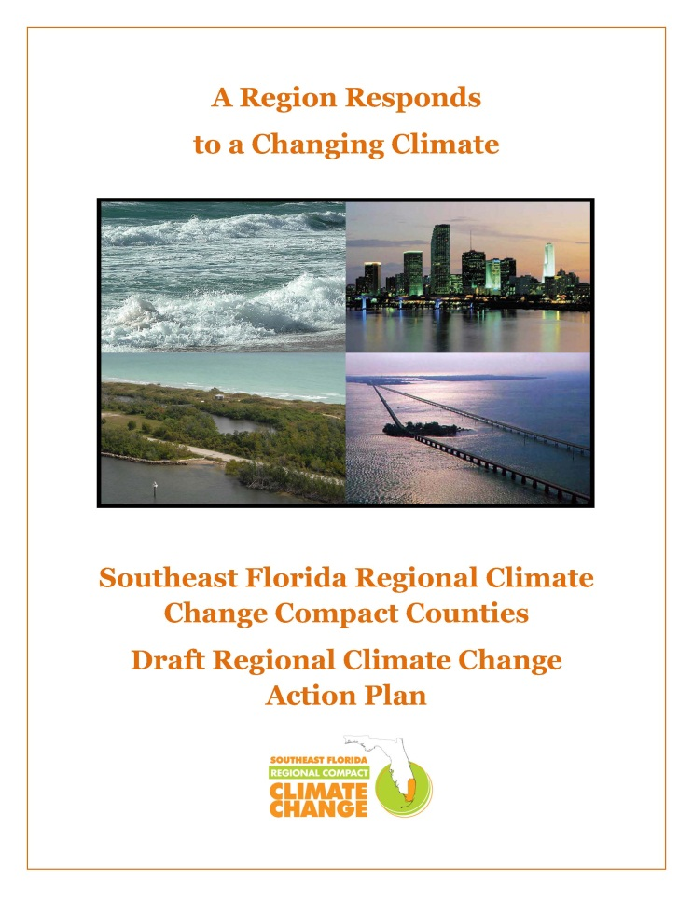
Regional Action Plan Planning Process
Work Groups:
Built Environment
Transportation
Land and Natural Systems
Focus on gaining efficiency and effectiveness through regional strategies and coordination

Slide 23
Participants and Planning Areas
Planning Areas
Sustainable Community and Transportation Planning
Water Supply, Management and Infrastructure
Risk Reduction and Emergency Management
Energy and Fuel
Natural Systems and Agriculture
Outreach and Public Policy
Participants
Fed, State, local governments
Water Managers/utility directors
Economic Development
Planning Agencies
Emergency Management
Transportation
Consultant Engineers
USGBC
Environmental
Academics

Slide 24
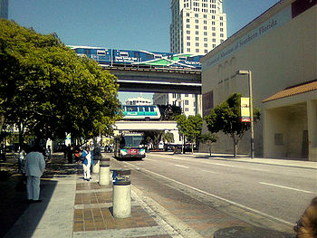
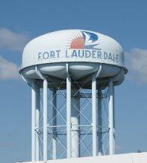
Regional Compact Work Groups
Transportation
Transit oriented development
Mass transit
Sustainable fuels and infrastructure
Transportation efficiencies
Freight
Green certification programs
Built Environment Work Group
Priority planning areas
Water resources infrastructure
Energy use and production
Building codes
Economic development

Slide 25
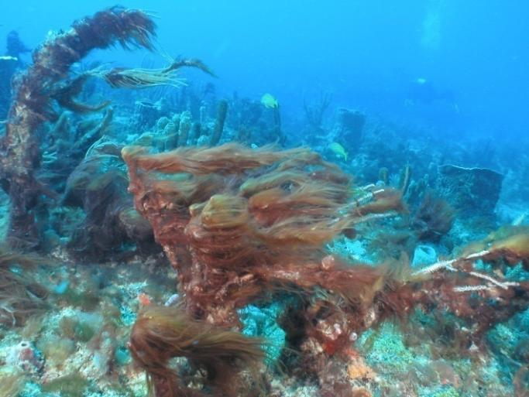
Regional Compact Work Groups
Land and Natural Systems
Reefs and coastal resources
Beach management
Agriculture
Monitoring
Land preservation
Management of exotics
Everglades restoration

Slide 26
Adaptation Actions Areas
In 2011 the Florida Legislature amended state law to provide for a definition of Adaptation Action Areas;
Optional component of local comprehensive plans
Allows local governments to:
Identify and designate low-lying coastal zones; and
Consider policies to improve resilience to coastal flooding , especially related to sea level rise.
Objective of prioritizing adaption projects and aligning state and federal funding to support such projects.

Slide 27
Water Resources Recommendations
Assume an integrated approach to water resource management and climate adaptation planning
Conduct Risk Assessments –
wellfields and infrastructure
Develop Integrated Water Management Plans - water supply, wastewater disposal, water conservation, alternative water supply, stormwater management and reuse
Provide Drainage and Flood Control –
identify and pursue infrastructure improvements in Adaptation Action Areas
Support Everglades Restoration

Slide 28
Regional Implementation
Comprehensive Planning
Incorporate Adaptation Action Area (AAA) designation into local and regional planning documents
Revise building codes and land development regulations to improve building and infrastructure resiliency.
Amendments to Broward comprehensive plan and land use plan underway and DEO grant will support Fort Lauderdale effort

Slide 29
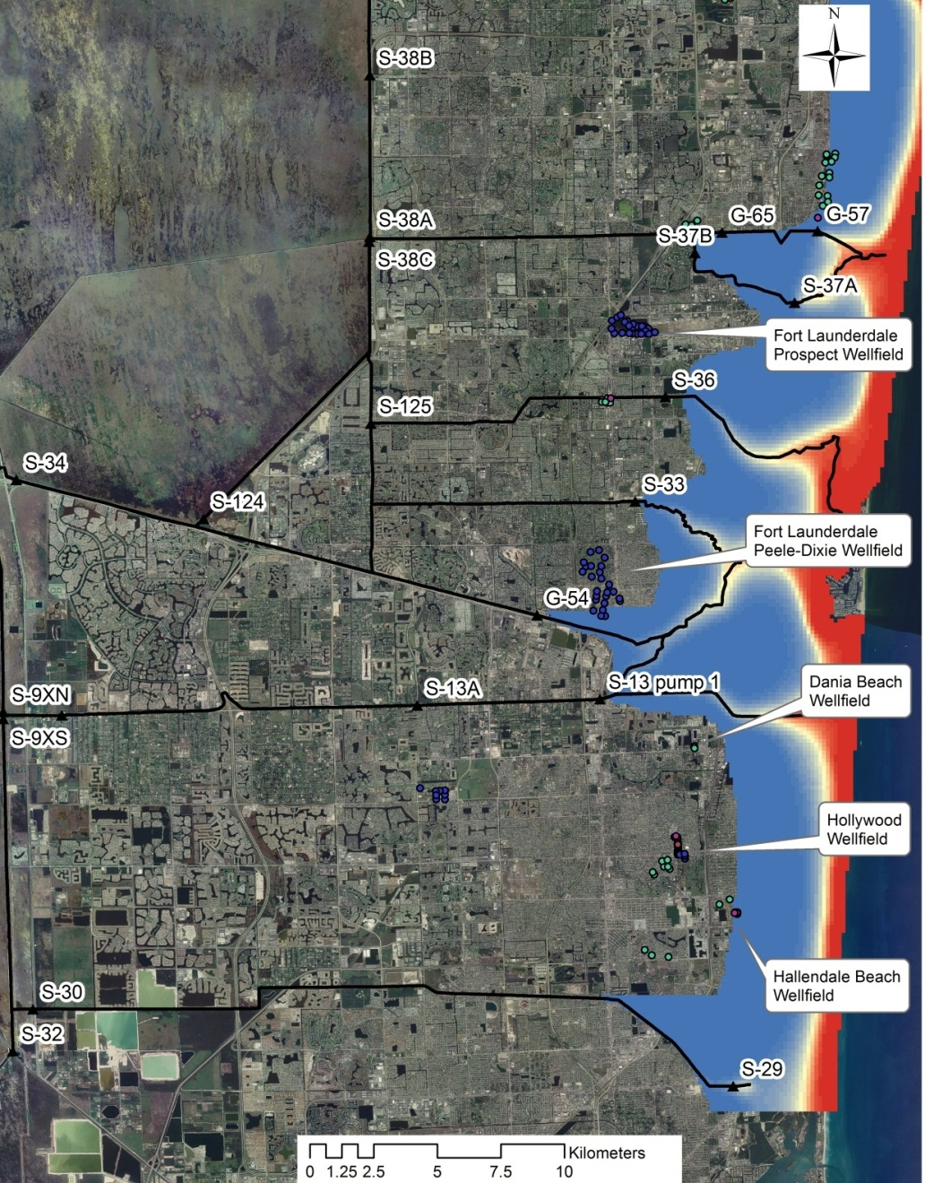
Regional Implementation
Water Quality
Coordinate development of saltwater intrusion baselines through monitoring and for use in model development.
Assess impacts of sea level rise on water supplies and water/wastewater infrastructure.
Regional variable density models are under development

Slide 30
North County Variable Density Modeling
0 cm
24 cm
48 cm
88 cm
Movement of 250 mg/L salt front with varying
sea level rise estimates

Slide 31
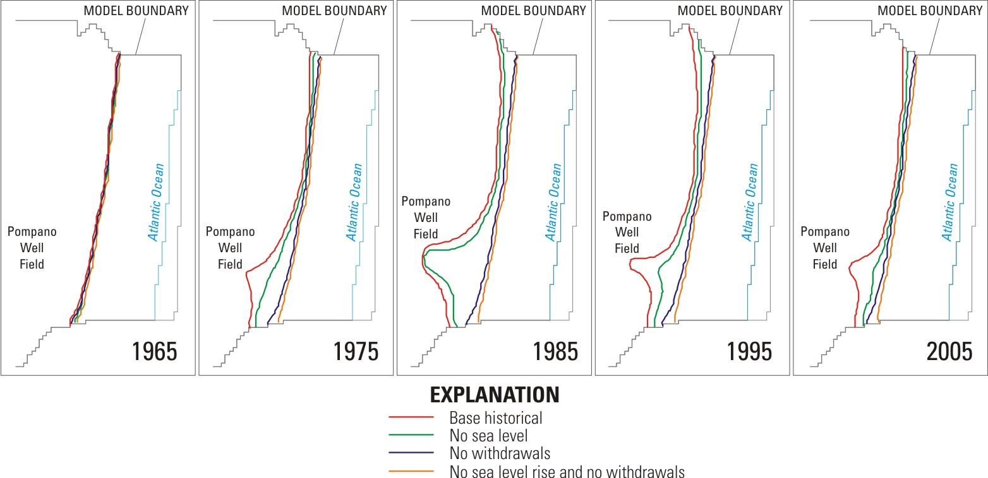
Wellfield Operations and Sea Level Rise
1640 ft
4920 ft
820 ft
Notes:
3 scenarios were formulated to be compared vs the base historical simulation
No sea level rise
No groundwater withdrawals
No sea level rise and no groundwater withdrawals
A qualitative comparison of the position of the saltwater front over time indicates that ground-water withdrawals had a larger effect on saltwater intrusion than sea-level rise
The saltwater front began to intrude in the late 1960s as coastal pumping increased to meet demands from population growth. The greatest encroachment occurred in the mid-1980s, attributable to peak rates of coastal pumping and an extended period of drought.
New production wells were constructed further inland from the Pompano well field in 1984 after increased chloride concentrations were observed in monitoring wells near the well field. By the 1990s, pumping was diverted away from the coast to these additional production wells to reduce drawdown and prevent further saltwater intrusion. The reallocation of pumping (additional wells added in 2001), in addition to periods of above-average rainfall, probably caused the saltwater front to retreat in the late 1990s through 2005.
31

Slide 32
Regional Implementation
Water Management
Develop and apply regional hydraulic and hydrologic models to evaluate influence of changing climate on water management infrastructure and identify adaptation strategies.
Will serve to ensure the maintenance of existing levels of service.
In process of developing integrated models for Broward and Miami-Dade counties

Slide 33
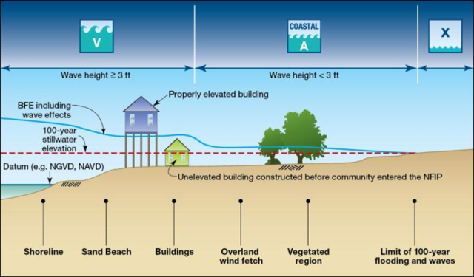
Pending Activities
Refine Vulnerability Maps – use models to evaluate climate impacts on drainage and flood control systems and test adaptation improvements
Utilize Coastal A Zone Flood Map Designations –consider map results in further assessment of coastal vulnerabilities and planning needs.
Generate Community Maps – integrate modeled climate impacts to be used in developing new design criteria for use in water management licensing, transportation planning, and establishment of base floor elevations.
)
Notes:
Even with mitigation, South Florida will need to adapt to certain climate change impacts that are inevitable.
Temperatures over the next century are expected rise from 2 to 10 degrees. However, we are already feeling these effects recognizing that eight of the last ten years have been the hottest on record going back to 1880.
We can also expect and increasing occurrence of extreme weather including hotter summers (Dallas, Texas exceeded 100 degrees F (37.8 degrees C) on 30 of the 31 days during July, 2011.)
Wet seasons will be wetter, dry seasons drier and rainfall will be more spotty. Hollywood rain event in the Dec 2009 where 8-16 inches fell in a period of just over 24 hours
Cold snaps - Jan-March 2010 - 4.5⁰F below average

Slide 34
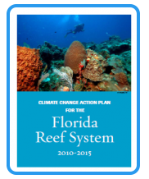
Regional Implementation
Natural Systems and Agriculture
Leverage work of the Florida Reef Resilience Program’s Climate Change Action Plan for Florida’s Coral Reef System 2010-2015 for protection of marine habitat.
Achieve long-term economic vitality and the quality-of-life benefits of management strategies that conserve, protect, and enhance the adaptive capacity of coastal and marine resources.
In the process of convening a regional Interagency Coastal Oceans Task Force

Slide 35
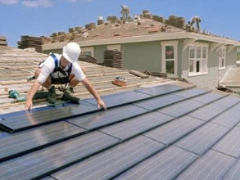
Regional Implementation
Pursue regional energy efficiency financing and advance energy-efficiencies, energy conservation and renewable and alternative energy technologies
Energy Efficiency Finance solicitation posted by Broward County
Electronic permitting for solar projects underway
Energy Efficiency and Renewable
Resources

Slide 36
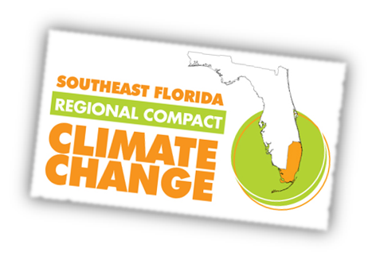
Compact Next Steps
Finalize Action Plan
Expand planning effort to the 7-county region as part of the 2060 Vision and Blue Print for Economic Prosperity
Develop agriculture and public health as separate focal areas
Convene and coordinate regional climate resilience work group
Work collectively on implementation

Slide 37
Questions?

