Slide 1
Groundwater and Surface Water Conditions in Haiti – An Update Since the Earthquake
Presented By Steve Krupa
South Florida Hydrologic Society
November 14, 2012

Slide 2
Haiti Earthquake Facts
Haiti Before the Earthquake
Haiti was 145th of 169 countries in the UN Human Development Index, which is the lowest in the Western Hemisphere
More than 70% of people in Haiti were living on less than $US2 per day
86% of people in Port au Prince were living in slum conditions - mostly tightly-packed, poorly-built, concrete buildings.
80% of education in Haiti was provided in often poor-quality private schools, the state system generally provided better education but provided far too few places
Half of people in Port-au-Prince had no access to latrines and only one-third has access to tap water
http://www.dec.org.uk/haiti-earthquake-facts-and-figures

Slide 3
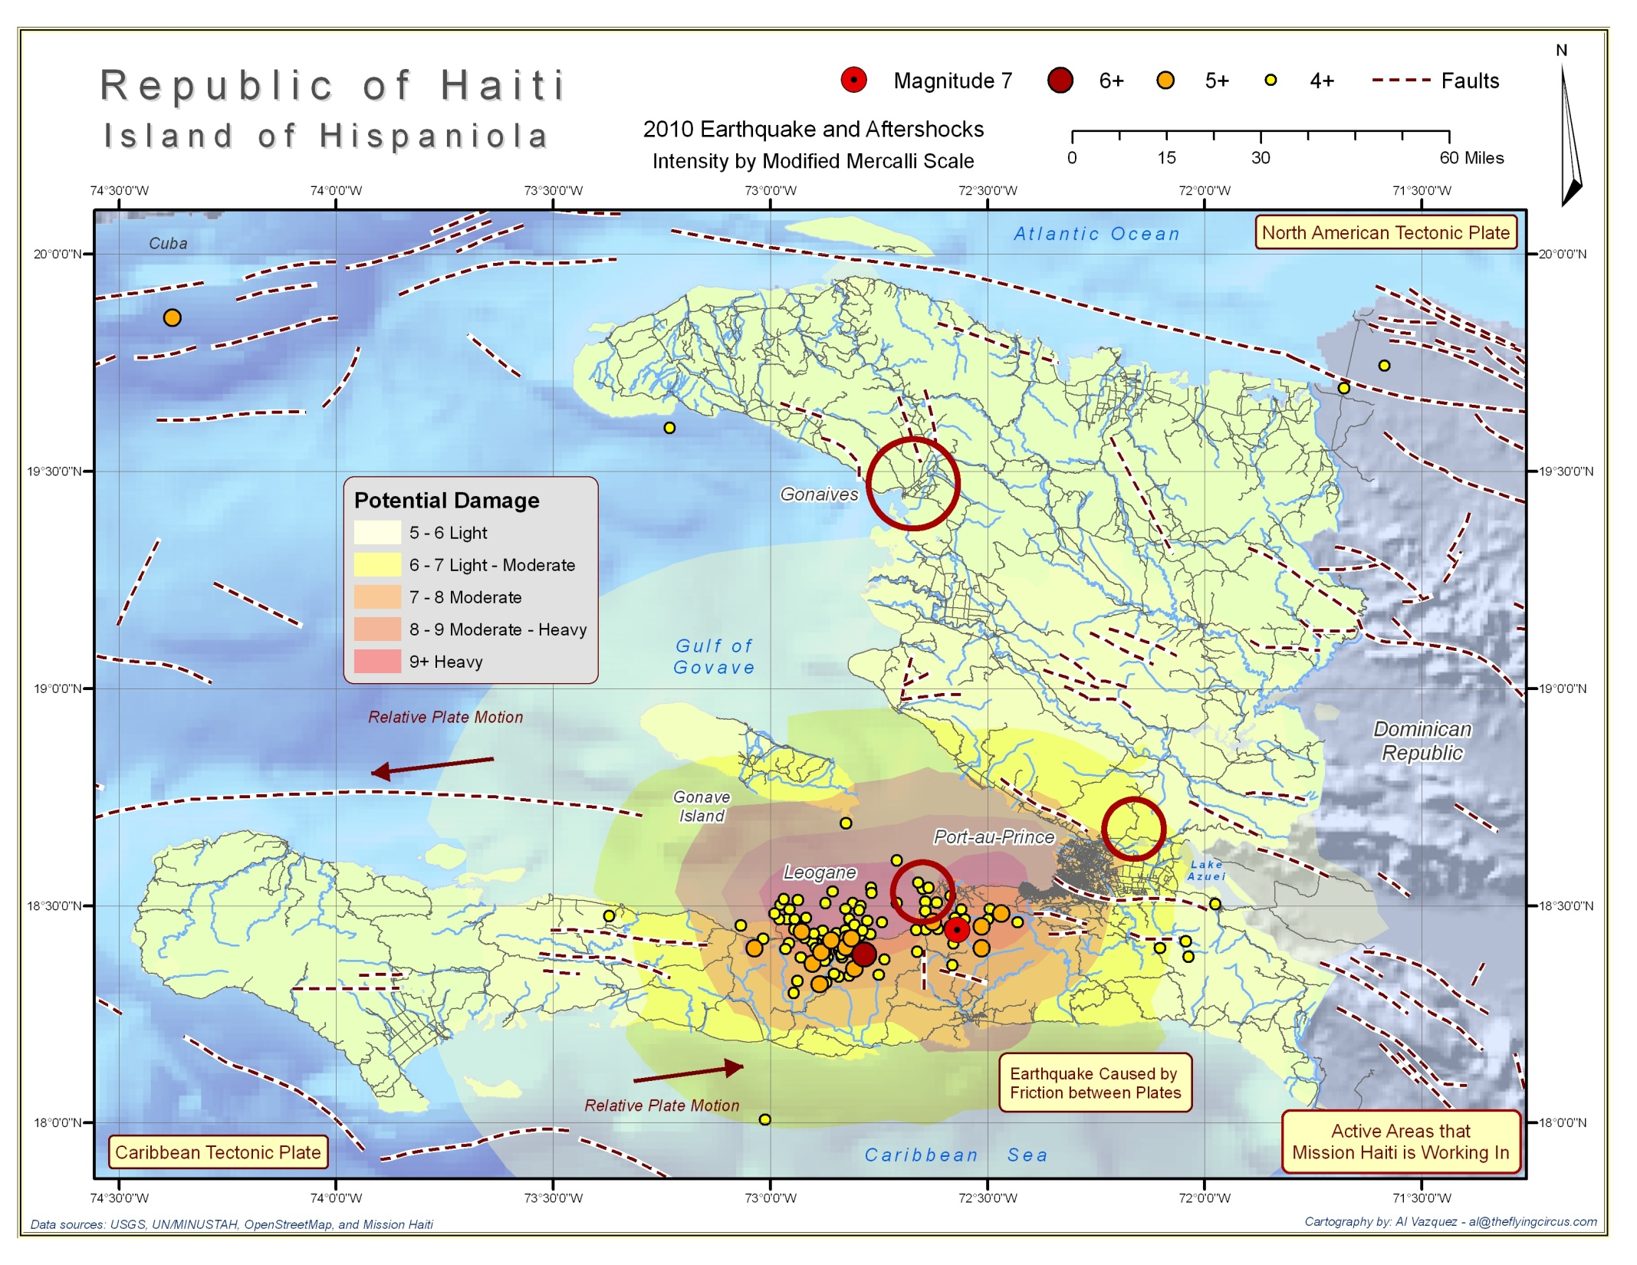

Slide 4
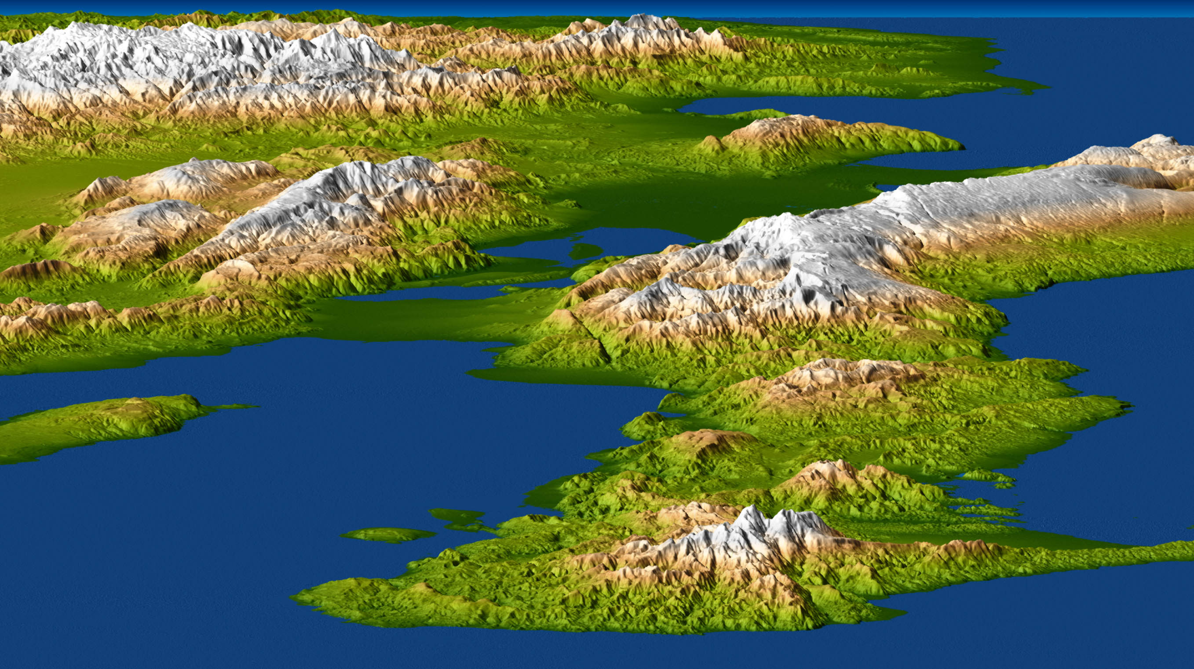
Orthographic View of Haiti and the Dominican Republic
Source: Shuttle Radar Topography Mission
Dominican Republic
Port-au-Prince
Area
Enriquillo-Plantain Garden fault zone (EPGF)

Slide 5
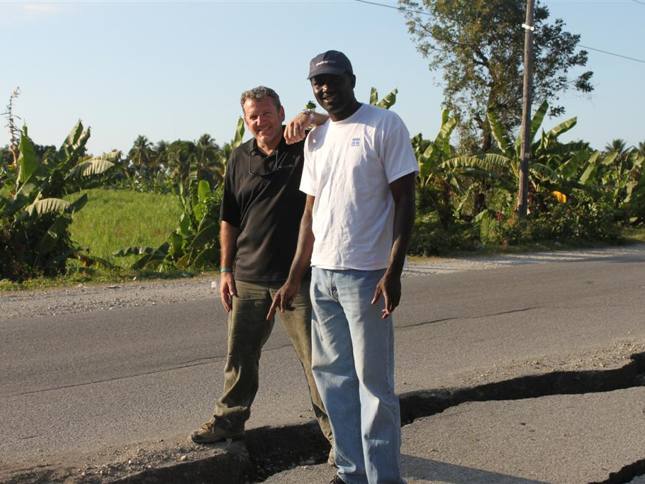
Standing on the Surface Expression of the Enriquillo-Plantain Garden fault zone (EPGF)
Standing on the North American Plate (?)
Standing on the Caribbean Plate (?)

Slide 6
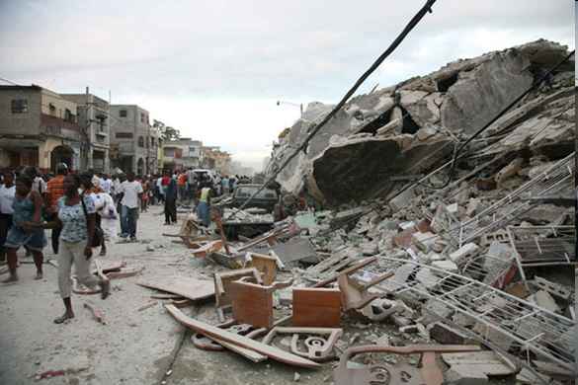
The Haitian Earthquake Occurred at 16:53
Local Time (21:53 UTC) on Tuesday, January 12, 2010
Nearly Total Destruction in Many Locations
http://www.justfocus.org.nz/wp-content/uploads/2010/01/haiti-earthquake.jpg

Slide 7
Impact of the 12 January earthquake
7.0 Magnitude Quake struck near Port au Prince
3,500,000 people were affected by the quake
220,000 people estimated to have died
300,000+ people were injured
Over 188,383 houses were badly damaged and 105,000 were destroyed by the earthquake (293,383 in total), 1.5m people became homeless
After the quake there were 19 million cubic metres of rubble and debris in Port au Prince – enough to fill a line of shipping containers stretching end to end from London to Beirut.
4,000 schools were damaged or destroyed
25% of civil servants in Port au Prince died
60% of Government and administrative buildings, 80% of schools in Port-au-Prince and 60% of schools in the South and West Departments were destroyed or damaged
Over 600,000 people left their home area in Port-au-Prince and mostly stayed with host families
At its peak, one and a half million people were living in camps including over 100,000 at critical risk from storms and flooding
Unrelated to the earthquake but causing aid response challenges was the outbreak of cholera in October 2010. By July 2011 5,899 had died as a result of the outbreak, and 216,000 were infected

Slide 8
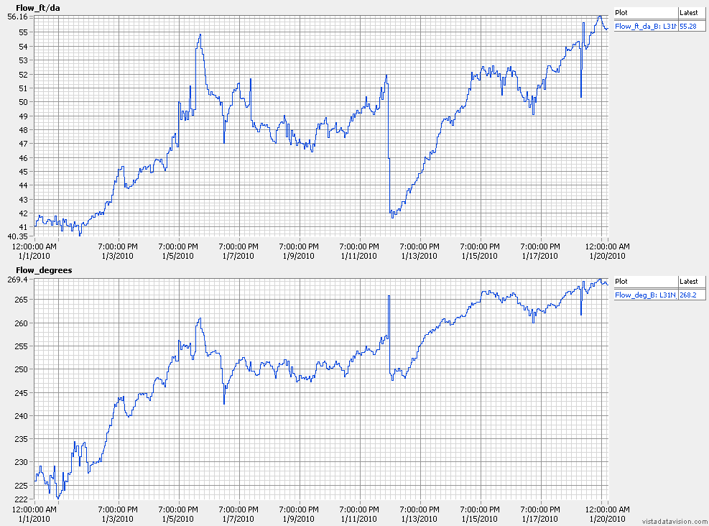
Influence of Haiti Earthquake on 12 Jan 2010 1653 on
Groundwater Flow Velocity and Direction – West Miami Well L31NN_B
12 Jan2010 1730
J.Brock/S. Krupa – Provisional Data

Slide 9
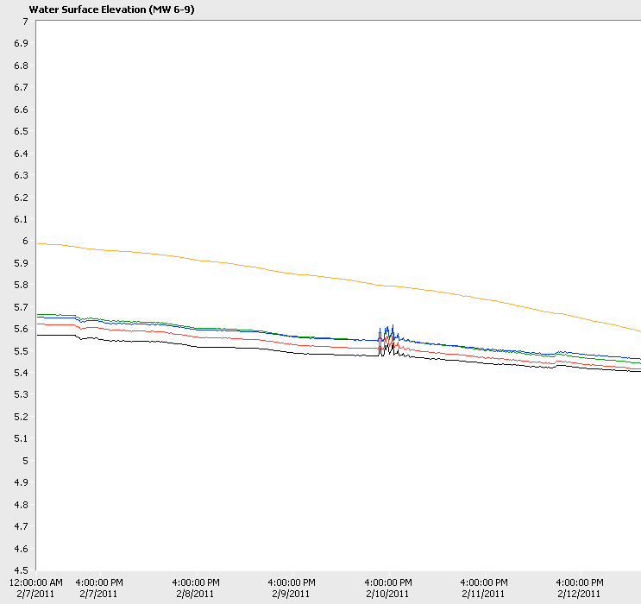
All Monitoring Wells Showed the disturbance, but
Surface water (amber) did not

Slide 10
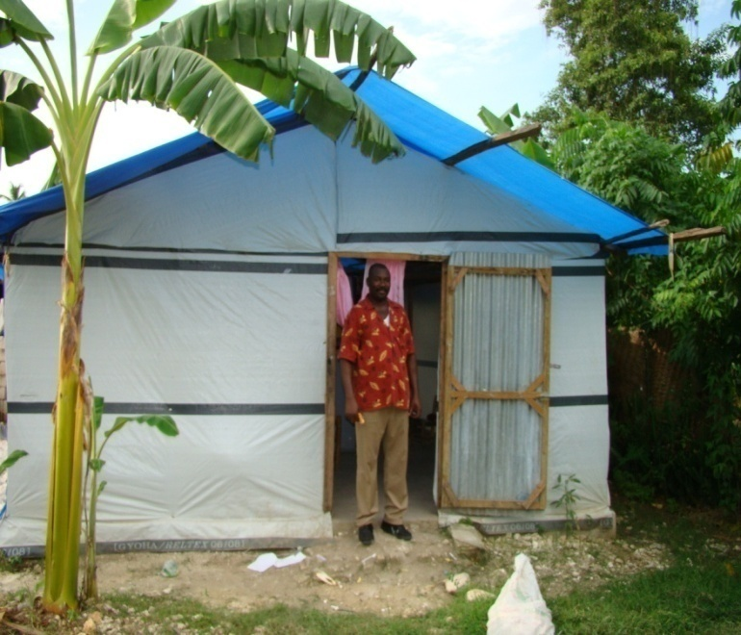
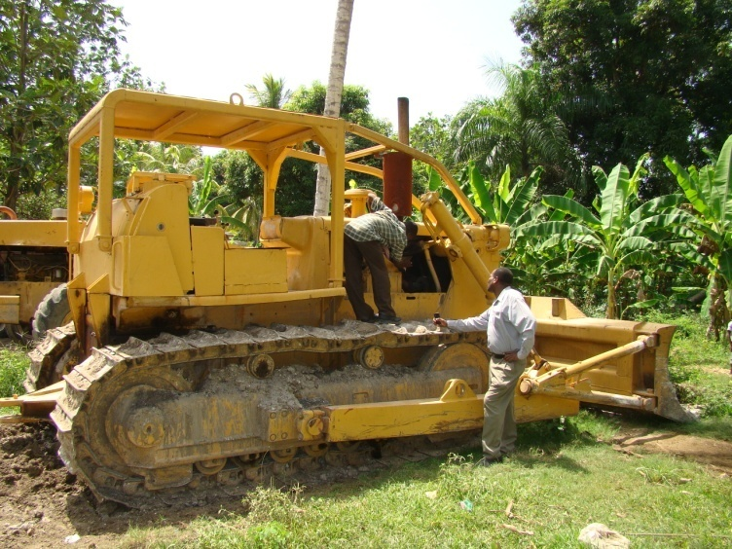
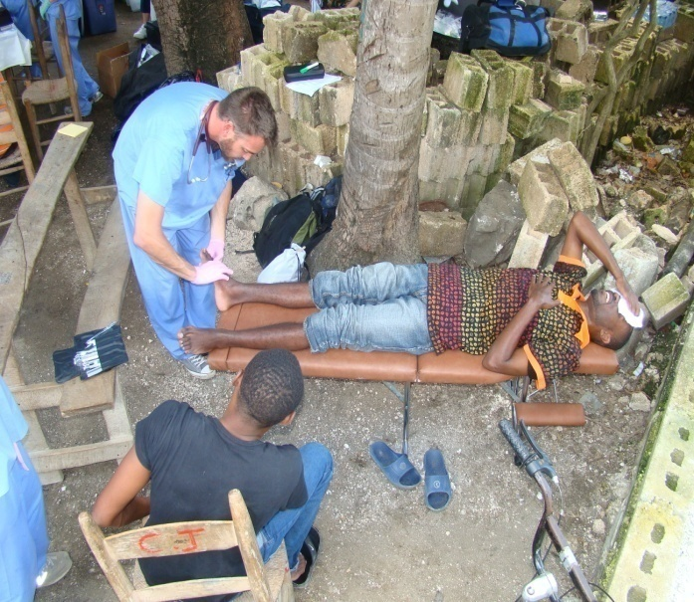


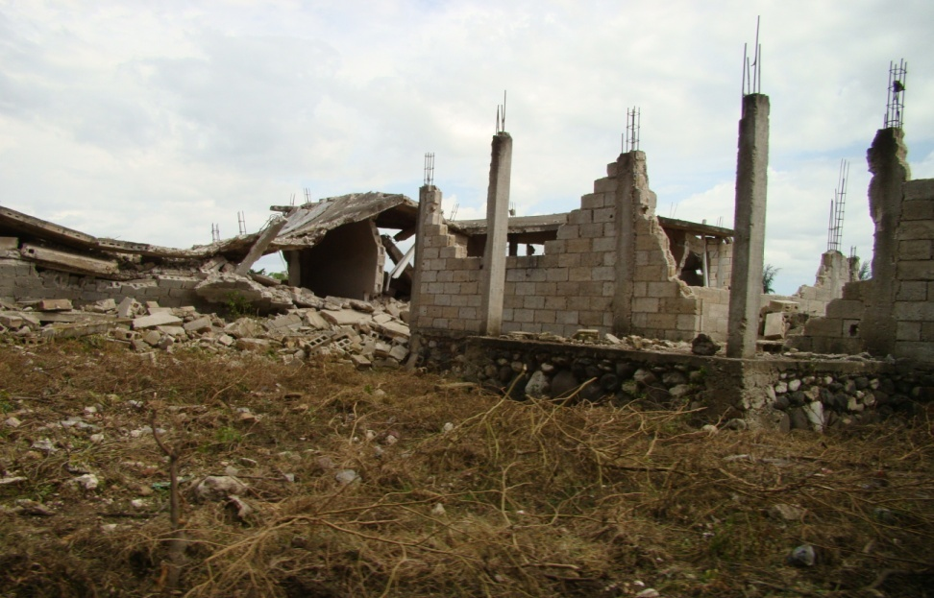
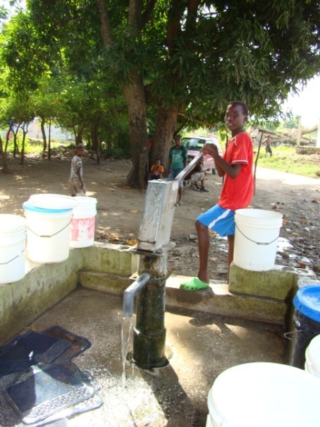
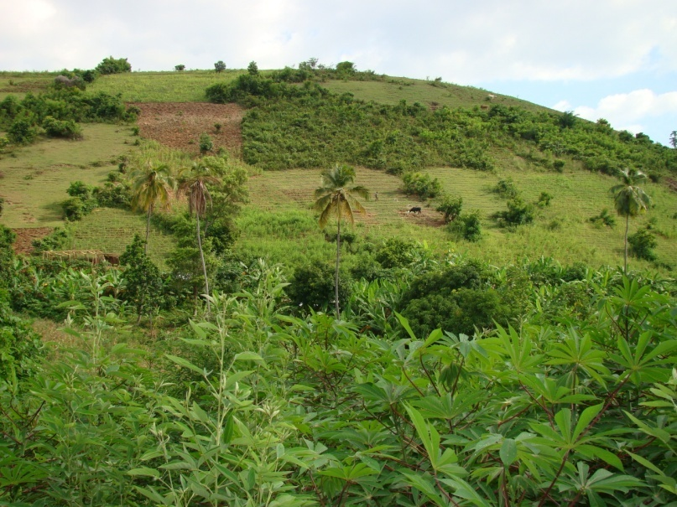
Mission: Haiti
Pastor Wilson’s
Temporary House
Earthquake Cleanup
Medical Help
By Steve Krupa
March 23, 2011
95 Percent Destruction
in Leogane
Clean Water
Deforestation

Slide 11
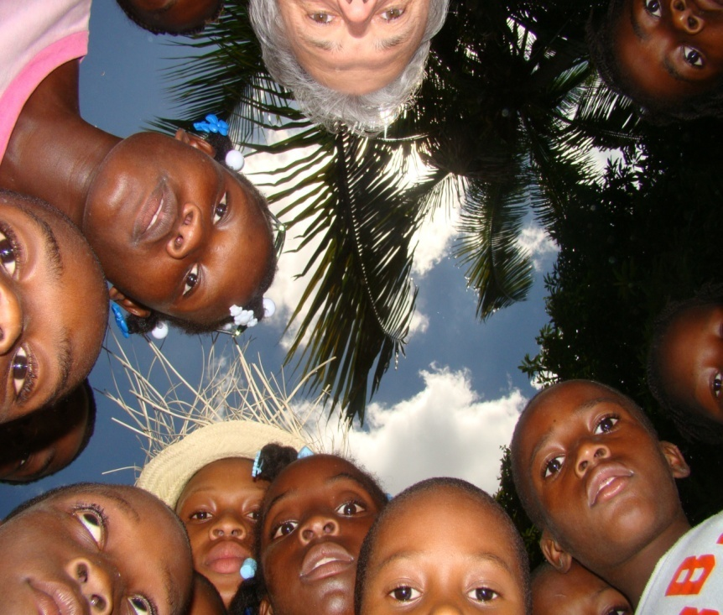
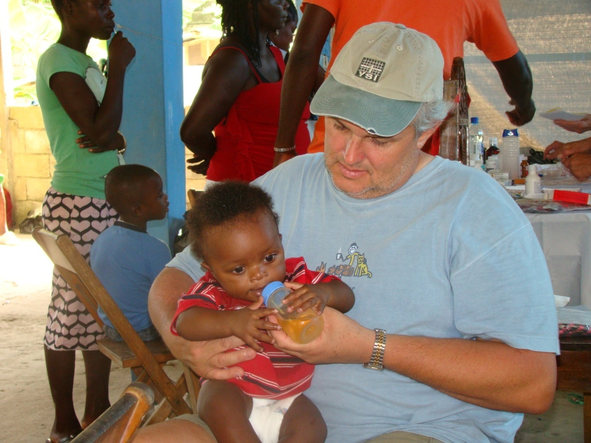
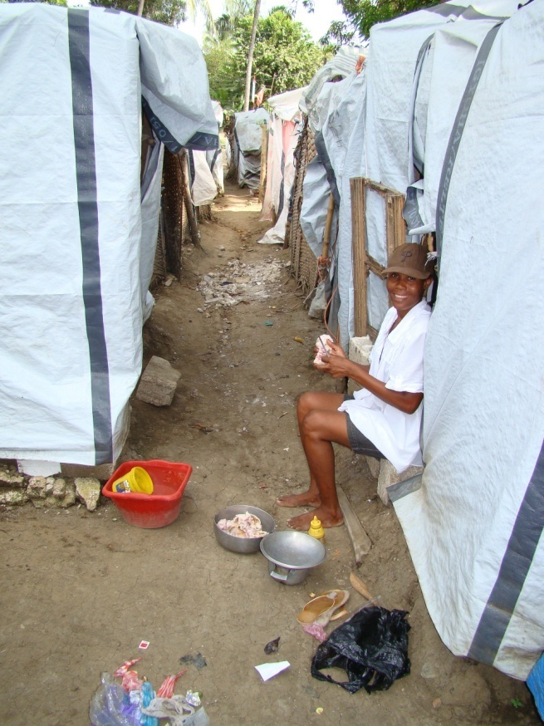
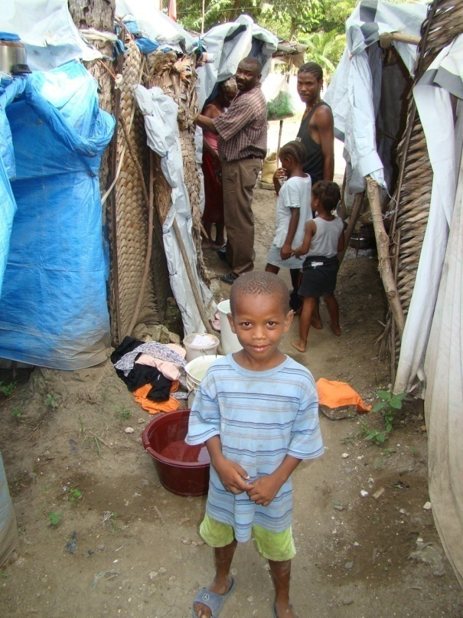
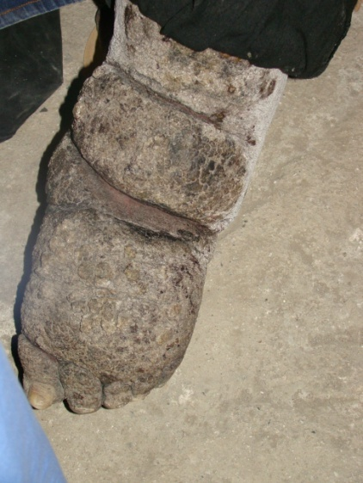
Just being kids
Dehydration and skin infections
Preparing dinner
Pig Skin Soup
Elephantiasis on a young
woman’s left leg
Life in the tent city

Slide 12
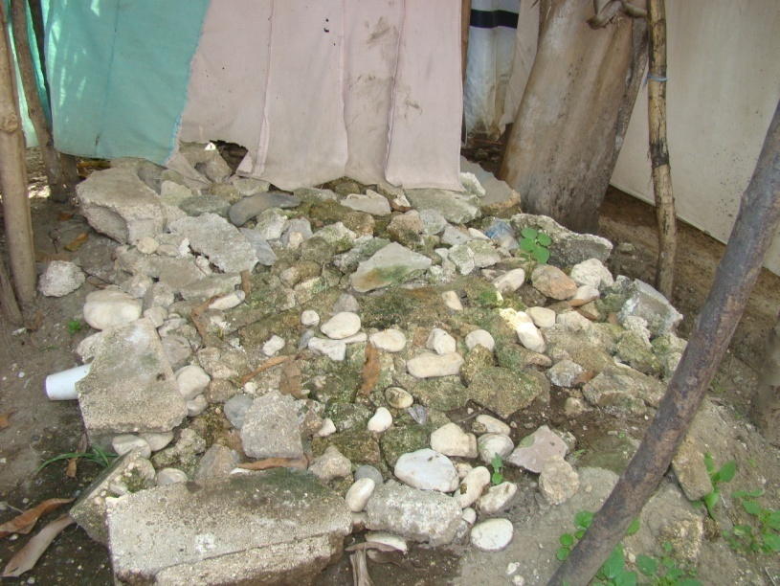
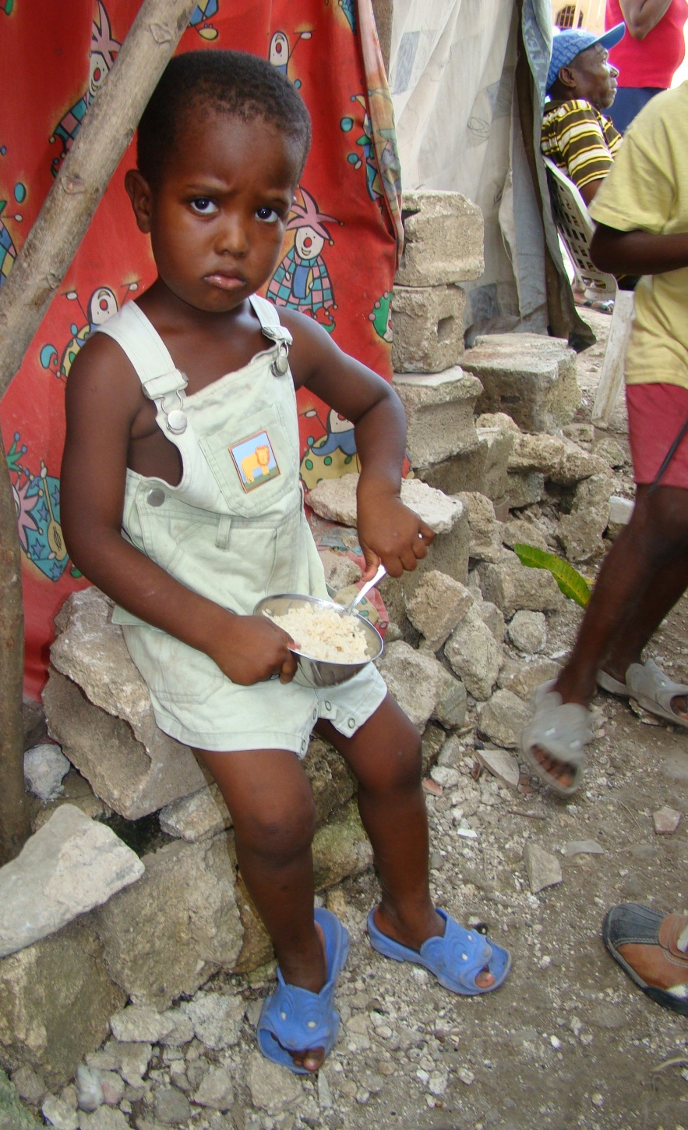
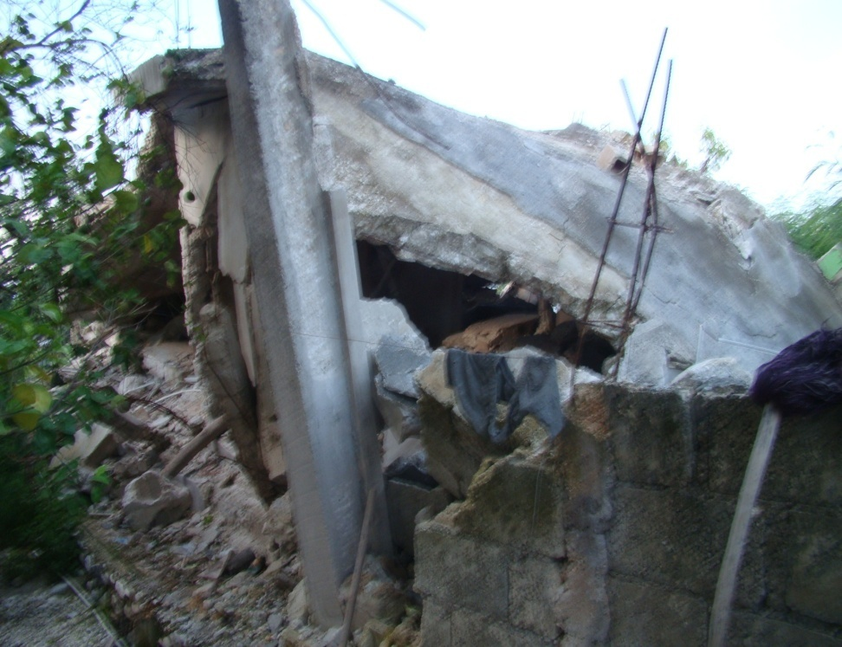
Someone’s raised area for a bed in the tent city; Flooding in low lying tent area is a problem
Young girl having porridge for dinner in the tent city
Homes destroyed

Slide 13
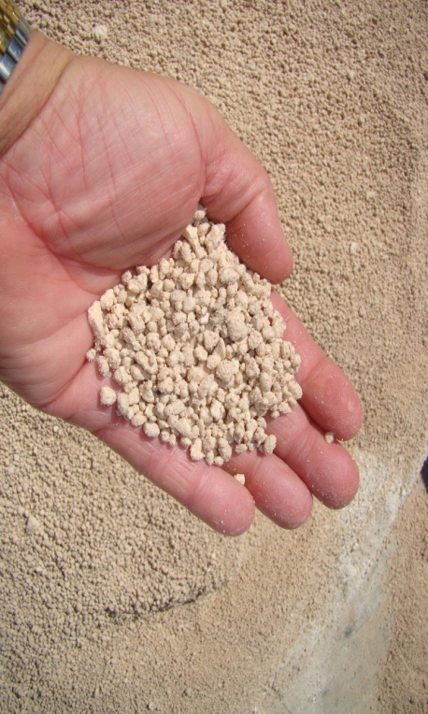
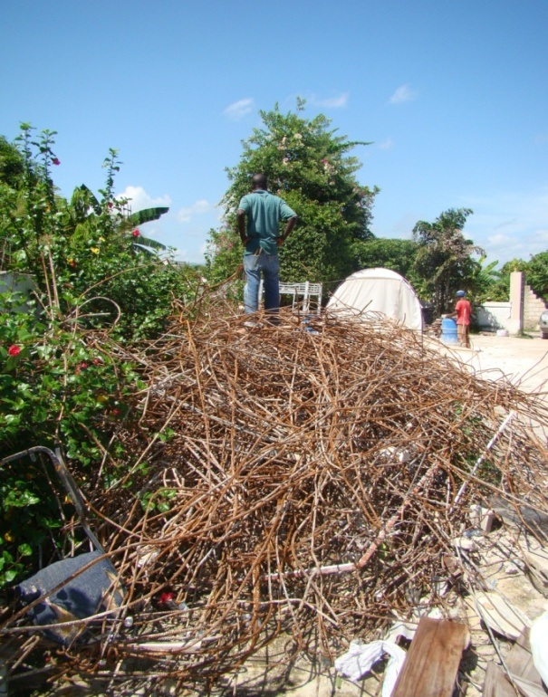
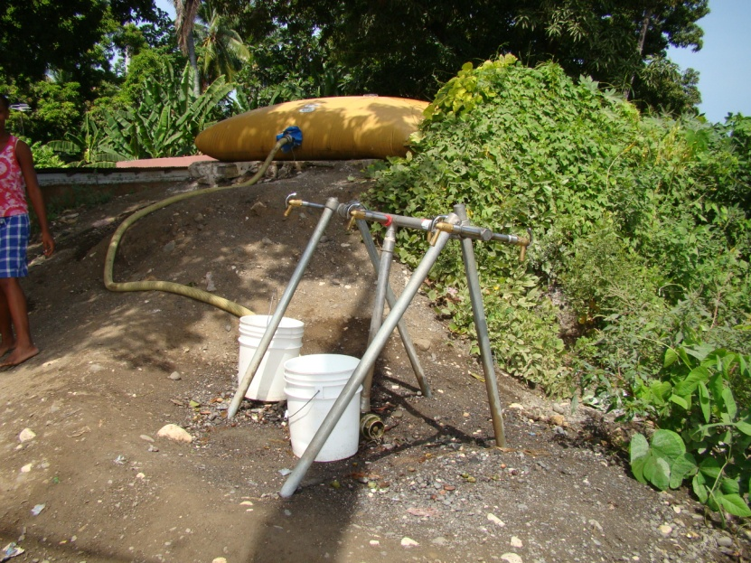
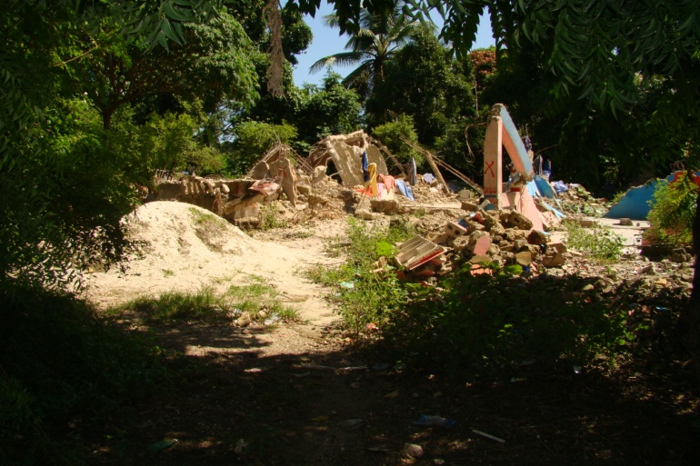
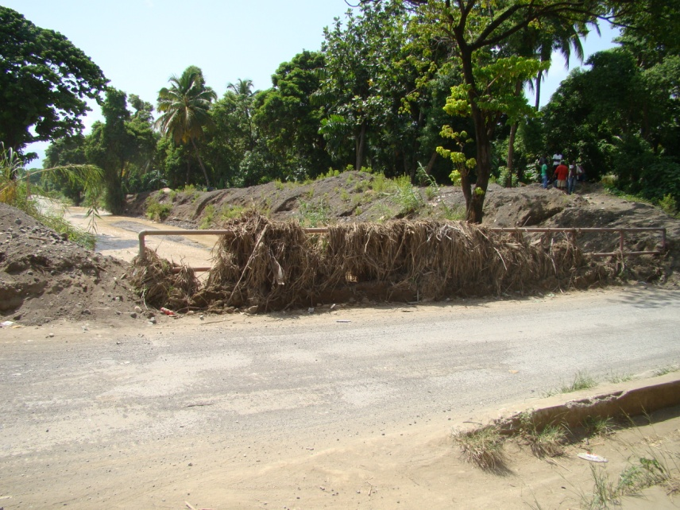
Oolitic limestone sand for cement
Reinforcing bar salvaged for re-use
Temporary drinking water
bladder and manifold setup
River overflow evidence -reminder of massive floods
to come, Leogane
A house: completely demolished

Slide 14
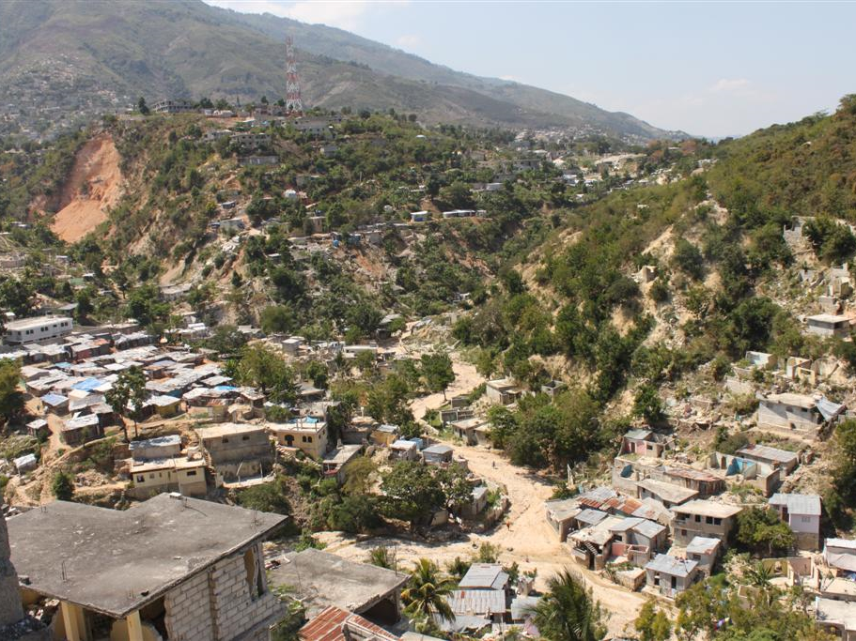
Construction is done as an ad-hoc process
There is no real entity for management of the watersheds
There is no protection of the watersheds
Aimond Alexis

Slide 15
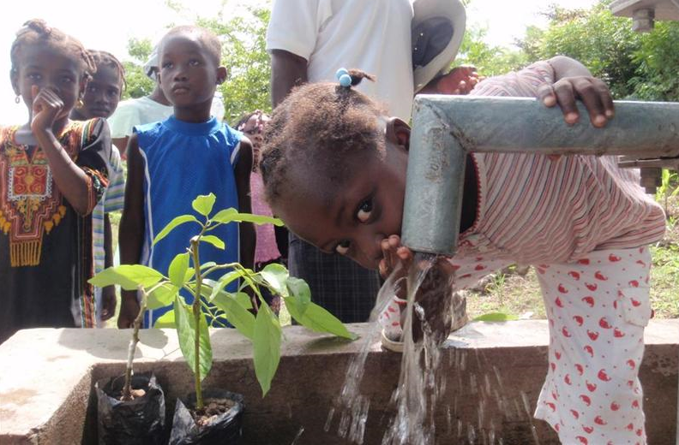
Haiti Clean Water Project
Notes:
The Haiti water project is the result of bringing together prior activities and personal concerns of Rick Miessau, Steve Krupa and Aimond Alexis. May 5, 2011

Slide 16
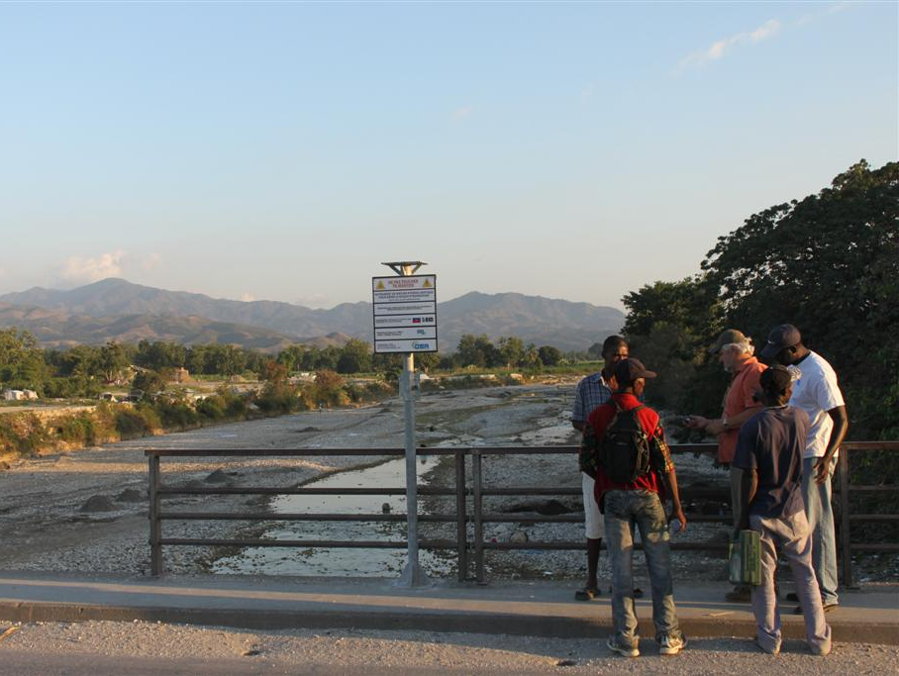
FOCUS of OUR INVOLVEMENT
Lack of access to potable water
Lack of sanitation and hygiene
Half of the population live under primitive conditions
Food and waterborne diseases kill more than 10% of the kids
Common waterborne diseases:
a) bacterial and protozoal diarrhea
b) hepatitis A and E
c) typhoid fever
d) dengue fever and malaria (very common)
e) leptospirosis (very prominent water contact diseases)
Aimond Alexis

Slide 17
Well Construction and
Drinking Water
Contamination
In Haiti

Slide 18
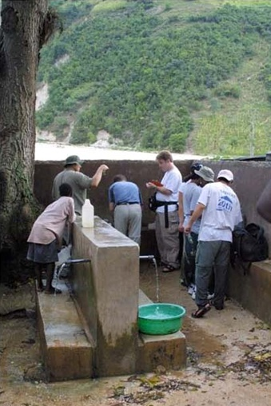
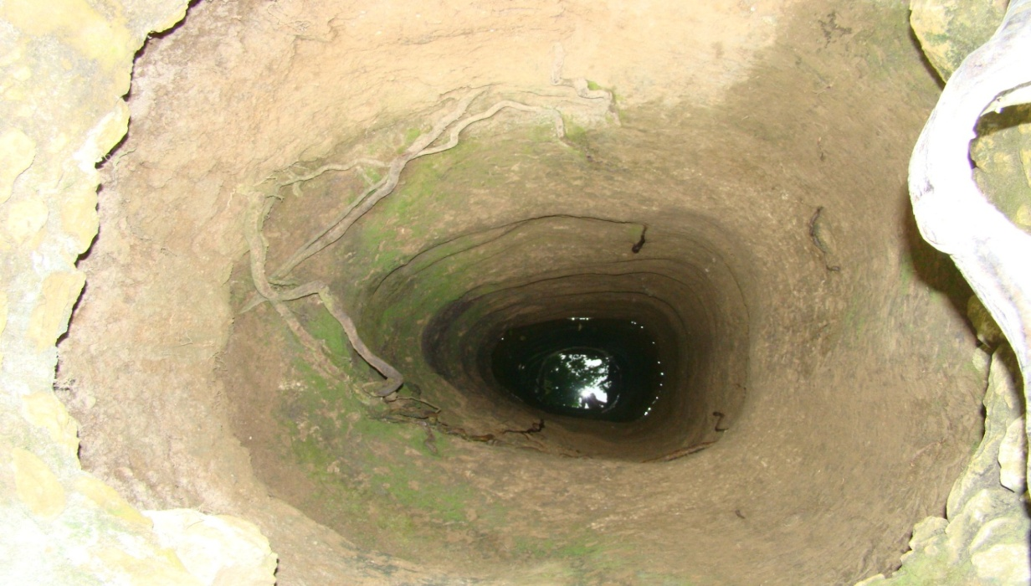
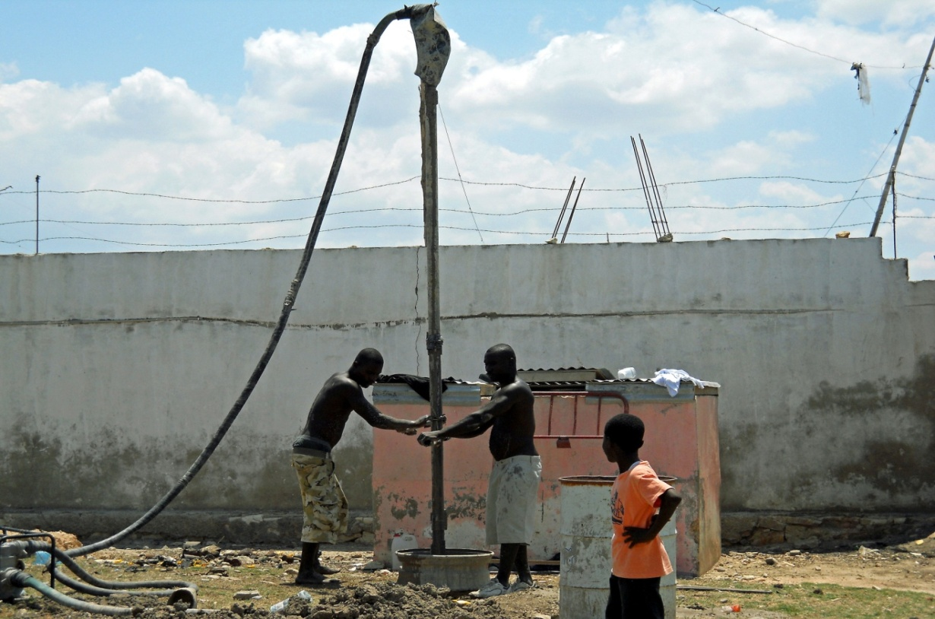
Hand Dug Well - Flat Side Was Where the Persons Back Was While Digging the Well, Near Leogane
Sampling of A Natural Spring In Port Au Prince
43 feet Deep
Basic Drilling Well Installation Methods - Brut Force Method
(Boardman et al; 2002)

Slide 19
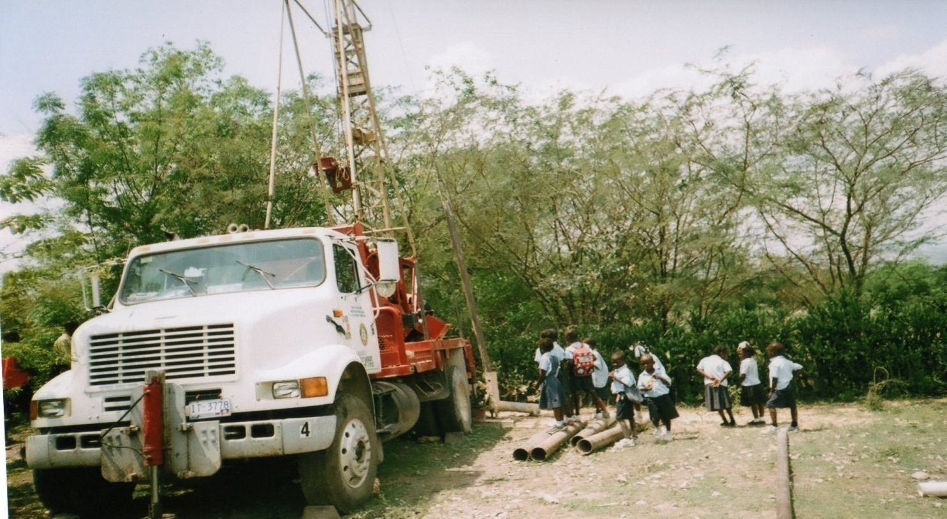
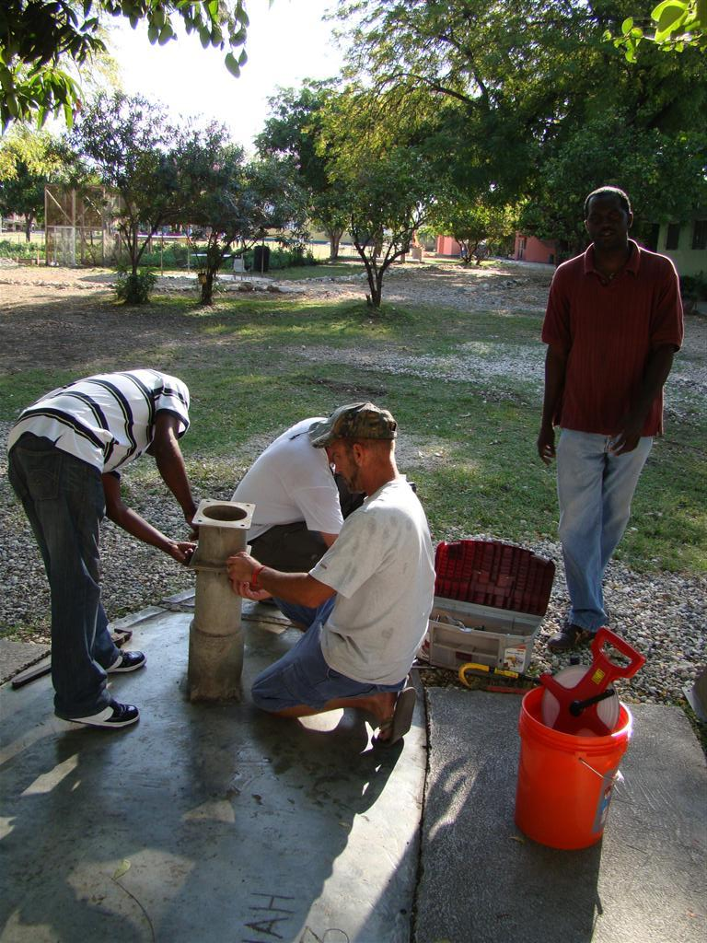
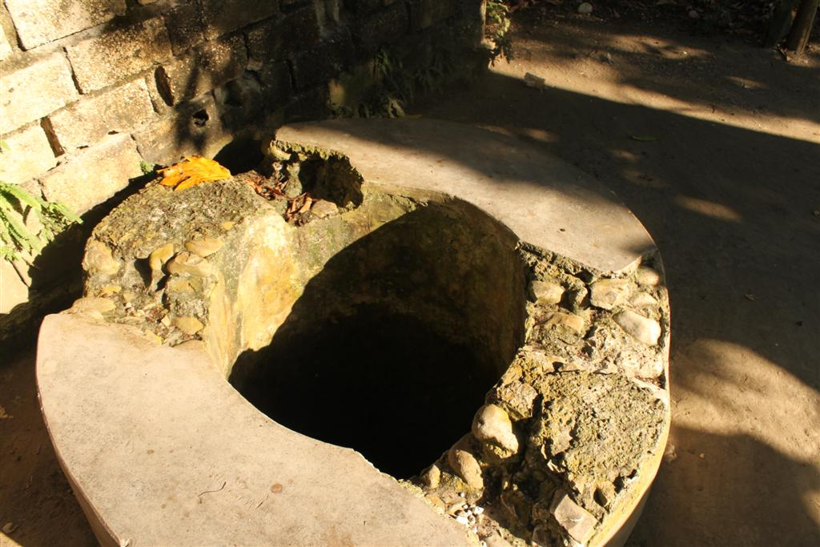
Working On A Well Head/Pump in New Life Orphanage, Port Au Prince
Drilling the Well at the Verrettes School
Hand Dug Well With Standing/Bathing Area – Cross Contamination

Slide 20
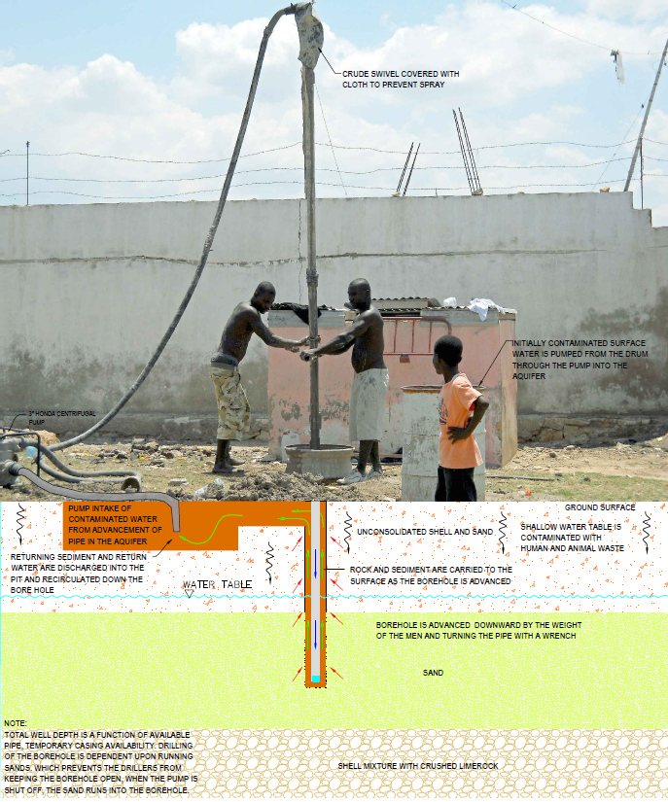
Trying to Drill A Shallow Groundwater Well at The Star Orphanage In Gonaives

Slide 21
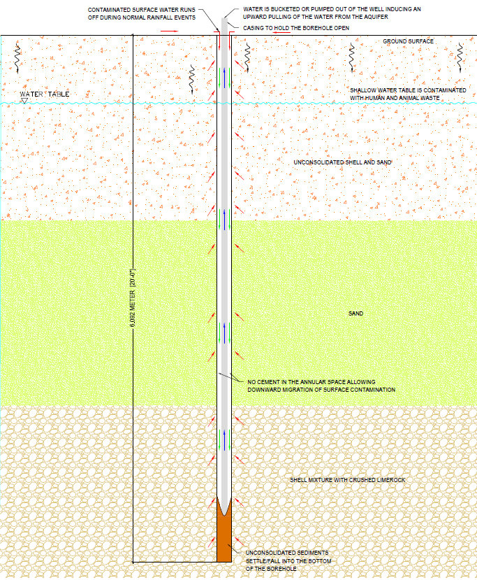
Poor Well Construction Techniques – A Decadal Disaster

Slide 22
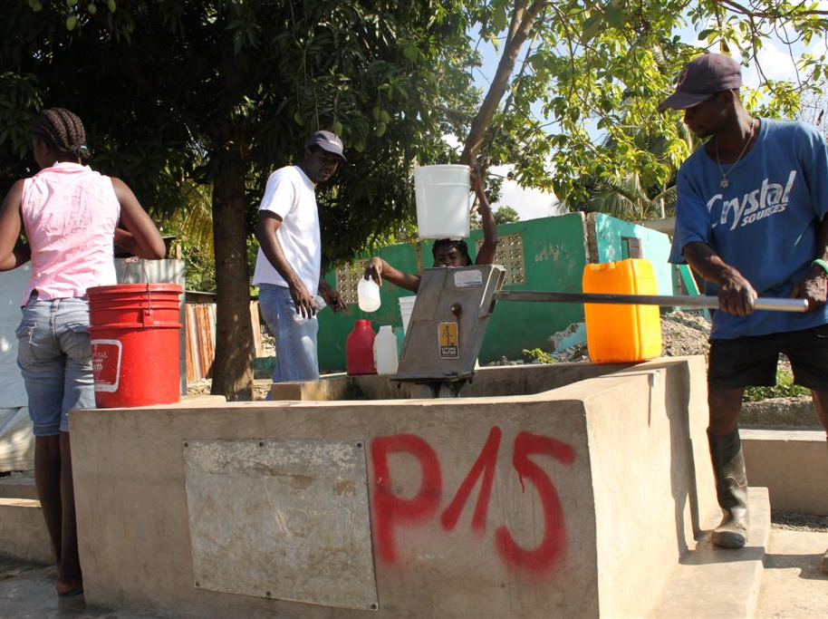
Field Water Quality Testing
Sites:
19 Wells
Port au Prince (5)
Verrettes (2)
Gonaives (5)
Leogane (2)
Carreffour Dufort (5)
Field Parameters:
Temperature, Specific Conductivity
Total Well Depth, Depth to Water
GPS Coordinates
Total Coliform
E.Coli
Pathogens

Slide 23
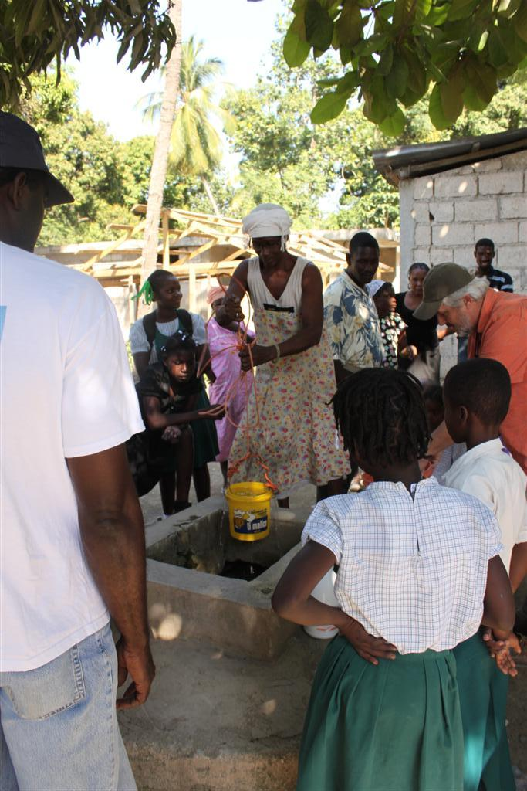
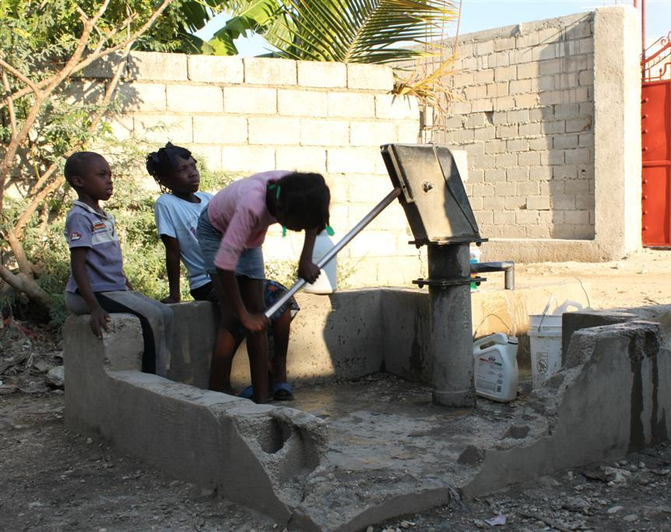
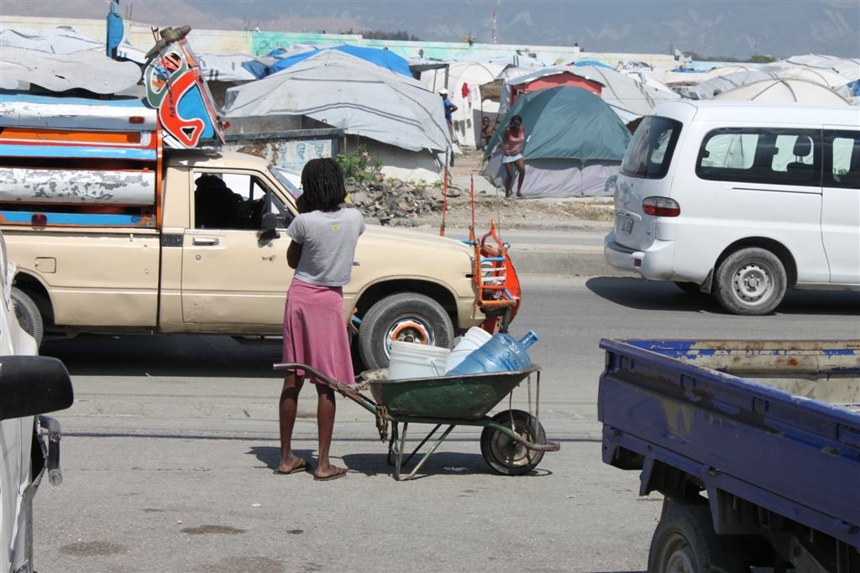
Daily Pumping of one of the Many Wells for Drinking and Bathing
Well Elder Showing How She Collects Water from the Well
Hauling of Collected Water

Slide 24
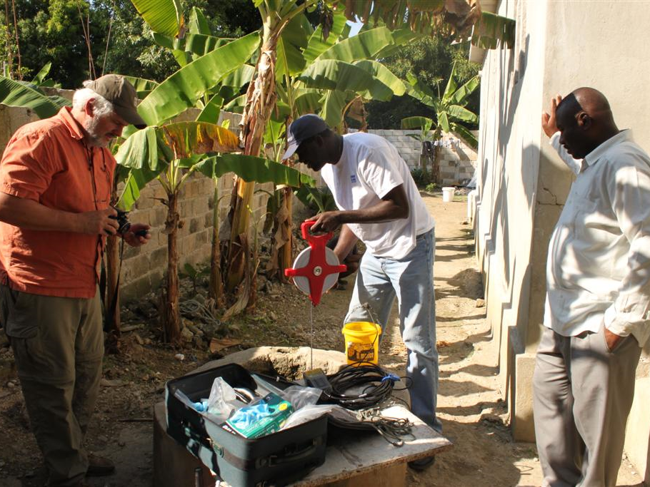
Testing a Well for Field Parameters and Water Quality at the Orphanage in Leogane

Slide 25
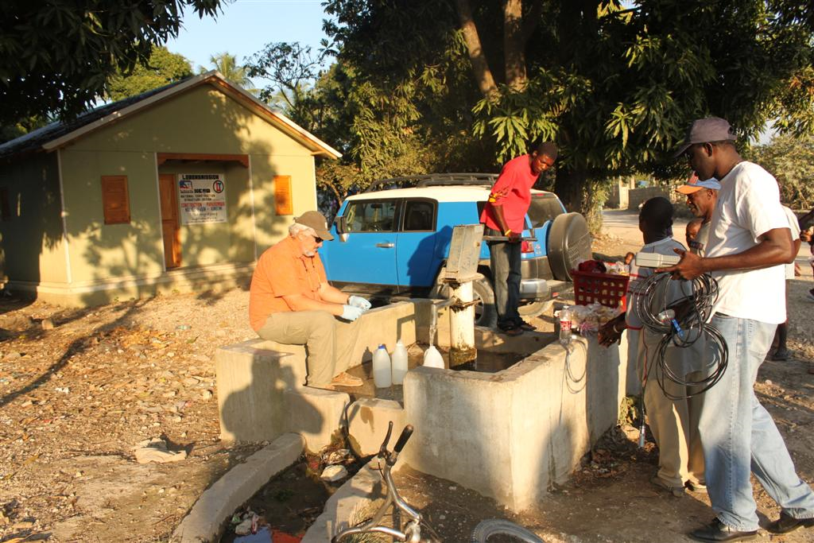
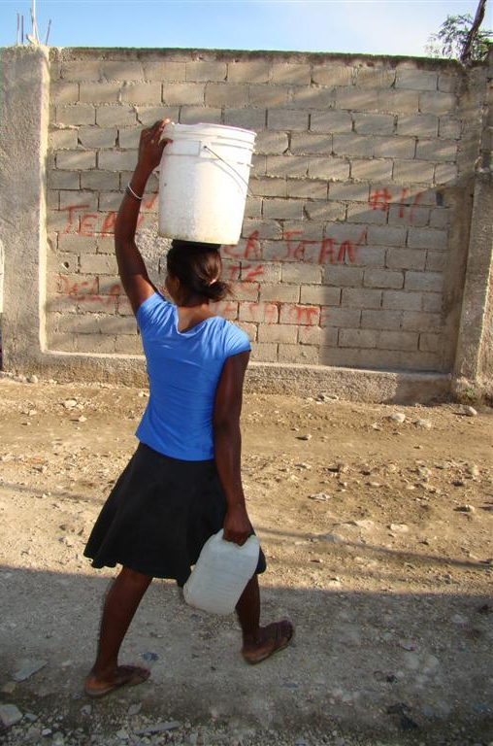
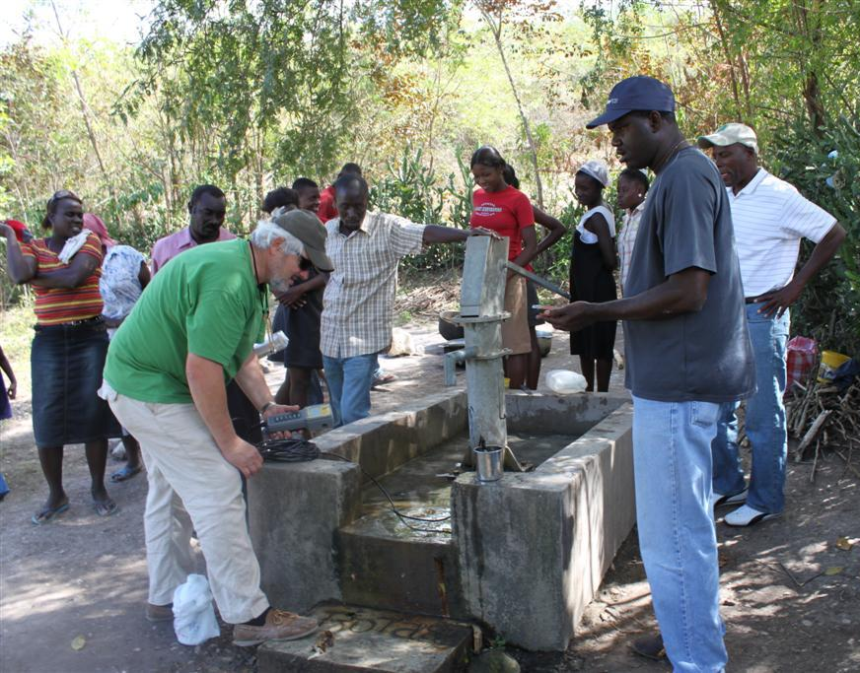
Bacteriological Testing of Drinking Water Wells
Checking Basic Water Quality and GPS’ing Well Locations In
Over 60 percent of the time is spent getting drinking and bathing water

Slide 26
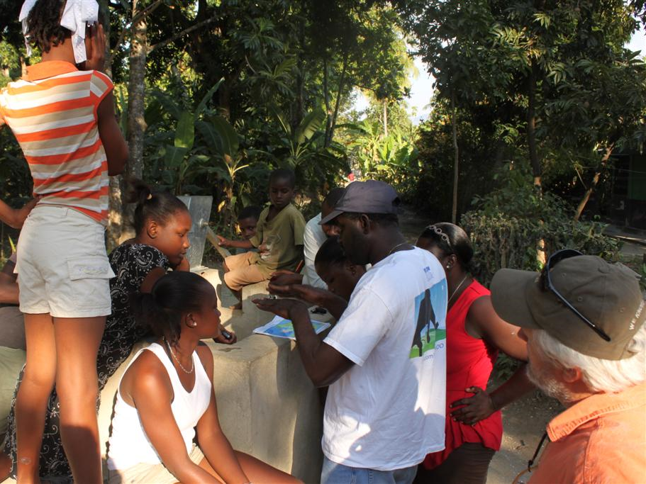
Wherever We Went We Educated and Explained the Importance of Hygiene, Having Clean Water To Drink and the Earthquake. We Tested Each of the Wells at These Locations

Slide 27
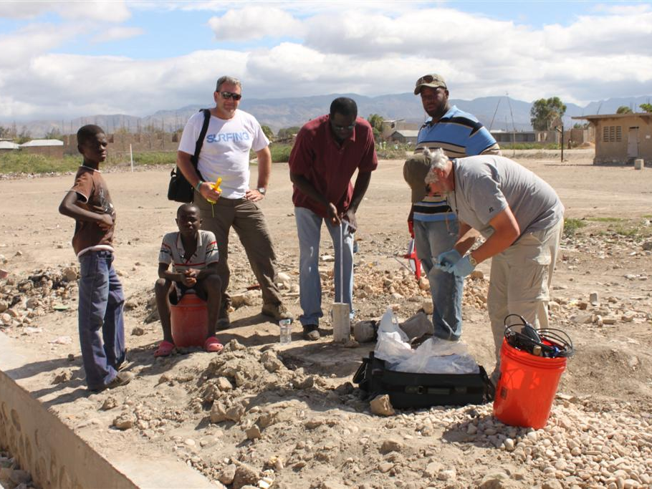
Testing a New Well Outside of Star Orphanage in Gonaives

Slide 28
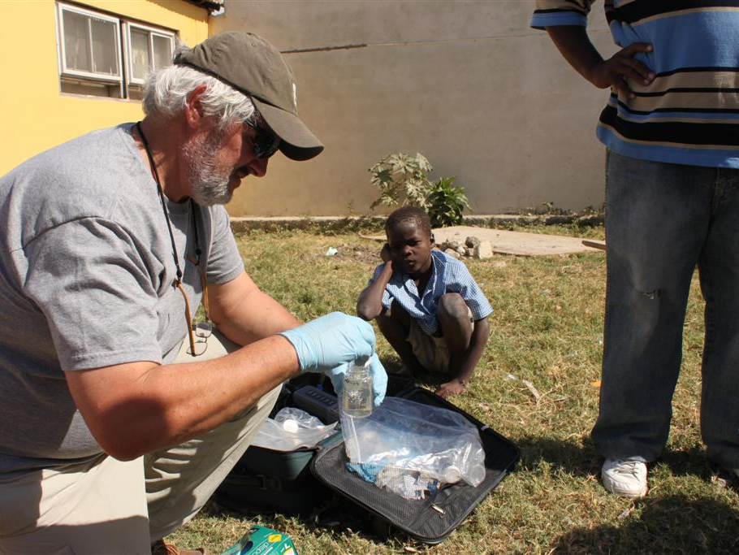
IDEXX Colilert Testing at the Star Orphanage in Gonaives

Slide 29
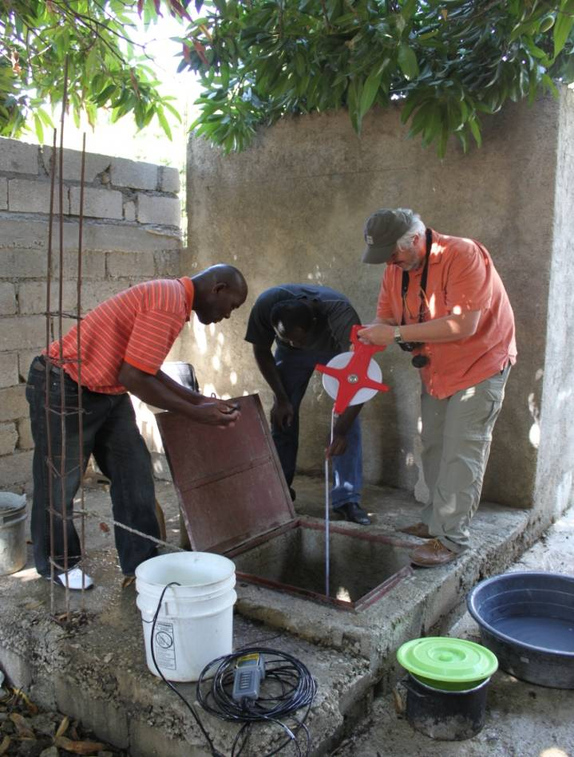
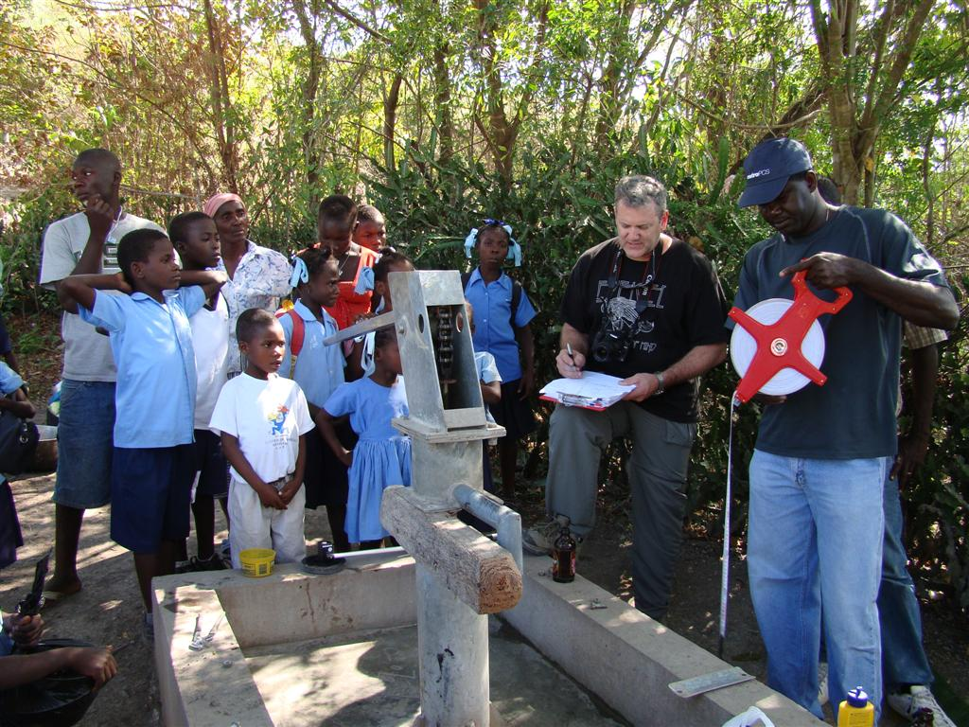
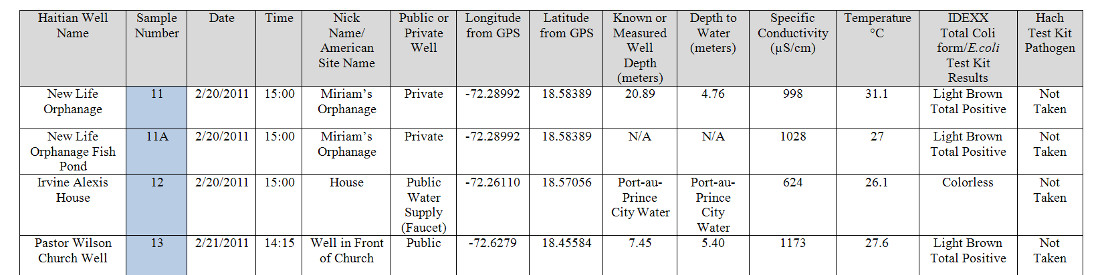
Collecting and Documenting Water Quality with YSI Donated Equipment from a Hand Dug Well, Port Au Prince
Collecting and Documenting Water Quality from a Machine Drilled Well Near Verrettes

Slide 30
What Primary Groundwater Issues
Do The Haitian People Have?
Chloride and Sodium Concentrations –
Saltwater
Contamination By Human and
Animal Waste

Slide 32

Visual Comparison of IDEXX Colilert
Water Quality Samples
1
2
3
4
5
6
7
8
9
10
11
11A
12
13
14
15
16
17
18
19
More than 60 % of the samples taken had confirmed hits of Total Coliform with at least 7 with E.Coli
Samples Taken While In Haiti
Towns of Verrettes, Port-au-Prince, Gonaives and Leogane
Aimond Alexis, Rick Miessau, and Steve Krupa
Samples taken
February 17, 2011, to February 23, 2011
March 2, 2011
Steve Krupa

Slide 33

Close Up 1st Sampling Event Results from February 17-23, 2011
Close Up Of Selected Colilert Results and Hach Pathoscreen Results (Black Vile)

Slide 34


Close Up 2nd Sampling Event Results from January 13-19, 2012
All 11 samples showed signs of bacteria contamination

Slide 35

Schematic Of Well Disinfection Equipment Sent to Haiti
November 3, 2011
Haiti Lutheran Ministry and Mission Society, Mission:Haiti and Epiphany Lutheran Church
Carrying Tubes for Tremie Pipe,
Short Pipes and Flexible Hoses
Clean 5 gallon Bucket for
Mixing Bleach With Water
Water Quality Test Kits
Temporary Well Closure Tools
Flexible Discharge-
Recharge Hoses
See Detailed Picture 2
Recharge-Discharge Quick
Connects
And Extra Pieces
See Detailed Picture 1
Flowmeter to Measure
Inflow and Outflow
Check Valves, Gate Valve,
Connectors, Turning Handle
and Extra “O” rings
Safety Gas Can
125 feet of ¾ Inch; 5 feet length. Threaded
Tremie Pipe. Threaded To Allow Rapid Removal and
to be able to Carry in a Plane or Vehicle
2 & 4 Inch
Well Brushes
and Adapters
Tool Box to Carry
Fittings and Brushes
¾ Inch Threaded Short & Long
Tremie Pipe Extensions
WB 15 Honda
Water Pump
Steve Krupa
November 3, 2011
Version 1.1

Slide 36

Results from
January 13-19, 2012

Slide 37

Disassembled Well by Hand

Slide 38



Slide 39


Repairs & New Parts

Slide 40

Cleaning the Well

Slide 41

Drilling Sludge

Slide 42

Chlorinating the Well

Slide 43

Mission Completed

Slide 44

Good Samaritan School &
Drinking Water Well Project
Verrettes
Notes:
44
Good Samaritan School in Canaue Verrettes was start in 2007 by Pastor Ezichiel Prophet, a Haitian pastor now living in West Palm Beach and Fr. Ralph Warren from Bethesda by the Sea.
The school provides free education and lunch to 100 students every day. The students come from the surrounding villages where they live without running water nor electricity.

Slide 45

Plans for installing running water and electricity will be provided via a solar panel and above ground centrifugal pump. Extra electricity will be used to provide light in the classroom.
Well
11.8m total depth
4.93m depth to water
clinic
168 ft.
115 ft.
46 ft.
19.07134
-72.46144
school
90 ft.
Well
22x17
Notes:
Measurements were taken to help design a water and electrical system for the property.

Slide 46


Handpump well serves school & community

Slide 47


Slide 48


Slide 49



Setting up for the dig

Slide 50


Slide 51



Slide 52


Phase I Complete

Slide 53





Phase II Complete

Slide 54




The reason we keep going back…

Slide 55



Slide 56

Star Orphanage, Gonaives

Slide 57


Slide 58


Testing
Public Wells

Slide 59


Testing
Public Wells

Slide 60

SFWMD Bake Sale
Cynthia Gefvert, Stacey Adams
And Debbie Bennett

Slide 61

THANK YOU
Donations to help support this ongoing effort can be sent directly to:
Bethesda-by-the-Sea
Episcopal Church
141 S. County Rd, Palm Beach FL 33480
memo: Haiti Water Project
Epiphany Lutheran Church
Missionary Fund
4660 Lyons Rd, Lake Worth, FL 33467
memo: Haiti Water Project
Mission: Haiti
7601 S.W. 39th St., Davie FL 33328
memo: Haiti Water Project

Slide 62
Contact Information for This Effort
www.svwaters.org
Aimond Alexis
561-939-9757
alaimond@hotmail.com
Steve Krupa
561-964-6760
steve.krupa.jcr@gmail.com
Rick Miessau
561-313-9971
miessau@mindspring.com

