Slide 1
Machine Learning to validate Coupled Model Developed to Assess Climate Change Effects with Surficial Aquifer Systems: Miami Beach Case Study
By
Carlos Tamayo

Slide 2
Outline
Climate Change, SLR, and tidal effects
Machine Learning
ANNs
Validation Methodology
General Conclusions

Slide 3
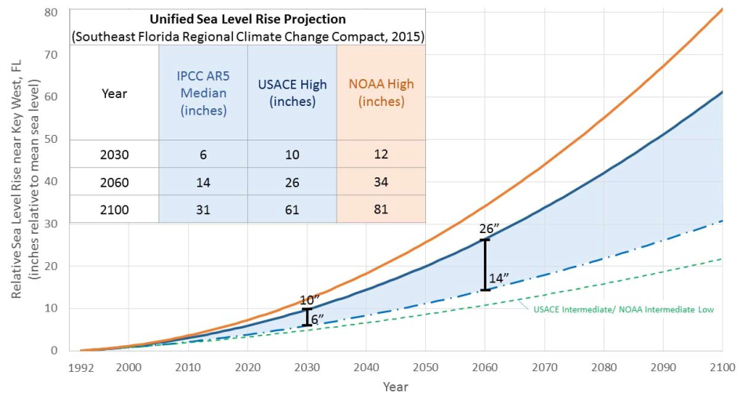
1. Climate Change, SLR, and Tides
2-2.5 feet SLR over next 50 years (2015 SE FL Regional Climate Compact)
Notes:
New SLR Projections released by SE FL Regional Climate Compact in Oct. 2015.

Slide 4
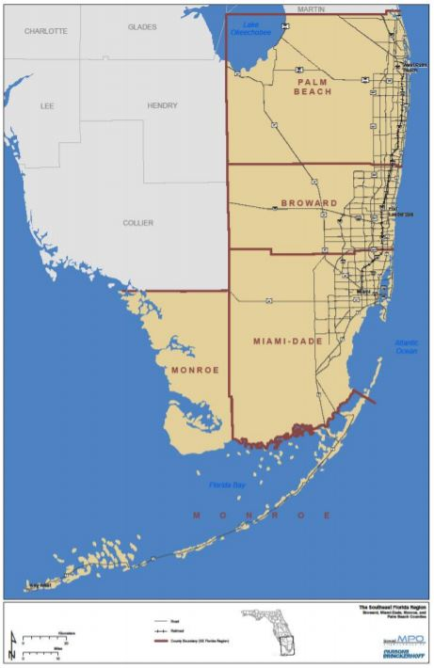
South Florida

Slide 5
Miami Beach
Notes:
New SLR Projections released by SE FL Regional Climate Compact in Oct. 2015.

Slide 6
Interrelated Problems

Slide 7
Integrated Model Overall Goal
Develop a planning tool (i.e., deterministic computer model) to assess potential engineering solutions in support of adaptation to climate change stressors, such as SLR, inland and coastal flooding

Slide 8
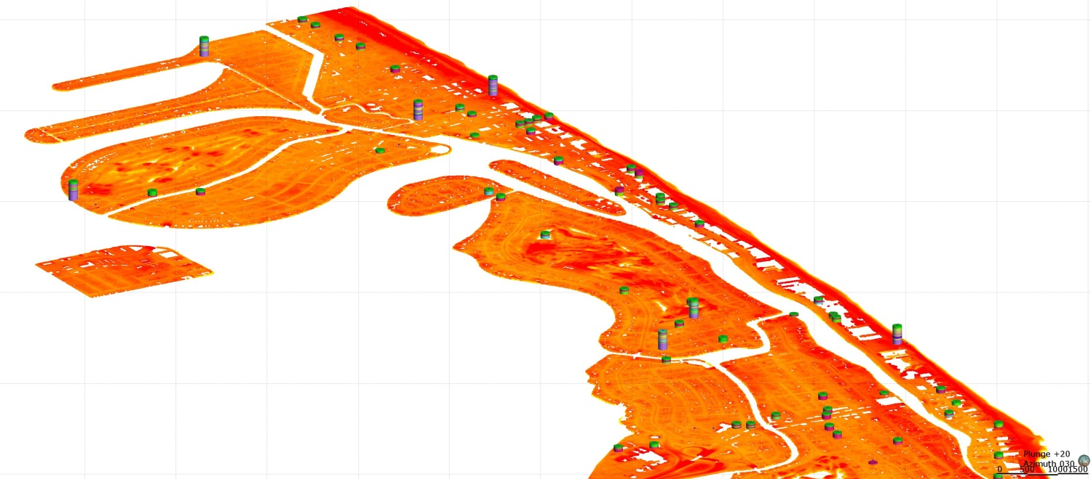
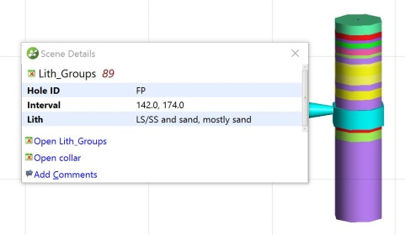
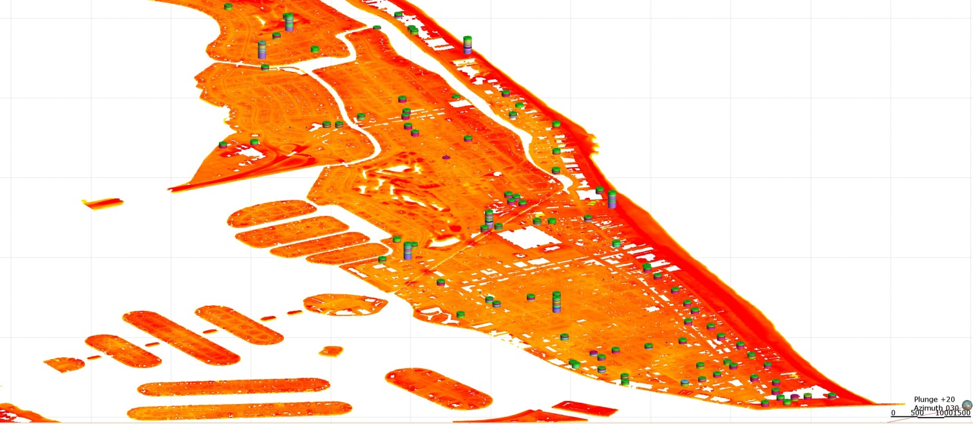
Integrated Model (Cont.)

Slide 9
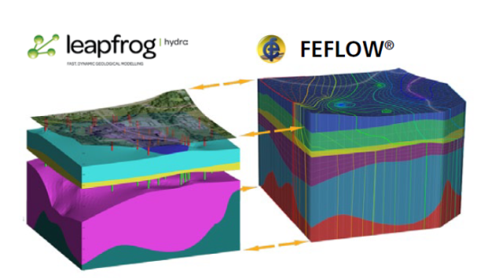
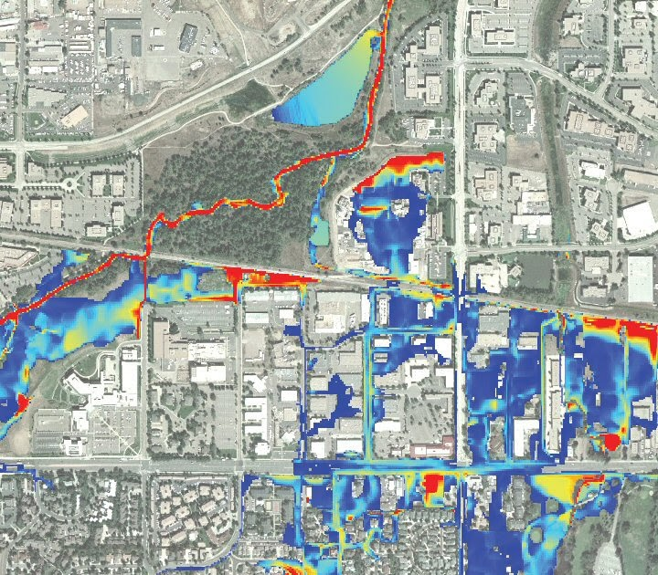
Integrated Model (Cont.)

Slide 10
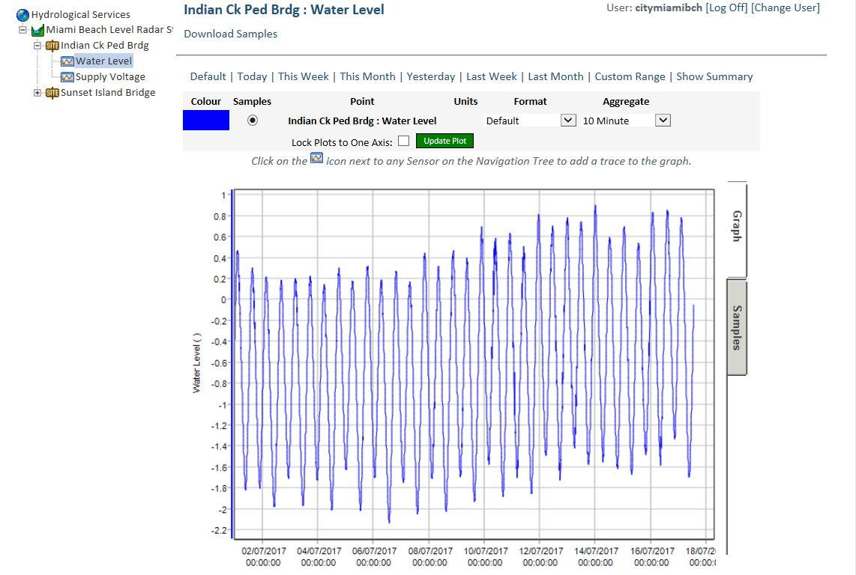
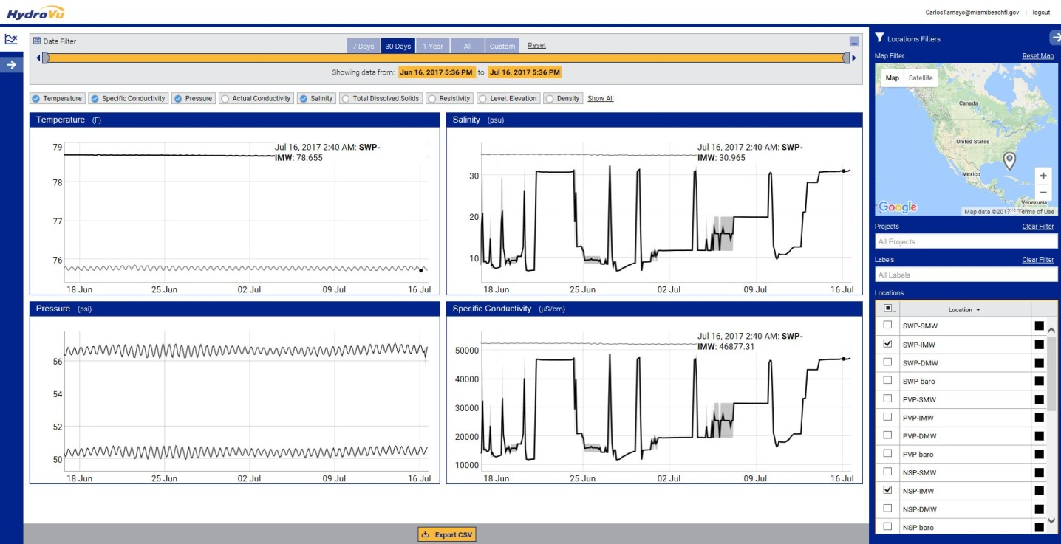
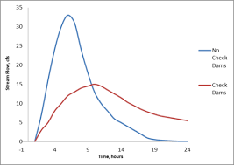
Integrated Model (Cont.)

Slide 11
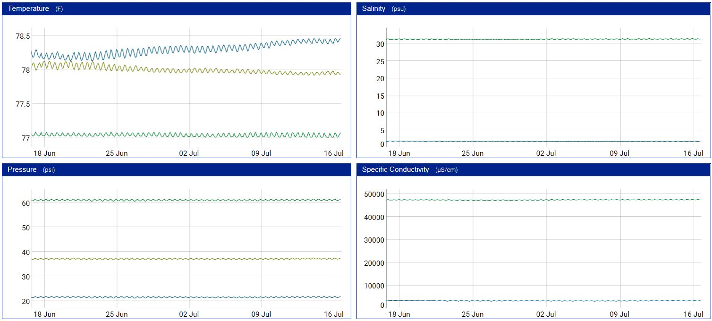
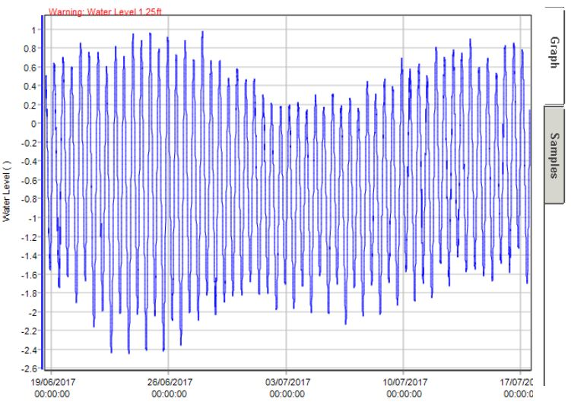
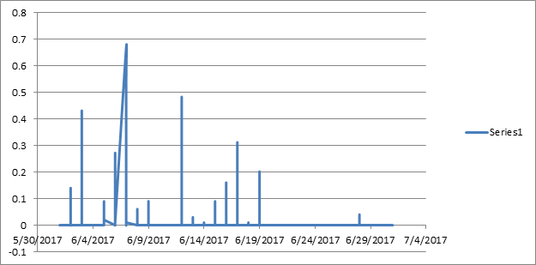
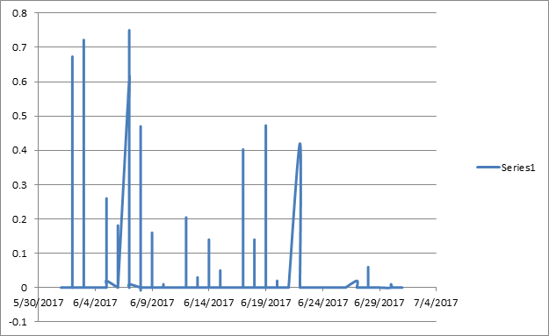
Integrated Model

Slide 12
Why do this?
Understand interaction of groundwater with tidal effects, rainfall, SLR, and storm surges
Understand hydrodynamic flood model with capabilities to add buildings, utilities, and hydraulic structures
Understand most influential factors affecting groundwater level fluctuations seasonally
Understand potential subsurface solutions for rising groundwater
Infiltration and groundwater levels
Soil storage capacity
Suitability of soils and lithology
Saltwater intrusion
Water quality

Slide 13
2. Machine Learning
Machine learning (ML) is a field of computer science that uses statistical techniques to give computer systems the ability to "learn" with data, without being explicitly programmed.
– Wikipedia
ML is an application of artificial intelligence (AI) that provides systems the ability to automatically learn and improve from experience without being explicitly programmed.
– Expert System

Slide 14
ML Workflow

Slide 15
Deep Learning
Deep learning (DL) is a subfield of ML. While both fall under the broad category of artificial intelligence, deep learning is what powers the most human-like artificial intelligence.
Deep learning (DL) structures algorithms in layers to create an “Artificial Neural Network (ANN)” that can learn and make intelligent decisions on its own.
- Zendesk

Slide 16
ML vs DL
Machine learning uses algorithms to parse data, learn from that data, and make informed decisions based on what it has learned.
Deep learning structures algorithms in layers to create an “artificial neural network” that can learn and make intelligent decisions on its own.

Slide 17
ML vs DL
- Edureka!

Slide 18
Why ML in Water Resources?
Solution for physically based models often require simplifying assumptions, because physiographic and geomorphic characteristics of most hydrologic systems are complicated, and have a large degree of uncertainty in the boundary conditions (Brutsaert 2005).
Practical application of physically based models can be limited by the lack of required data and the expense of data acquisition.
To overcome these limitations, researchers have used data-driven models based on ML approach as an alternative to physically based models (Khalil et al. 2005a; Solomatine and Shrestha 2009).

Slide 19
Why ML in Water Resources? (Cont.)
In the ML approach, a model is formulated to link the macro-description of the behavior of a system (output) to the behavior of the constituents of this system (inputs) (Guergachi and Boskovic 2008).
It is necessary to use methods that can model the nonstationary behaviors of environmental variables to optimize water systems (Milly et al. 2008).
Studies proved that machine learning models are more suitable than ARIMA (models in learning the nonlinear dynamics and nonstationary behavior of water resources systems with the final purpose of making accurate predictions for previously unseen values (Pulido Calvo et al. 2003 and Nourani et al. 2009).
Autoregressive Integrated Moving Average

Slide 20
Data-Driven Models in Water Resources
Task | Example of use
Anomaly detection | Identification of unusual data records (outliers, pattern change, data deviation) in weather or hydrological time series variables
Association rule learning | Discovery of relationships (dependency) between variables from different sources for a given phenomena, e.g. identification of critical weather variables, vegetation cover and urban development information to explain the change of lake water levels in time.
Clustering | Detection of groups and structures in the data that is alike, without using known structures or relationship for the data. For example, detection of areas with similar weather-hydrological patterns is the Western US.
Classification | Discovery of structures in the data to identify patterns among them. For example, identification of vegetation covertures in aerial or satellite image.
Regression | Identification of a mathematical expression or equation that models the data with the least error. E.g. prediction of water flow in rivers based on weather parameters and local geographic conditions
Summarization | Compact representation of data (visualization and report). E.g. Reduction of LandSat TM/ETM+ satellite bands from 7 to 3 using Principal Component Analysis.

Slide 21
Numerical Model Validation with ML GOAL
Evaluate machine learning algorithms as numerical model validation mechanisms with potentially higher efficiency and accuracy

Slide 22
Numerical Model Validation with ML
ML algorithms are divided into two main groups called: supervised- and unsupervised-learning.
For supervised-learning algorithms, there is a relationship of causality predefined by the user or modeler that is specified before providing the variables to the ML models. E.g.: most regression analyses are supervised-learning process.
For unsupervised-learning processes, the relationship of causality among the variables is unknown. Therefore there are not outputs, but only inputs for which the ML algorithm determines the relationship among them.

Slide 23
Artificial Neural Networks (ANN)

Slide 24
Example of use of Data-driven algorithms by type of learning
Data-Driven Algorithm | Supervised Learning | Unsupervised Learning
Artificial Neural Networks (ANN) | Classification Regression Association Rule Learning | Clustering
Support Vector Machines (SVM) | Classification Regression Association Rule Learning | Clustering Anomaly Detection
Random Forest (RF) | Classification Regression Association Rule Learning | Clustering
Relevance Vector Machines (RVM) | Classification Regression Association Rule Learning
Classification And Regression Trees (CART) | Classification Regression | Clustering
Linear Discriminant Analysis | Classification

Slide 25
Clustering
Clustering is a Machine Learning technique that involves the grouping of data points.
Given a set of data points, we can use a clustering algorithm to classify each data point into a specific group.
In theory, data points that are in the same group should have similar properties and/or features, while data points in different groups should have highly dissimilar properties and/or features.

Slide 26
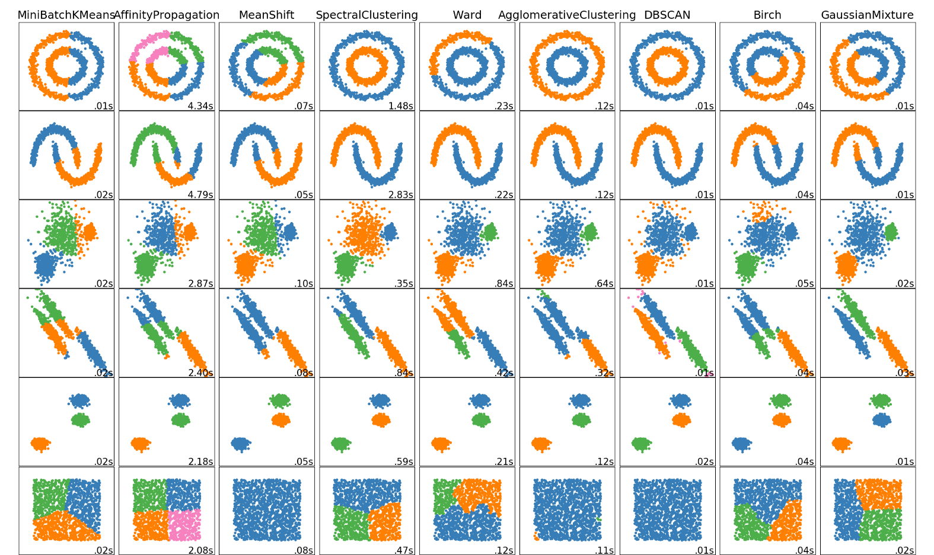
Clustering (Cont.)

Slide 27
3. Artificial Neural Networks (ANN)
ANN is one of the most known ML algorithm inspired by the architecture of real brains.
The fundamental component of this algorithm is the artificial neuron or nodes that connect and transmit the information altering it according to the data used to calibrate the neurons as its biological counterpart.

Slide 28
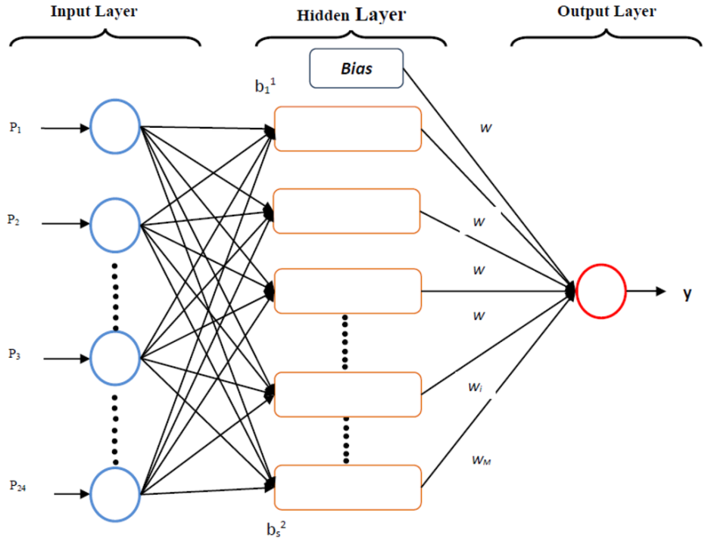
Bayesian Multi-Layer Perceptron
The Multi-Layer Perceptron (MLP) is reported to be one of the most widely used models of ANN (Nabney, 2001).
This ANN algorithm is attractive because of its ability to approximate any smooth function, considering that enough information about the under study phenomena is available to calibrate the MLP parameters (Bishop, 2007).

Slide 29
Bayesian Multi-Layer Perceptron (Cont.)
The BMLP architecture can be described as:
where:
y^{(n)}: the dependent variables vector (outputs of the model),
x_{i}: i^{th} component of the independent variables (inputs) vector x^{(n)} =[x₁,… x_{i}…x_{I}],
Wa_{hi}, Wb_{h}^{(n)}: matrix weights for the first and second layer respectively,
I: number of inputs in the MLP,
H: number of hidden neurons,
b^{(n)}, b_{h}: bias values for the first and second layer respectively.

Slide 30
Bayesian Multi-Layer Perceptron (Cont.)
Using a dataset D = [x^{(n)}, t^{(n)}] with n =1…N, where N is the number of training examples provided to the BMLP, the training of the parameters [Wa, Wb, b^{(n)}, b_{h}] is performed by minimizing the Overall Error Function E (Bishop, 2007):
Where:
E_{D}: data error function,
E_{W}: penalization term,
W= number of weights and biases in the neural network, and
α and β: Bayesian hyper-parameters.

Slide 31
Bayesian Multi-Layer Perceptron (Cont.)
In Bayesian terms, the goal is to estimate the probability of the weights and bias of the MLP model, given the dataset D:
Where, as explained by MacKay (1992),
p(W|t^{(n)}): the posterior probability of the weights,
p(t^{(n)}|W): the likelihood function,
p(W): the prior probability of the weights, and
p(t^{(n)}): the evidence for the dataset.

Slide 32
4. Validation Methodology Integrated Model Validation Parameters
Hydrodynamic Model:
Water level
Velocity data
Flow data
Groundwater Model:
Hydraulic conductivities
Water level
Specific storage
Specific yield

Slide 33
Validation Methodology
The mathematical form of a three-layer feed forward ANN is given as:
Where I_{i} is the input value to node i of the input layer and O_{k} is the output at node k of the output layer [Tiwari, Chatterjee 2010].
The strength of the connection between the input node i and the hidden node j is controlled by w_{ji}, and w_{kj} controls the strength of the connection between the hidden node j and the output node k. g₁ and g₂ are activation functions for the hidden layer and the output layer, respectively.

Slide 34
Validation Methodology
The Levenberg-Marquart (LM) algorithm will be utilized to train the ANN models (e.g., MATLAB) since it has been shown to be fast, accurate, and reliable [Adamowski, Karapataki 2010; Pramanik, Panda 2009].

Slide 35
Validation Methodology
The Levenberg-Marquardt algorithm adaptively varies the parameter updates between the gradient descent update and the Gauss-Newton update.
Gradient descent is a first-order iterative optimization algorithm for finding the minimum of a function.

Slide 36
Validation Methodology Model Performance Comparison
The performance of the models will be evaluated by analyzing the simulated results against the observed data and using three commonly used statistical tools:
Coefficient of determination (R² )
Root mean squared error (RMSE)
Modeling efficiency (EF)

Slide 37
Validation Methodology Model Performance Comparison (Cont.)
The root mean squared error represents the mean error between the simulated values and the observed values.
A small RMSE indicates less mean error between the simulated and observed results than a large RSME. However, RMSE can be very sensitive to extreme values with a single large error result capable of resulting in a high RMSE. If the data is strongly biased.
The modeling efficiency (EF) gives a more acceptable analysis than R² . A negative value for EF indicates very poor model performance.

Slide 38
General Conclusions
ML models or data-driven techniques are additional tools for use in water resources engineering that can complement, improve (or replace in some scenarios) physical-based models. The main advantage of these tools is their capability to capture complex nonlinear patterns and trends in the available data.
While physical-based models (e.g. rainfall-runoff) components allows for the analysis of their internal components, the imbedded components of data-driven tools do not allow for a direct interpretation yet (black-box algorithms).
ML models in most cases have a better performance than physical-based model; nevertheless they are limited by the quality and availability of information.
The use of ML models is recommended under the following scenarios: incomplete data to develop physical-based models, extensive records of the phenomena and related causes or inputs, data forecasting, and classification-type problems.

Slide 39
LET’S PLAY!

Slide 40
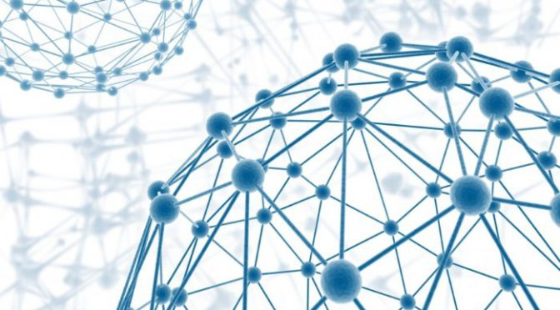
THANK YOU!
Carlos Tamayo, MS, LEEP AP, ENV SP
carlos.tamayo@aecom.com

Slide 44
Bayesian Multi-Layer Perceptron (Cont.)
For regression tasks, the Bayesian Inference method allows the prediction y^{(n)} and the variance of the predictions σ_{y}², once the distribution of W has been estimated by maximizing the likelihood for α and β (Bishop, 2007). σ_{y}² is the output variance vector σ_{y}² = (σ₁²,…, σ_{k}²,…, σ_{K}²). This can be expressed as:
The output variance has two sources:
The first source arises from the intrinsic noise in the output values, and
The second source comes from the posterior distribution of the BMLP weights. The output standard deviation vector σ_{y} can be interpreted as the error bar for confidence interval estimation (Bishop, 2007).

Slide 45
Bayesian Multi-Layer Perceptron
To overcome absence of uncertainty, Bishop (2007) implemented the Bayesian Inference framework (MacKay, 1992) for the calibration of the MLP parameters (BMLP).

